Slide 1
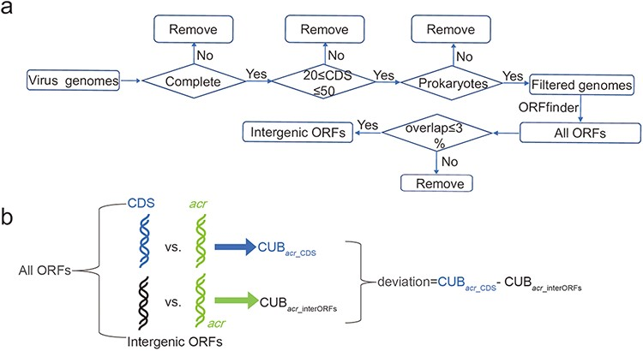
Figure 1. Construction of intergenic ORFs of virus genomes and comparison of CUB. (a) Pipeline of constructing ...
Notes:
Figure 1. Construction of intergenic ORFs of virus genomes and comparison of CUB. (a) Pipeline of constructing intergenic ORFs in virus genomes. The four diamonds represent our filtering conditions, where ‘complete’ means completely assembled level and ‘prokaryotes’ means virus hosts in bacteria or archaea; (b) A schematic workflow to illustrate the definition of deviation. ‘All ORFs’ means the ORFs annotated by ORFfinder. ‘CDS’ in light blue represents all CDS according to NCBI annotation. ‘intergenic ORFs’ in black represents ORFs that have overlapping ratio less 3% compared with CDS.
Unless provided in the caption above, the following copyright applies to the content of this slide: © The Author(s) 2022. Published by Oxford University Press.This is an Open Access article distributed under the terms of the Creative Commons Attribution License (https://creativecommons.org/licenses/by/4.0/), which permits unrestricted reuse, distribution, and reproduction in any medium, provided the original work is properly cited.

Slide 2
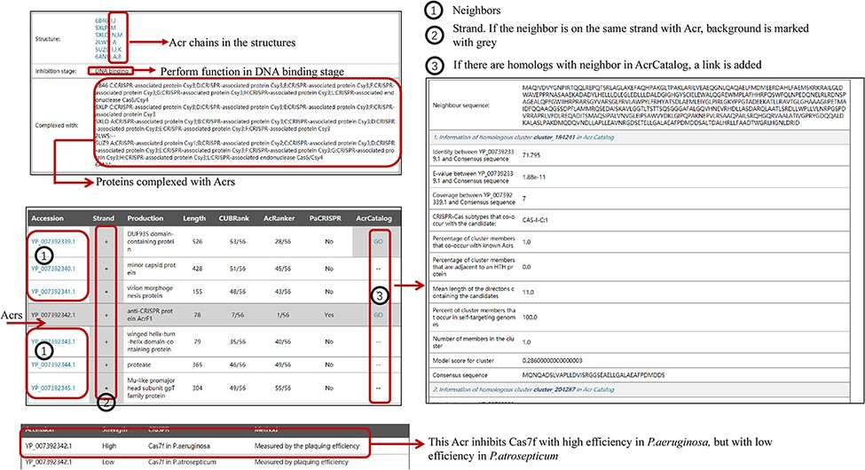
Figure 2. The organization of newly added entries. Data shown in the right panel come from AcrCatalog database ...
Notes:
Figure 2. The organization of newly added entries. Data shown in the right panel come from AcrCatalog database (http://acrcatalog.pythonanywhere.com/catalog/), which is constructed by Gussow et al. Gray background in ‘Strand’ column means Acr and its neighbors whose coding genes are in the same strand, which may form directon, a term proposed by Gussow et al. (10). Rows marked by ‘1’ represent accession numbers of Acr neighbors. In ‘AcrCatalog’ column, ‘GO’ labels with highlighted gray background means similarity sequence can be found in AcrCatalog database.
Unless provided in the caption above, the following copyright applies to the content of this slide: © The Author(s) 2022. Published by Oxford University Press.This is an Open Access article distributed under the terms of the Creative Commons Attribution License (https://creativecommons.org/licenses/by/4.0/), which permits unrestricted reuse, distribution, and reproduction in any medium, provided the original work is properly cited.

Slide 3
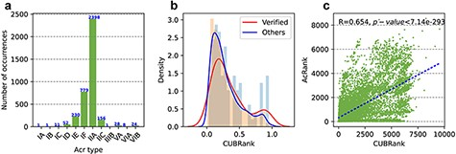
Figure 3. Statistics of Acrs and analysis of CUBRank. (a) Distribution of Acr types. The blue number on each bar ...
Notes:
Figure 3. Statistics of Acrs and analysis of CUBRank. (a) Distribution of Acr types. The blue number on each bar represents the Acr number of corresponding type; (b) Analysis of CUBRank. The red and blue curves on the histogram denote the fitted lines; (c) Correlation between CUBRank and AcRanker. We used AcRank to represent the rank predicted by AcRanker (y-axis), and the blue dotted line is fitted by CUBRank and AcRank.
Unless provided in the caption above, the following copyright applies to the content of this slide: © The Author(s) 2022. Published by Oxford University Press.This is an Open Access article distributed under the terms of the Creative Commons Attribution License (https://creativecommons.org/licenses/by/4.0/), which permits unrestricted reuse, distribution, and reproduction in any medium, provided the original work is properly cited.

Slide 4
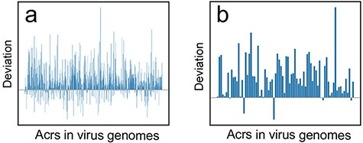
Figure 4. The deviation (${\bf{\it{CU}}}{{\bf{\it{B}}}_{{\bf{\it{acr}}}\_{\bf{\it{CDS}}}}} - ...
Notes:
Figure 4. The deviation (${\bf{\it{CU}}}{{\bf{\it{B}}}_{{\bf{\it{acr}}}\_{\bf{\it{CDS}}}}} - {\bf{\it{CU}}}{{\bf{\it{B}}}_{{\bf{\it{acr}}}\_{\bf{\it{interORFs}}}}}$) distribution at two different BLASTp cutoffs. (a) Deviation distribution calculated by comparison between CDS vs. acrs ($CU{B_{acr\_CDS}}$) and intergenic ORFs vs. acrs ($CU{B_{acr\_interORFs}}$) at a threshold of e-value ≤10e−3; (b) Deviation distribution calculated by comparison between $CU{B_{acr\_CDS}}$ and $CU{B_{acr\_interORFs}}$ at a threshold of e-value ≤10e−6.
Unless provided in the caption above, the following copyright applies to the content of this slide: © The Author(s) 2022. Published by Oxford University Press.This is an Open Access article distributed under the terms of the Creative Commons Attribution License (https://creativecommons.org/licenses/by/4.0/), which permits unrestricted reuse, distribution, and reproduction in any medium, provided the original work is properly cited.

Slide 5
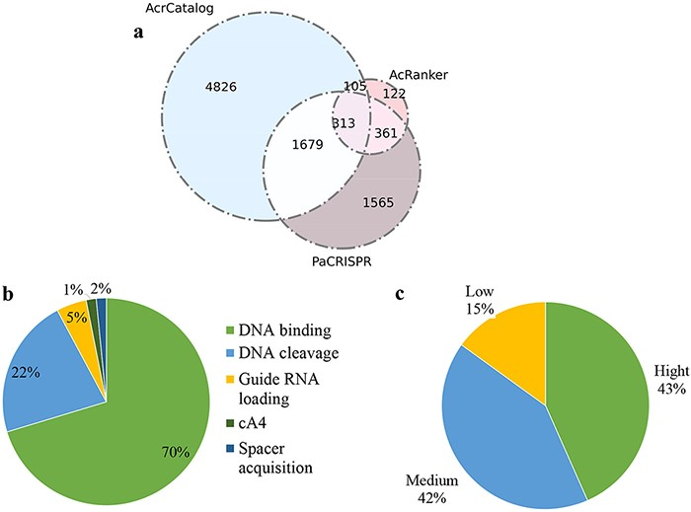
Figure 5. Data statistics in Anti-CRISPRdb v2.2. (a) Venn diagram of the predicted results from three algorithms ...
Notes:
Figure 5. Data statistics in Anti-CRISPRdb v2.2. (a) Venn diagram of the predicted results from three algorithms including PaCRISPR, AcRanker and AcrCatalog; (b) Distribution of inhibitory mechanisms; (c) Distribution of Acr inhibitory activity levels.
Unless provided in the caption above, the following copyright applies to the content of this slide: © The Author(s) 2022. Published by Oxford University Press.This is an Open Access article distributed under the terms of the Creative Commons Attribution License (https://creativecommons.org/licenses/by/4.0/), which permits unrestricted reuse, distribution, and reproduction in any medium, provided the original work is properly cited.

Slide 6
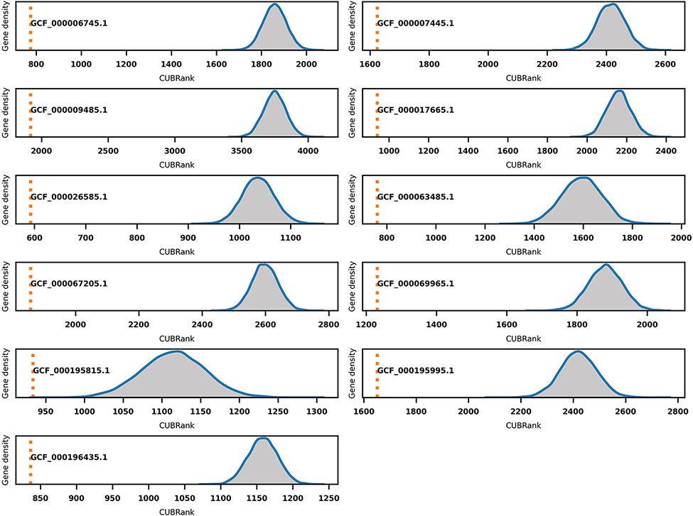
Figure 6. Monte Carlo simulation for CUBRank based on 11 species with well-studied GI annotations. The orange dotted ...
Notes:
Figure 6. Monte Carlo simulation for CUBRank based on 11 species with well-studied GI annotations. The orange dotted line represents the average CUBRank within GIs. The blue curve with gray background is the kernel density estimation of CUBRank for genes in non-GI regions in the total 10 000 Monte Carlo simulations. The annotation near orange dotted line indicates the Genbank accession number for the genome assembly (GCF_000196435.1: Bartonella tribocorum CIP 105 476, GCF_000067205.1: Bordetella petrii DSM 12 804, GCF_000009485.1: Burkholderia cenocepacia J2315, GCF_000063485.1: Clavibacter michiganensis NCPPB 382, GCF_000195815.1: Corynebacterium diphtheriae NCTC 13 129, GCF_000017665.1: Cronobacter sakazakii ATCC BAA-894, GCF_000007445.1: Escherichia coli CFT073, GCF_000069965.1: Proteus mirabilis HI4320, GCF_000195995.1: Salmonella enterica Typhi CT18, GCF_000026585.1: Streptococcus equi 4047, GCF_000006745.1: Vibrio cholerae O1 biovar eltor str. N16961).
Unless provided in the caption above, the following copyright applies to the content of this slide: © The Author(s) 2022. Published by Oxford University Press.This is an Open Access article distributed under the terms of the Creative Commons Attribution License (https://creativecommons.org/licenses/by/4.0/), which permits unrestricted reuse, distribution, and reproduction in any medium, provided the original work is properly cited.

