Slide 1
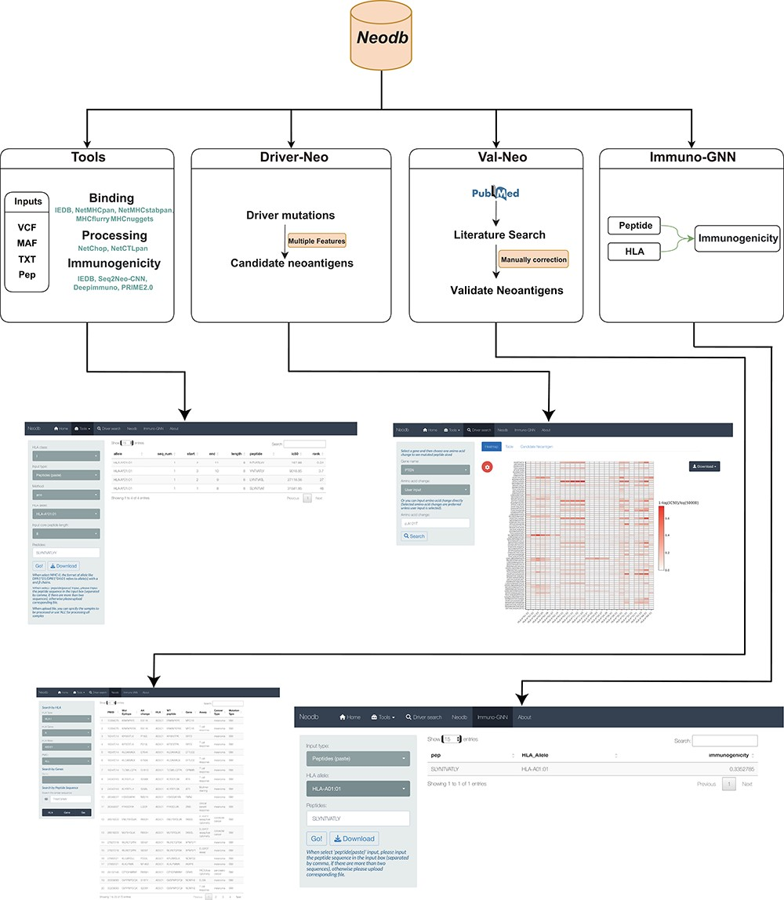
Figure 1. A comprehensive neoantigen database and discovery platform. An overview of the Neodb includes four modules: ...
Notes:
Figure 1. A comprehensive neoantigen database and discovery platform. An overview of the Neodb includes four modules: (i) the Tools module, which integrates the commonly used tools in the neoantigen prediction process; (ii) the Driver-Neo module, which includes the list of candidate neoantigens for common driver mutations predicted by combining multiple features; (iii) the Val-Neo module, which contains manually collected experimentally validated neoantigen peptide data; (iv) the Immuno-GNN model, which is a novel immunogenicity prediction tool.
Unless provided in the caption above, the following copyright applies to the content of this slide: © The Author(s) 2023. Published by Oxford University Press.This is an Open Access article distributed under the terms of the Creative Commons Attribution License (https://creativecommons.org/licenses/by/4.0/), which permits unrestricted reuse, distribution, and reproduction in any medium, provided the original work is properly cited.

