Slide 1
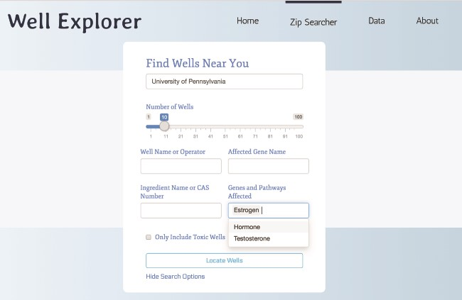
Figure 6 Searching WellExplorer for hydraulic fracturing wells using ingredients that target estrogen pathways. Note ...
Notes:
Figure 6 Searching WellExplorer for hydraulic fracturing wells using ingredients that target estrogen pathways. Note that ‘estrogen’ is selected in the ‘genes and pathways affected’ option. Clicking on ‘locate wells’ will retrieve all wells using ingredients that target estrogen pathways ranked from the closest in distance (in miles).
Unless provided in the caption above, the following copyright applies to the content of this slide: © The Author(s) 2020. Published by Oxford University Press.This is an Open Access article distributed under the terms of the Creative Commons Attribution License (http://creativecommons.org/licenses/by/4.0/), which permits unrestricted reuse, distribution, and reproduction in any medium, provided the original work is properly cited.

