Slide 1
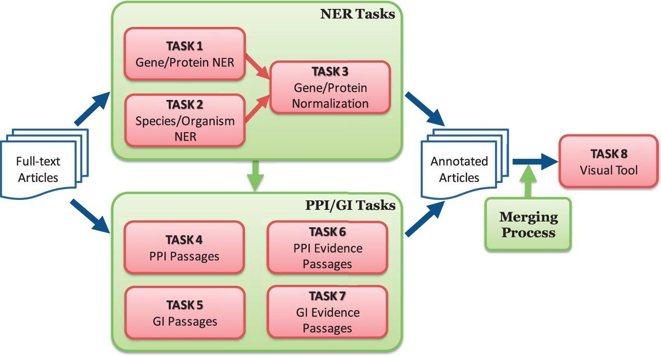
Figure 1. Overview of BioCreative V BioC track. The track consists of named entity recognition (NER), protein–protein ...
Notes:
Figure 1. Overview of BioCreative V BioC track. The track consists of named entity recognition (NER), protein–protein interaction (PPI), genetic interaction (GI) and visual tool tasks. The NER tasks include gene/protein NER, species/organism NER and gene/protein normalization. The PPI/GI tasks include finding passages with PPI/GI information (PPI/GI Passages), passages with PPI experimental methods (PPI Evidence Passages) and passages with GI types (GI Evidence Passages).
Unless provided in the caption above, the following copyright applies to the content of this slide: Published by Oxford University Press 2016. This work is written by US Government employees and is in the public domain in the US.

Slide 2
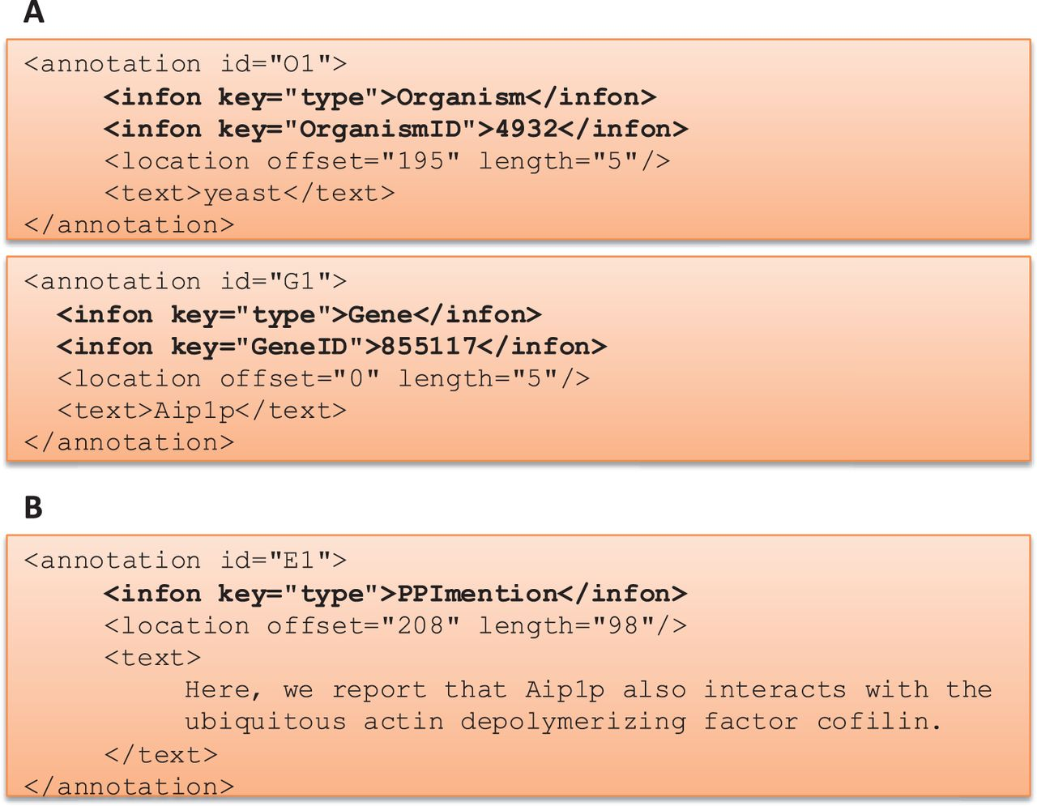
Figure 2. BioC Format for BioCreative V BioC track. (A) BioC format to share annotations for named entity recognition ...
Notes:
Figure 2. BioC Format for BioCreative V BioC track. (A) BioC format to share annotations for named entity recognition tasks: gene/protein and organism mentions and normalization. OrganismID and GeneID are NCBI Taxonomy ID and Entrez Gene ID, respectively. (B) BioC format to share annotations for the molecular interaction tasks: protein–protein interaction mention and evidence (PPImention, PPIevidence) and genetic interaction mention and evidence (GImention, GIevidence).
Unless provided in the caption above, the following copyright applies to the content of this slide: Published by Oxford University Press 2016. This work is written by US Government employees and is in the public domain in the US.

Slide 3
Figure 3. Annotation Interface for full-text PMC articles. This is a screenshot of our annotation interface that ...
Notes:
Figure 3. Annotation Interface for full-text PMC articles. This is a screenshot of our annotation interface that curators used to create a gold-standard annotation set. For annotations, a curator selects relevant text and chooses an annotation type button on the screen. Gene ID and Tax ID options are for assigning IDs to gene and organism names.
Unless provided in the caption above, the following copyright applies to the content of this slide: Published by Oxford University Press 2016. This work is written by US Government employees and is in the public domain in the US.

Slide 4
Figure 4. Score assigning process for each submission from PPI/GI tasks.
Notes:
Figure 4. Score assigning process for each submission from PPI/GI tasks.
Unless provided in the caption above, the following copyright applies to the content of this slide: Published by Oxford University Press 2016. This work is written by US Government employees and is in the public domain in the US.

Slide 5
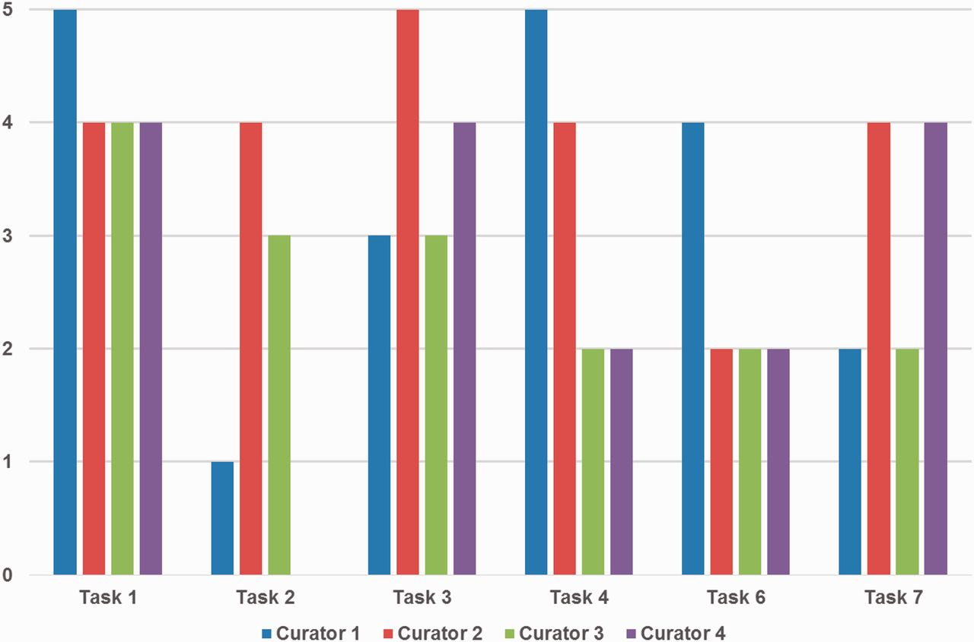
Figure 5. Curators’ ratings for prediction performance for each task. Tasks 1, 2 and 3 are gene/protein named entity ...
Notes:
Figure 5. Curators’ ratings for prediction performance for each task. Tasks 1, 2 and 3 are gene/protein named entity recognition (NER), species/organism NER and gene/protein name normalization, respectively. Tasks 4, 6 and 7 are passages with protein–protein interactions (PPIs), PPI experimental methods and genetic interaction types, respectively. Tasks 1 and 3 received positive responses overall, however ratings were mixed for other tasks depending on curators’ preferences. Curator 4 did not assign a score for Task 2.
Unless provided in the caption above, the following copyright applies to the content of this slide: Published by Oxford University Press 2016. This work is written by US Government employees and is in the public domain in the US.

