Slide 1
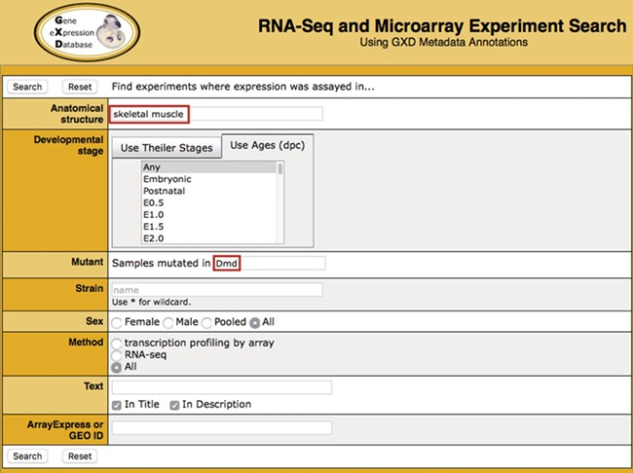
Figure 1 Search. Illustrated is a search for experiments studying gene expression in the skeletal muscle of dystrophin ...
Notes:
Figure 1 Search. Illustrated is a search for experiments studying gene expression in the skeletal muscle of dystrophin (Dmd) mutants. It takes advantage of two of the curated sample attribute fields: anatomical structure (‘skeletal muscle’) and mutant gene (‘Dmd’). Additional curated fields available for searching are developmental stage, strain and sex. Users can also do free text searching of experiment titles and descriptions, as well as search by ArrayExpress or GEO id.
Unless provided in the caption above, the following copyright applies to the content of this slide: © The Author(s) 2020. Published by Oxford University Press.This is an Open Access article distributed under the terms of the Creative Commons Attribution License (http://creativecommons.org/licenses/by/4.0/), which permits unrestricted reuse, distribution, and reproduction in any medium, provided the original work is properly cited.

Slide 2
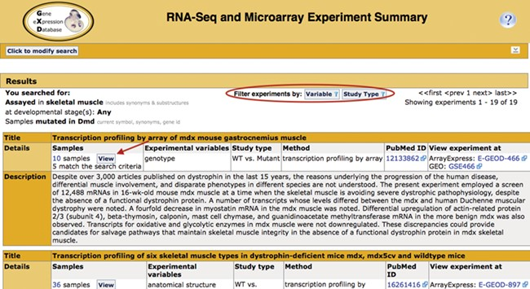
Figure 2 Search return. Pictured is the return for the search in Figure 1. Filters that allow for further refinement ...
Notes:
Figure 2 Search return. Pictured is the return for the search in Figure 1. Filters that allow for further refinement of the return are circled. The red arrow indicates the button to access the pop-up sample table (Figure 3; discussed below). The display also includes the annotated experimental variable(s) and study type, as well as link-outs to the data at ArrayExpress and GEO and the publication at PubMed.
Unless provided in the caption above, the following copyright applies to the content of this slide: © The Author(s) 2020. Published by Oxford University Press.This is an Open Access article distributed under the terms of the Creative Commons Attribution License (http://creativecommons.org/licenses/by/4.0/), which permits unrestricted reuse, distribution, and reproduction in any medium, provided the original work is properly cited.

Slide 3
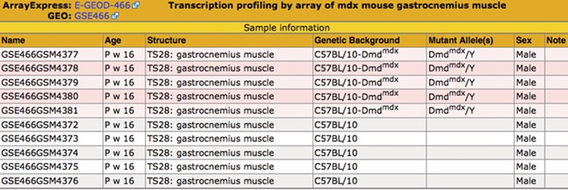
Figure 3 Sample table. The sample information is displayed in a pop-up table that can be accessed by using the View ...
Notes:
Figure 3 Sample table. The sample information is displayed in a pop-up table that can be accessed by using the View button (Figure 2). Samples that match the search criteria (Figure 1) are highlighted in pink. The matching samples are annotated to tissues that are ontological children of the search term skeletal muscle and carry mutations of the dystrophin (Dmd) gene.
Unless provided in the caption above, the following copyright applies to the content of this slide: © The Author(s) 2020. Published by Oxford University Press.This is an Open Access article distributed under the terms of the Creative Commons Attribution License (http://creativecommons.org/licenses/by/4.0/), which permits unrestricted reuse, distribution, and reproduction in any medium, provided the original work is properly cited.

