Slide 1
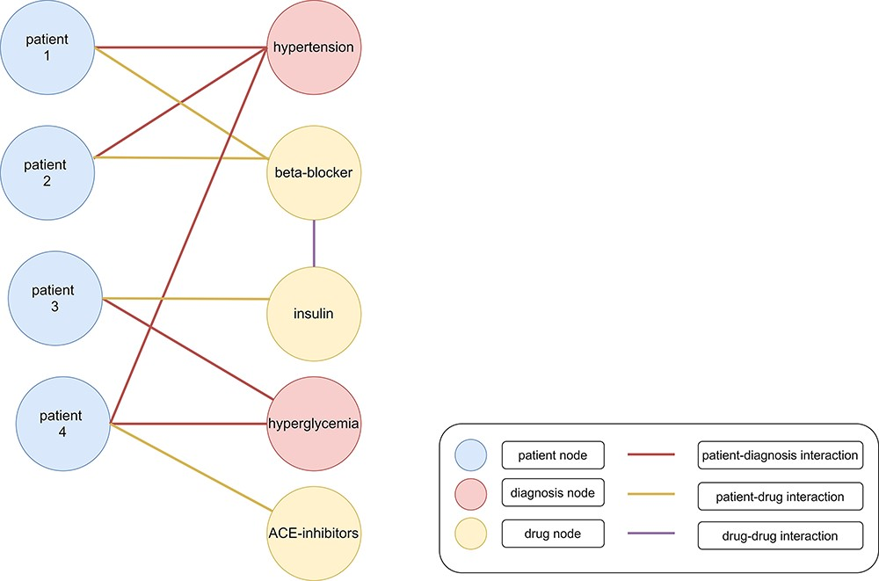
Figure 1. Heterogenous graph with clinical data. Patients (blue nodes) are connected with diagnoses (red nodes) with a ...
Notes:
Figure 1. Heterogenous graph with clinical data. Patients (blue nodes) are connected with diagnoses (red nodes) with a red edge and drugs (yellow nodes) with a yellow edge. Interactions between different drugs are represented as a purple edge. Patients 1 and 2 were diagnosed with hypertension. Therefore, beta-blockers were administered as treatment. Patient 3 was diagnosed with hyperglycemia and cured with insulin. However, patient 4 was diagnosed with hypertension and hyperglycemia (199). The administration of beta-blockers and insulin would lead to negative side effects because of an increased risk for hypoglycemia. Therefore, angiotensin-converting enzyme (ACE) inhibitors might be administered as treatment (200).
Unless provided in the caption above, the following copyright applies to the content of this slide: © The Author(s) 2024. Published by Oxford University Press.This is an Open Access article distributed under the terms of the Creative Commons Attribution License (https://creativecommons.org/licenses/by/4.0/), which permits unrestricted reuse, distribution, and reproduction in any medium, provided the original work is properly cited.

