Slide 1
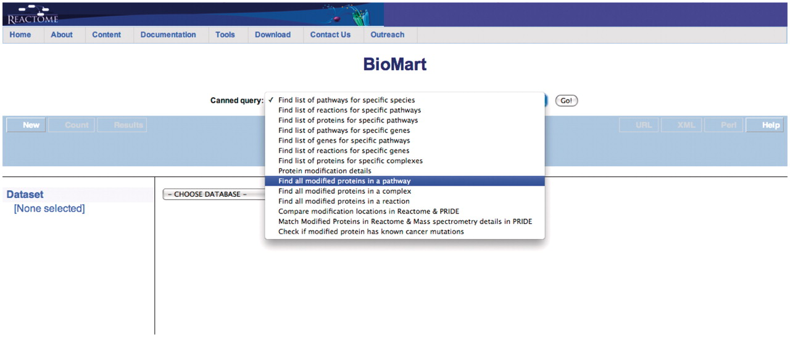
Figure 1. Select the appropriate canned query, in this case ‘Find all modified proteins in a pathway’.
Notes:
Figure 1. Select the appropriate canned query, in this case ‘Find all modified proteins in a pathway’.
Unless provided in the caption above, the following copyright applies to the content of this slide: © The Author(s) 2011. Published by Oxford University Press.This is Open Access article distributed under the terms of the Creative Commons Attribution Non-Commercial License (http://creativecommons.org/licenses/by-nc/2.5), which permits unrestricted non-commercial use, distribution, and reproduction in any medium, provided the original work is properly cited.

Slide 2
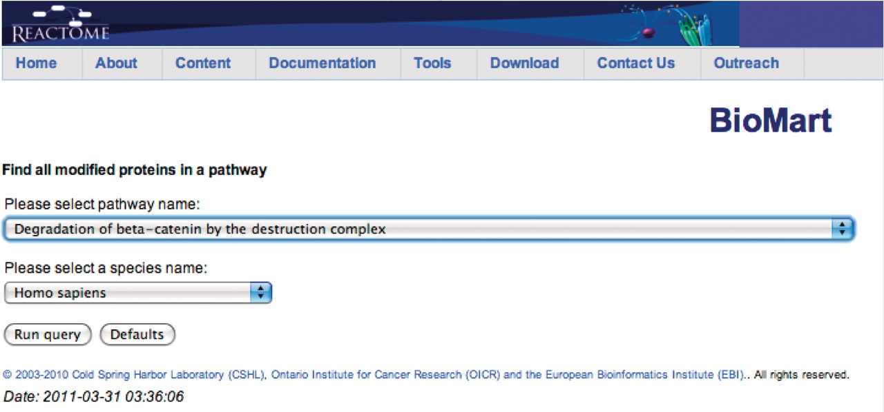
Figure 2. Canned query data input page. The user selects the pathway and species names from the respective drop down ...
Notes:
Figure 2. Canned query data input page. The user selects the pathway and species names from the respective drop down lists and then presses the ‘Run query’ button.
Unless provided in the caption above, the following copyright applies to the content of this slide: © The Author(s) 2011. Published by Oxford University Press.This is Open Access article distributed under the terms of the Creative Commons Attribution Non-Commercial License (http://creativecommons.org/licenses/by-nc/2.5), which permits unrestricted non-commercial use, distribution, and reproduction in any medium, provided the original work is properly cited.

Slide 3
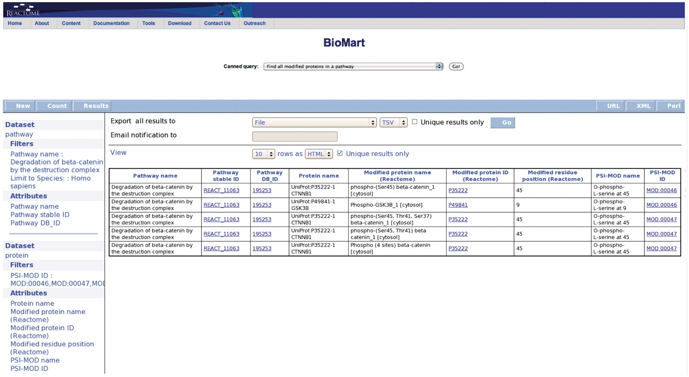
Figure 3. Results of finding all modified proteins in a pathway. The user is then able to inspect the retrieved ...
Notes:
Figure 3. Results of finding all modified proteins in a pathway. The user is then able to inspect the retrieved proteins for the kinds of modification present on each protein (PSI-MOD), the modified residue in the protein, the cell compartment of the modified protein and the position of the modified residue on the protein if known (Modified Residue coordinate).
Unless provided in the caption above, the following copyright applies to the content of this slide: © The Author(s) 2011. Published by Oxford University Press.This is Open Access article distributed under the terms of the Creative Commons Attribution Non-Commercial License (http://creativecommons.org/licenses/by-nc/2.5), which permits unrestricted non-commercial use, distribution, and reproduction in any medium, provided the original work is properly cited.

Slide 4
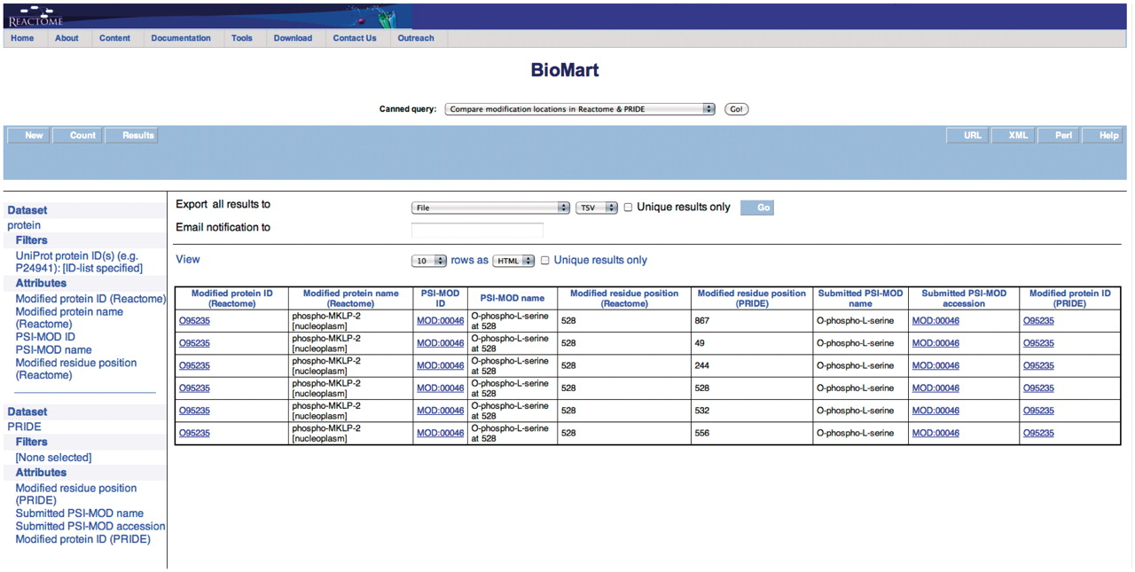
Figure 4. Results of comparing modification locations between Reactome and PRIDE. The modified protein's UniProt ID, ...
Notes:
Figure 4. Results of comparing modification locations between Reactome and PRIDE. The modified protein's UniProt ID, its name, cellular compartment, the modified residue and its residue coordinate from Reactome are reported. PRIDE also reports corresponding details of the protein present in their database i.e. location of modification on protein, PSI-MOD name, ID and the UniProt Accession.
Unless provided in the caption above, the following copyright applies to the content of this slide: © The Author(s) 2011. Published by Oxford University Press.This is Open Access article distributed under the terms of the Creative Commons Attribution Non-Commercial License (http://creativecommons.org/licenses/by-nc/2.5), which permits unrestricted non-commercial use, distribution, and reproduction in any medium, provided the original work is properly cited.

Slide 5
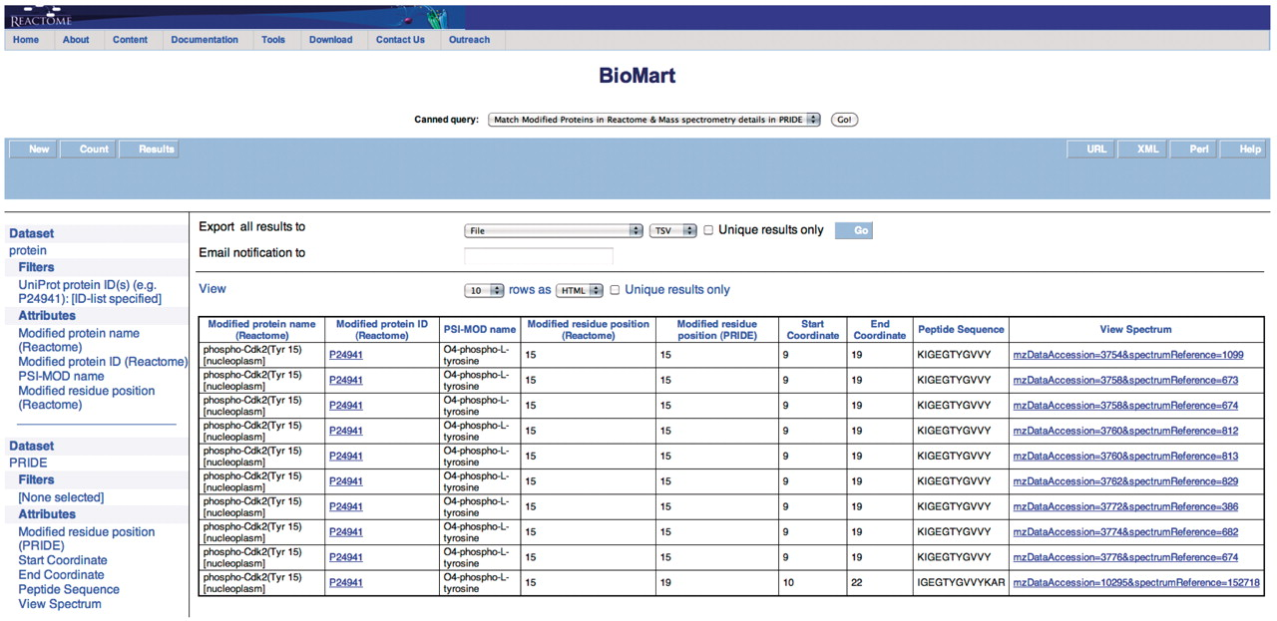
Figure 5. Results of matching modified proteins in Reactome with the MS details available in PRIDE. The peptide ...
Notes:
Figure 5. Results of matching modified proteins in Reactome with the MS details available in PRIDE. The peptide sequence and the option to view the spectrum (Supplementary Figure S8) are returned in addition to the columns returned in Figure 4.
Unless provided in the caption above, the following copyright applies to the content of this slide: © The Author(s) 2011. Published by Oxford University Press.This is Open Access article distributed under the terms of the Creative Commons Attribution Non-Commercial License (http://creativecommons.org/licenses/by-nc/2.5), which permits unrestricted non-commercial use, distribution, and reproduction in any medium, provided the original work is properly cited.

Slide 6
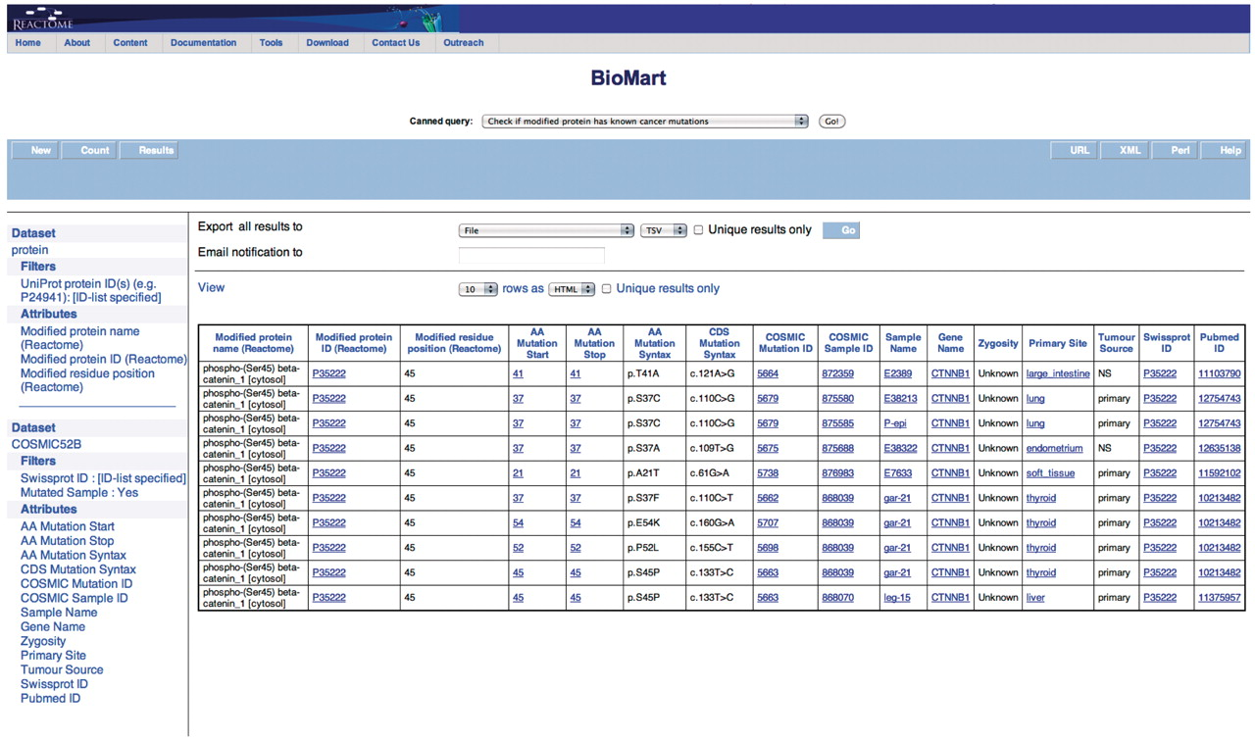
Figure 6. Results of checking if the modified protein has known cancer mutations. The modified protein's UniProt ID, ...
Notes:
Figure 6. Results of checking if the modified protein has known cancer mutations. The modified protein's UniProt ID, the COSMIC Sample ID and name, the gene name, the nucleotide and residue changes caused by the mutation, the zygosity, primary histology, tumor source and the reference paper for the study are returned. By further choosing more attributes finer details can be retrieved. The query spans the ‘Protein’ and ‘COSMIC’ data sets.
Unless provided in the caption above, the following copyright applies to the content of this slide: © The Author(s) 2011. Published by Oxford University Press.This is Open Access article distributed under the terms of the Creative Commons Attribution Non-Commercial License (http://creativecommons.org/licenses/by-nc/2.5), which permits unrestricted non-commercial use, distribution, and reproduction in any medium, provided the original work is properly cited.

Slide 7
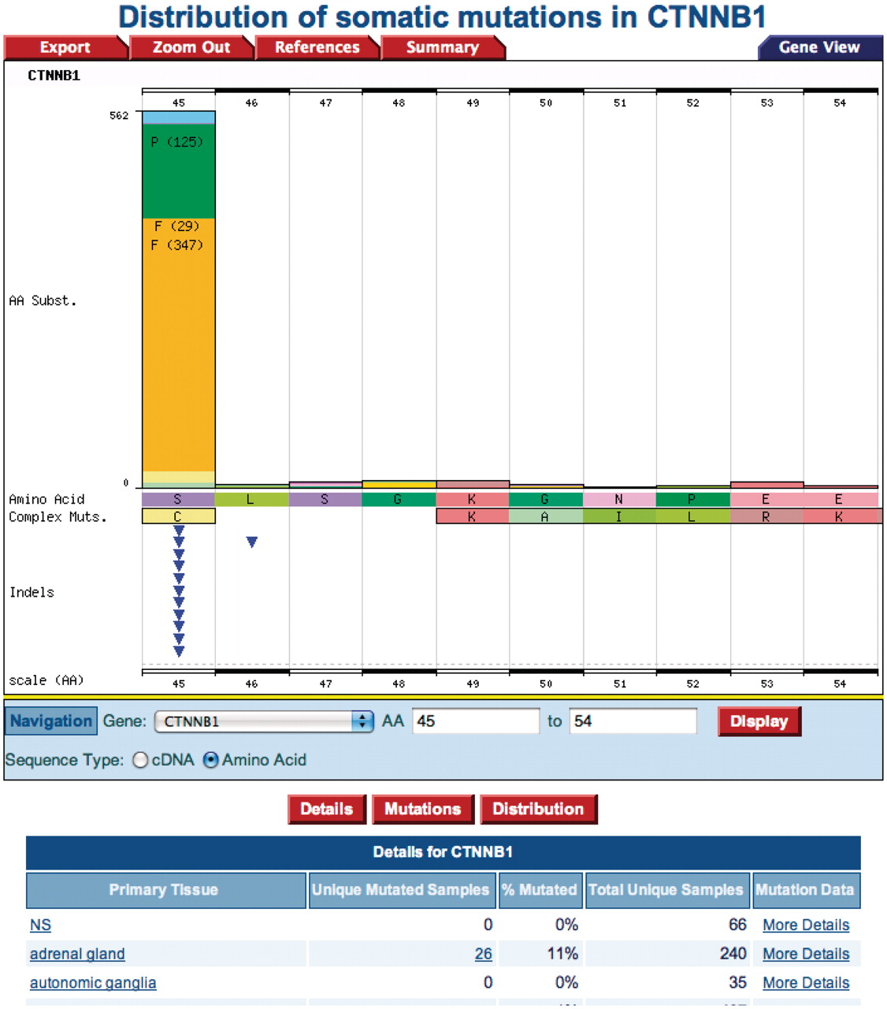
Figure 7. A COSMIC Gene View histogram from clicking the ‘AA mutation start or AA mutation stop’ position. The amino ...
Notes:
Figure 7. A COSMIC Gene View histogram from clicking the ‘AA mutation start or AA mutation stop’ position. The amino acid serine at position 45 is mutated to a phenylalanine.
Unless provided in the caption above, the following copyright applies to the content of this slide: © The Author(s) 2011. Published by Oxford University Press.This is Open Access article distributed under the terms of the Creative Commons Attribution Non-Commercial License (http://creativecommons.org/licenses/by-nc/2.5), which permits unrestricted non-commercial use, distribution, and reproduction in any medium, provided the original work is properly cited.

