Slide 1
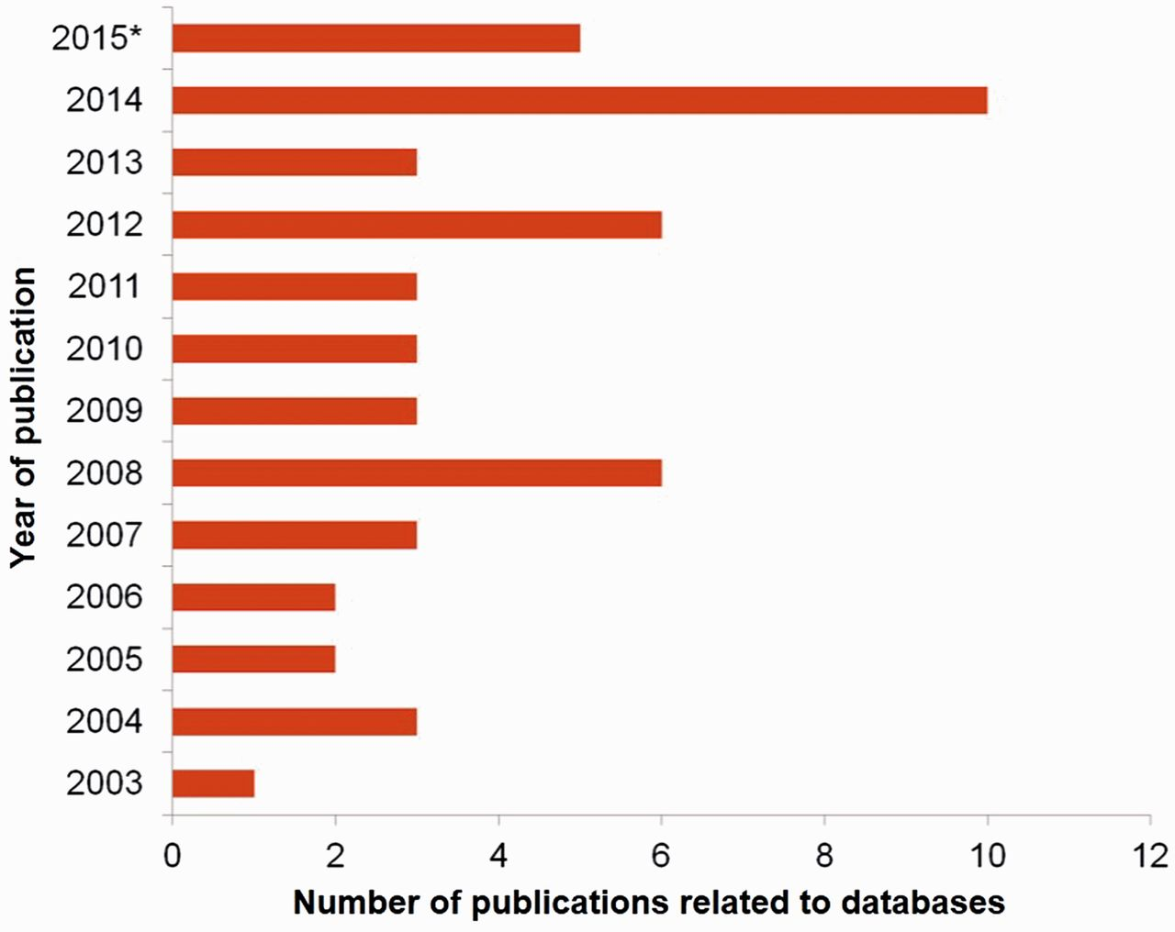
Figure 1. Number of publications on seri-related databases from the year 2003 to 2015* where (*) represents ...
Notes:
Figure 1. Number of publications on seri-related databases from the year 2003 to 2015* where (*) represents 2015-continued year.
Unless provided in the caption above, the following copyright applies to the content of this slide: © The Author(s) 2016. Published by Oxford University Press.This is an Open Access article distributed under the terms of the Creative Commons Attribution License (http://creativecommons.org/licenses/by/4.0/), which permits unrestricted reuse, distribution, and reproduction in any medium, provided the original work is properly cited.

Slide 2
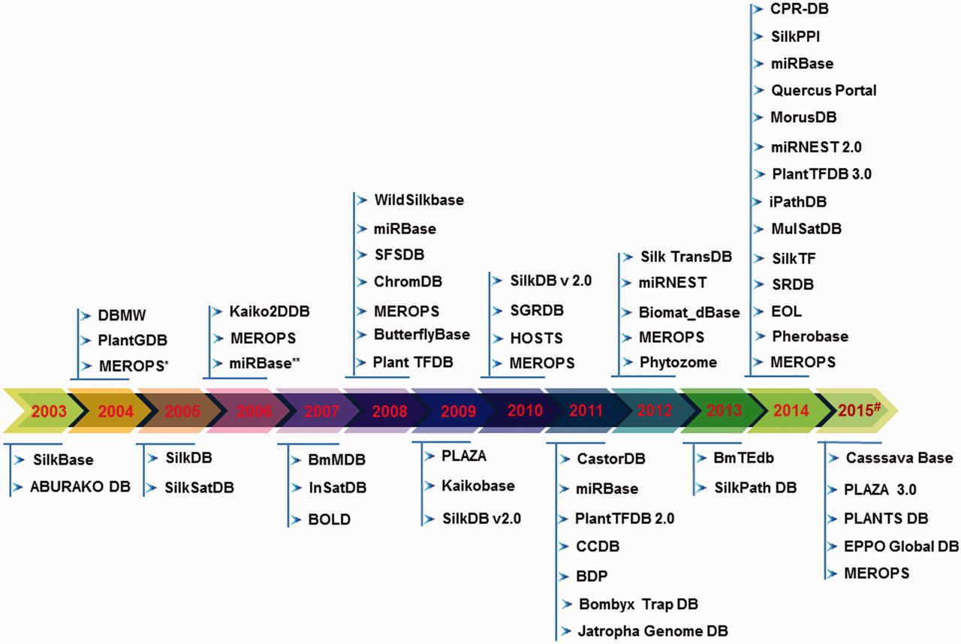
Figure 2. Timeline of the existing seri-databases from the year 2003 to 2015# generated using respective publication in ...
Notes:
Figure 2. Timeline of the existing seri-databases from the year 2003 to 2015# generated using respective publication in the literature and database creation year from websites, where (#) represents 2015-continued year; (*) indicates database first published in 1999 and its updated versions considered from period 2003–2015; (**) indicates the same database with updated information.
Unless provided in the caption above, the following copyright applies to the content of this slide: © The Author(s) 2016. Published by Oxford University Press.This is an Open Access article distributed under the terms of the Creative Commons Attribution License (http://creativecommons.org/licenses/by/4.0/), which permits unrestricted reuse, distribution, and reproduction in any medium, provided the original work is properly cited.

Slide 3
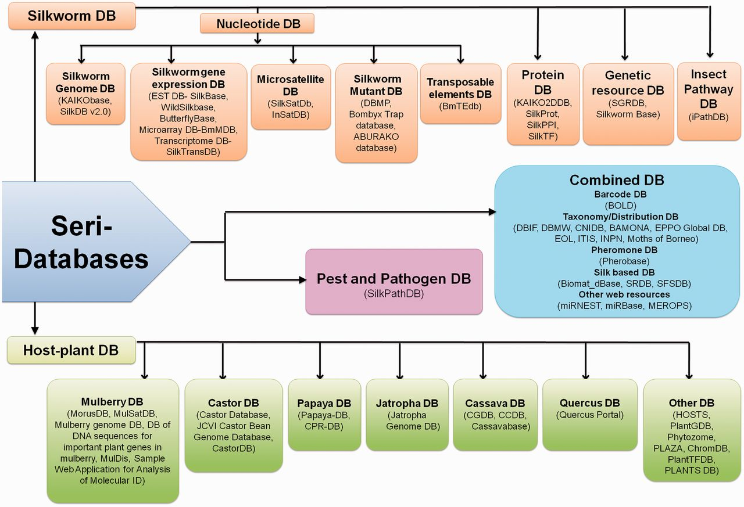
Figure 3. Schematic representation of Seri-databases classified into four categories- Silkworm Databases-20 No.s, Host ...
Notes:
Figure 3. Schematic representation of Seri-databases classified into four categories- Silkworm Databases-20 No.s, Host Plant Databases-23 No.s, Pest and Pathogen Databases- 01 No., Combined Databases-17 No.s.(Abbreviations- SilkDB: Silkworm Knowledgebase, EST DB: Expressed Sequence Tag Database, BmMDB: Bombyx mori Microarray Database, SilkTransDB: Silkworm Transcriptome Database, SilkSatDb: Silkworm Microsatellite Database, DBMP: Database of Bombyx mutant photographs, BmTEdb: Transposable elements database for B. mori, SilkProt: Annotated protein database of silkworm, SilkPPI: Silkworm Protein–Protein Interaction database, SilkTF: Silkworm Transcription Factor Database, SGRDB: Silkworm Gene Resources database, iPathDB: Insect Pathway Database, MorusDB: Morus Genome Database, MulSatDB: Mulberry Microsatellite Database, CastorDB: A comprehensive knowledgebase database for R. communis, Papaya-DB: Papaya Genomic Resources Online, CPR-DB: Papaya Repeat Database, CGDB: Cassava Genome Database, CCDB: Chinese Cassava Genome Database, HOSTS: a Database of the World's Lepidopteran Host plants, PlantGDB: Resources for Comparative Plant Genomics, ChromDB: The Chromatin Database, PlantTFDB: Plant Transcription Factor Database, SilkPathDB: Silkworm Pathogen Database, BOLD: Barcode of Life Data System, DBIF: Database of Insects and their Food Plants, DBMW: Database of Butterflies and Moth of the World, CNIDB: Common Names of Insects Databases, BAMONA: Butterflies and moths of North America, EOL: Encyclopedia of Life, ITIS: Integrated taxonomic information system, SRDB: Spatio-temporal database of Silk Road, SFSDB: Silk Fabric Specification Database, miRNEST: An integrative microRNA resource, miRBase: The microRNA database, MEROPS: the peptidase database).
Unless provided in the caption above, the following copyright applies to the content of this slide: © The Author(s) 2016. Published by Oxford University Press.This is an Open Access article distributed under the terms of the Creative Commons Attribution License (http://creativecommons.org/licenses/by/4.0/), which permits unrestricted reuse, distribution, and reproduction in any medium, provided the original work is properly cited.

Slide 4
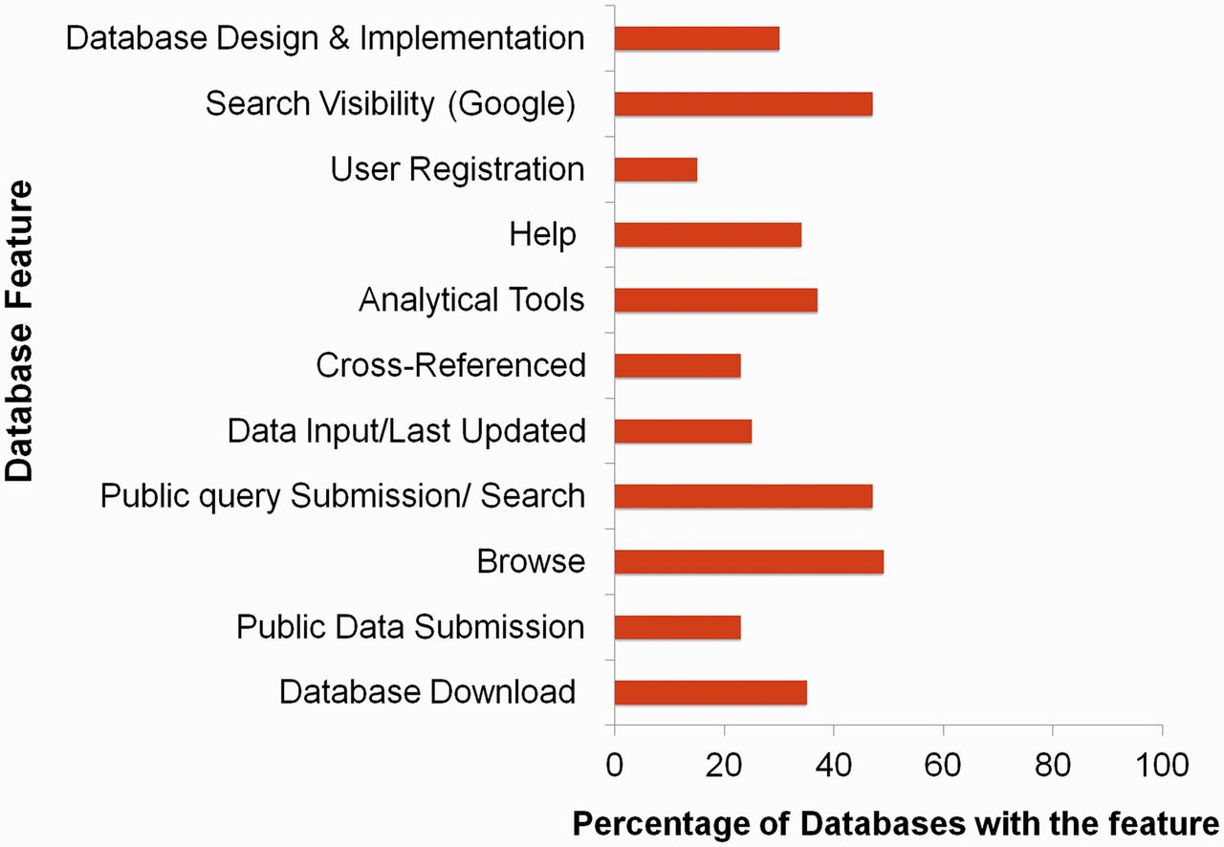
Figure 4. Percentage distribution of various features across seri-databases.
Notes:
Figure 4. Percentage distribution of various features across seri-databases.
Unless provided in the caption above, the following copyright applies to the content of this slide: © The Author(s) 2016. Published by Oxford University Press.This is an Open Access article distributed under the terms of the Creative Commons Attribution License (http://creativecommons.org/licenses/by/4.0/), which permits unrestricted reuse, distribution, and reproduction in any medium, provided the original work is properly cited.

