Slide 1
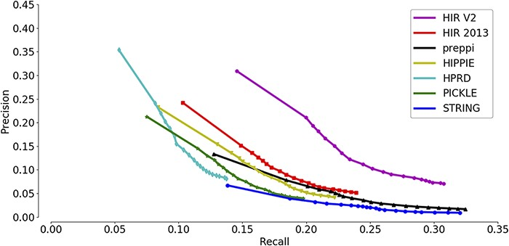
Figure 3. Assessment of the capabilities of seven interactomes to group functionally associated genes together. The ...
Notes:
Figure 3. Assessment of the capabilities of seven interactomes to group functionally associated genes together. The precision-recall curves of gene function prediction using different interactomes are illustrated. Precision measures the proportion of correct annotations identified by an interactome, while recall measures the proportion of new annotations that are identified by an interactome.
Unless provided in the caption above, the following copyright applies to the content of this slide: © The Author(s) 2021. Published by Oxford University Press.This is an Open Access article distributed under the terms of the Creative Commons Attribution License (http://creativecommons.org/licenses/by/4.0/), which permits unrestricted reuse, distribution, and reproduction in any medium, provided the original work is properly cited.

