Slide 1
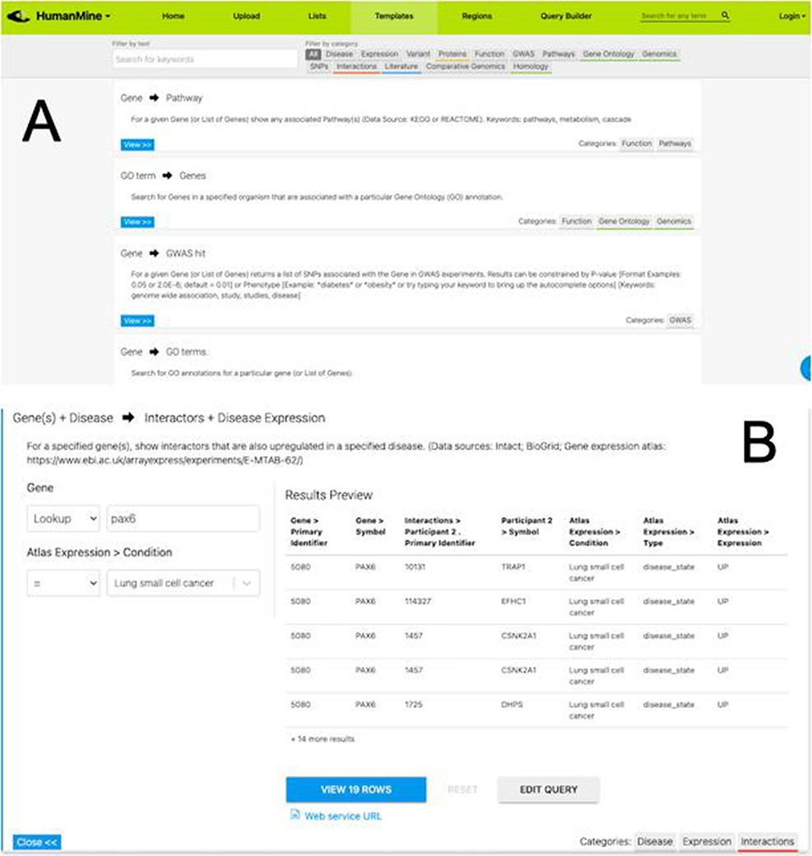
Figure 5. (A) A library of ‘template’ searches is available from the ‘Templates’ tab. The template library can be ...
Notes:
Figure 5. (A) A library of ‘template’ searches is available from the ‘Templates’ tab. The template library can be searched using keywords or filtered using the various data category tags. (B) The ‘Gene(s) + Disease Interactors + Disease Expression’ template expanded. Each template provides one or more constraints that can be modified according to the search the user wishes to run. A preview of the template result is shown with options to view the full results or edit the query in the Query Builder.
Unless provided in the caption above, the following copyright applies to the content of this slide: © The Author(s) 2022. Published by Oxford University Press.This is an Open Access article distributed under the terms of the Creative Commons Attribution-NonCommercial License (https://creativecommons.org/licenses/by-nc/4.0/), which permits non-commercial re-use, distribution, and reproduction in any medium, provided the original work is properly cited. For commercial re-use, please contact journals.permissions@oup.com

