Slide 1
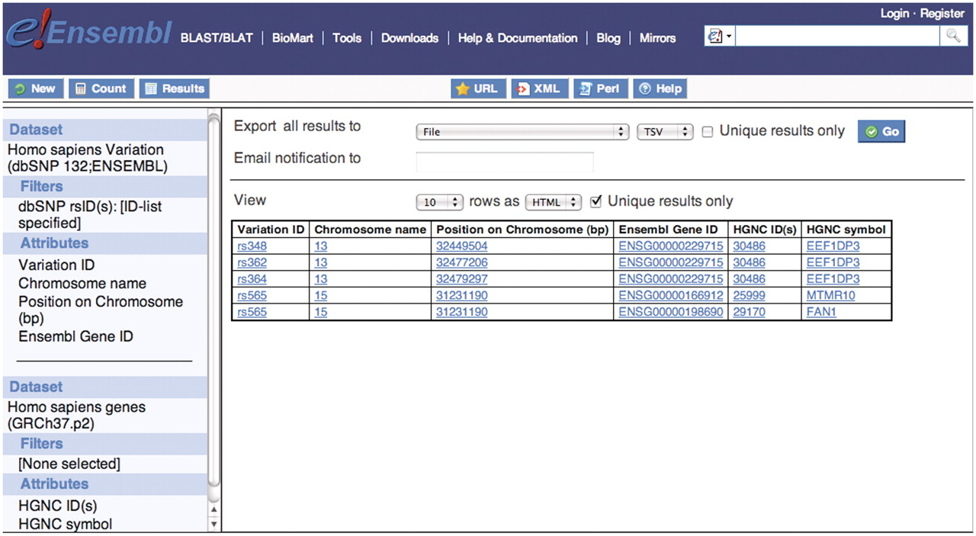
Figure 4. Five dbSNP rs IDs were used to filter the human variation data set and Ensembl gene IDs containing these five ...
Notes:
Figure 4. Five dbSNP rs IDs were used to filter the human variation data set and Ensembl gene IDs containing these five variations were selected in the attributes. Then linking to the second data set, human gene data set from Ensembl Genes database, the HGNC ID and symbol were selected in the attribute section to retrieve the corresponding gene names from HGNC. They are FAN1, MTMR10 and EEF1DP3.
Unless provided in the caption above, the following copyright applies to the content of this slide: © The Author(s) 2011. Published by Oxford University Press.This is Open Access article distributed under the terms of the Creative Commons Attribution Non-Commercial License (http://creativecommons.org/licenses/by-nc/2.5), which permits unrestricted non-commercial use, distribution, and reproduction in any medium, provided the original work is properly cited.

