Slide 1
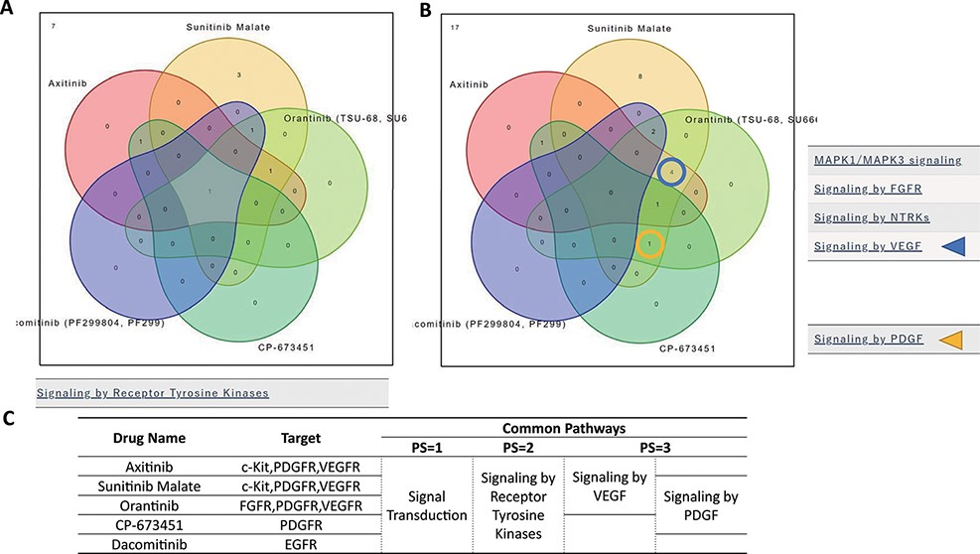
Figure 4. ‘Compare Pathway’ section. Five inhibitory drugs of the protein tyrosine kinase pathway were selected. (A) In ...
Notes:
Figure 4. ‘Compare Pathway’ section. Five inhibitory drugs of the protein tyrosine kinase pathway were selected. (A) In the higher pathway hierarchy (pathway stratum = 2), five drugs commonly downregulated the ‘Signaling by Receptor Tyrosine Kinases’. (B) At lower pathway hierarchy, five drugs showed various specificities for pathway activities. (C) The drug information and common pathway results are summarized.
Unless provided in the caption above, the following copyright applies to the content of this slide: © The Author(s) 2022. Published by Oxford University Press.This is an Open Access article distributed under the terms of the Creative Commons Attribution-NonCommercial License (https://creativecommons.org/licenses/by-nc/4.0/), which permits non-commercial re-use, distribution, and reproduction in any medium, provided the original work is properly cited. For commercial re-use, please contact journals.permissions@oup.com

