Slide 1
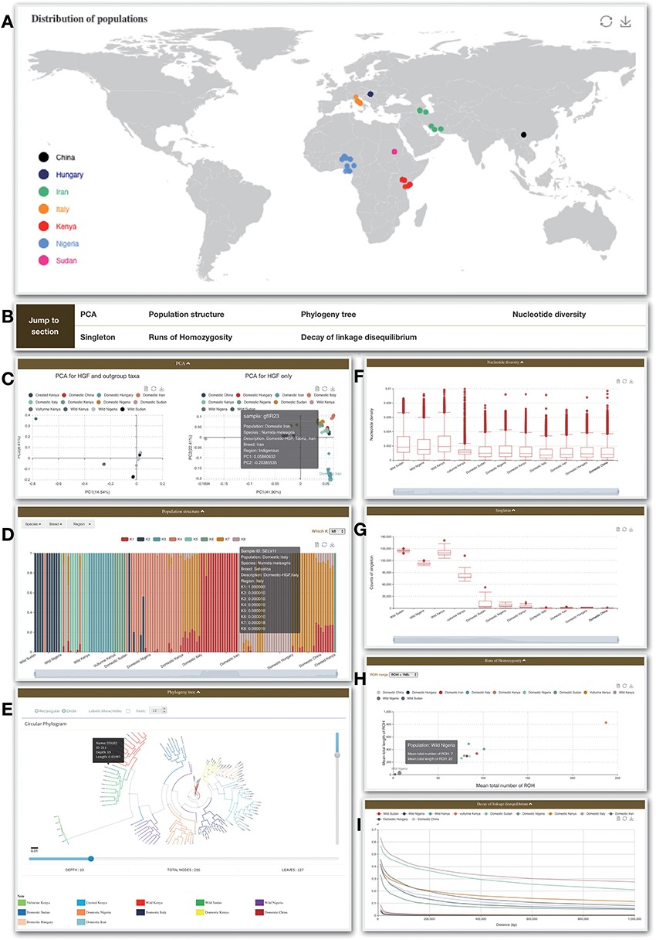
Figure 3. Re-sequence module. (A) Geological distribution of 129 individuals. In addition, there are some bar charts on ...
Notes:
Figure 3. Re-sequence module. (A) Geological distribution of 129 individuals. In addition, there are some bar charts on this page. (B) Navigation bar of the Analysis page in the Re-sequence module. (C) The PCA section shows all 129 individuals belonging to HGF and outgroup taxa (left) and PCA for HGF only (right). (D) Bar plot of ADMIXTURE analysis for all samples with K from 2 to 10. (E) Phylogenetic tree. (F) Nucleotide diversity. (G) Singleton statistic. (H) ROHs. (I) Decay of linkage disequilibrium.
Unless provided in the caption above, the following copyright applies to the content of this slide: © The Author(s) 2021. Published by Oxford University Press.This is an Open Access article distributed under the terms of the Creative Commons Attribution License (http://creativecommons.org/licenses/by/4.0/), which permits unrestricted reuse, distribution, and reproduction in any medium, provided the original work is properly cited.

