Slide 1
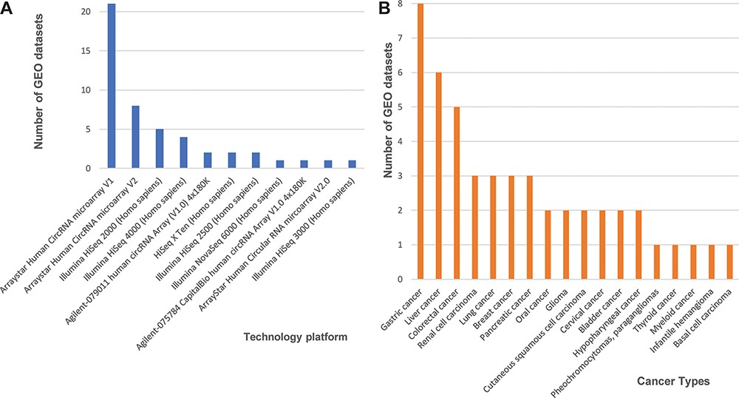
Figure 1. Statistics of 48 curated GEO data sets of circRNA expression in cancers. (A) The number of data sets from ...
Notes:
Figure 1. Statistics of 48 curated GEO data sets of circRNA expression in cancers. (A) The number of data sets from various technology platforms. (B) The number of data sets for curated cancer types.
Unless provided in the caption above, the following copyright applies to the content of this slide: © The Author(s) 2021. Published by Oxford University Press.This is an Open Access article distributed under the terms of the Creative Commons Attribution License (http://creativecommons.org/licenses/by/4.0/), which permits unrestricted reuse, distribution, and reproduction in any medium, provided the original work is properly cited.

Slide 2
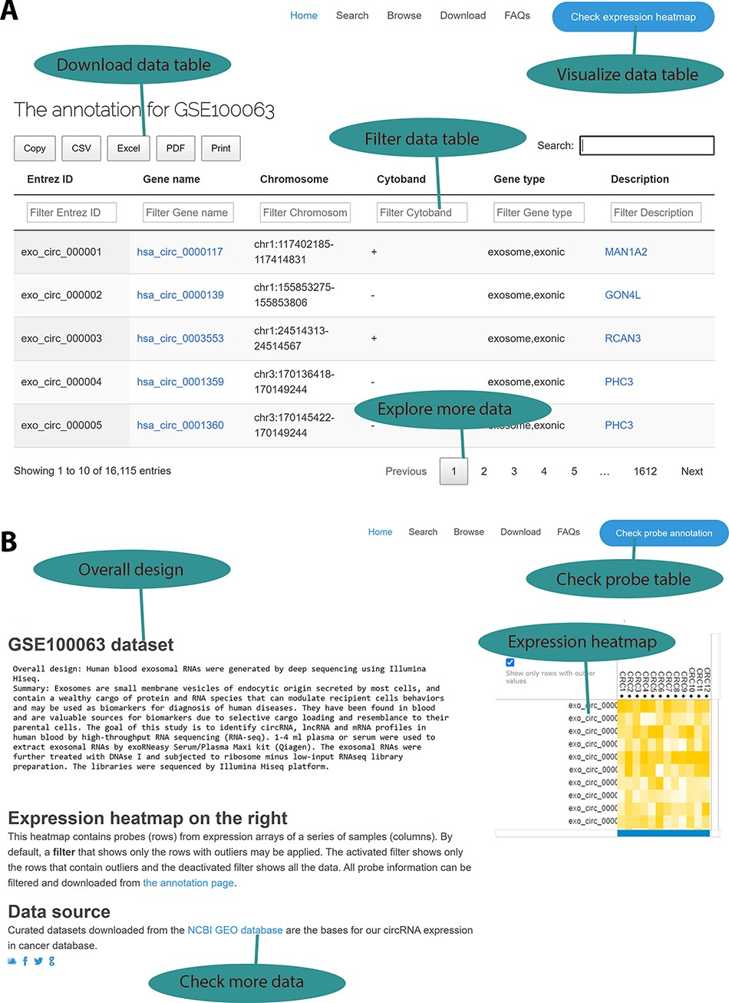
Figure 2. Web interface for the circExp database. (A) On the probe annotation page, users can follow four highlighted ...
Notes:
Figure 2. Web interface for the circExp database. (A) On the probe annotation page, users can follow four highlighted functions for data filtering, downloading and pagination. Each column in the data table can also be sorted by clicking the column number. The column filtering function works by entering a keyword for a column. The filtered results can be downloaded in Excel, CSV and PDF formats. Users can switch to the expression heatmap by clicking the button on the top right of the screen. (B) On the expression heatmap page, users find a data set’s overall design and they can link back to the original records in the public database. The data set’s heatmap explores expression patterns.
Unless provided in the caption above, the following copyright applies to the content of this slide: © The Author(s) 2021. Published by Oxford University Press.This is an Open Access article distributed under the terms of the Creative Commons Attribution License (http://creativecommons.org/licenses/by/4.0/), which permits unrestricted reuse, distribution, and reproduction in any medium, provided the original work is properly cited.

Slide 3
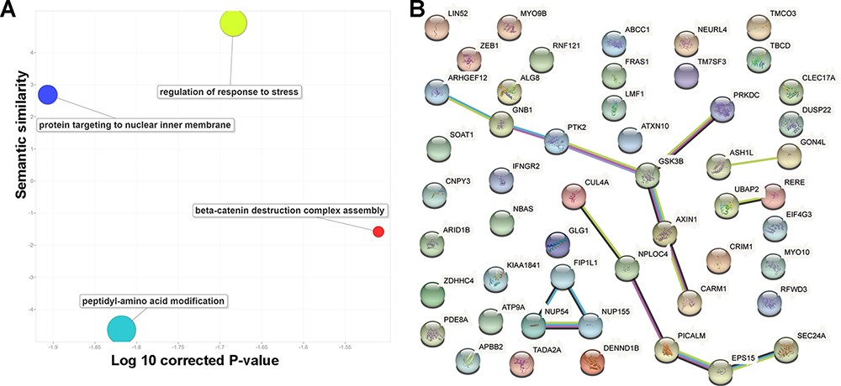
Figure 3. Basic functions of 52 circRNA differentially expressed parental genes found in 32 TCGA studies. (A) Key gene ...
Notes:
Figure 3. Basic functions of 52 circRNA differentially expressed parental genes found in 32 TCGA studies. (A) Key gene ontology (biological process) terms (B) The molecular network constructed from the STRING web server includes gene–gene association pairs (light green lines) gathered by text mining, gene co-expression pairs (black lines), evolutionary homolog-inferred interactions (blue lines), and large-scale experimentally validated protein–protein interactions (pink lines).
Unless provided in the caption above, the following copyright applies to the content of this slide: © The Author(s) 2021. Published by Oxford University Press.This is an Open Access article distributed under the terms of the Creative Commons Attribution License (http://creativecommons.org/licenses/by/4.0/), which permits unrestricted reuse, distribution, and reproduction in any medium, provided the original work is properly cited.

Slide 4
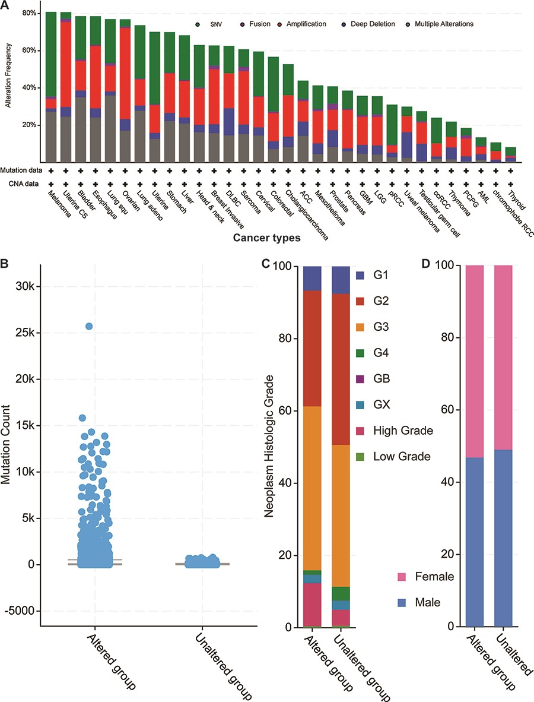
Figure 4. Cancer genomics overview of the 52 circRNA differentially expressed parental genes in 32 TCGA studies. (A) ...
Notes:
Figure 4. Cancer genomics overview of the 52 circRNA differentially expressed parental genes in 32 TCGA studies. (A) Mutational frequencies in various cancer types. (B) The mutation counts for those samples with (altered) or without (unaltered) genetic variants among the 52 genes. (C) The histological grade distributions for those samples with or without genetic variants among the 52 genes. (D) Gender ratios for those samples with or without genetic variants among the 52 genes.
Unless provided in the caption above, the following copyright applies to the content of this slide: © The Author(s) 2021. Published by Oxford University Press.This is an Open Access article distributed under the terms of the Creative Commons Attribution License (http://creativecommons.org/licenses/by/4.0/), which permits unrestricted reuse, distribution, and reproduction in any medium, provided the original work is properly cited.

Slide 5
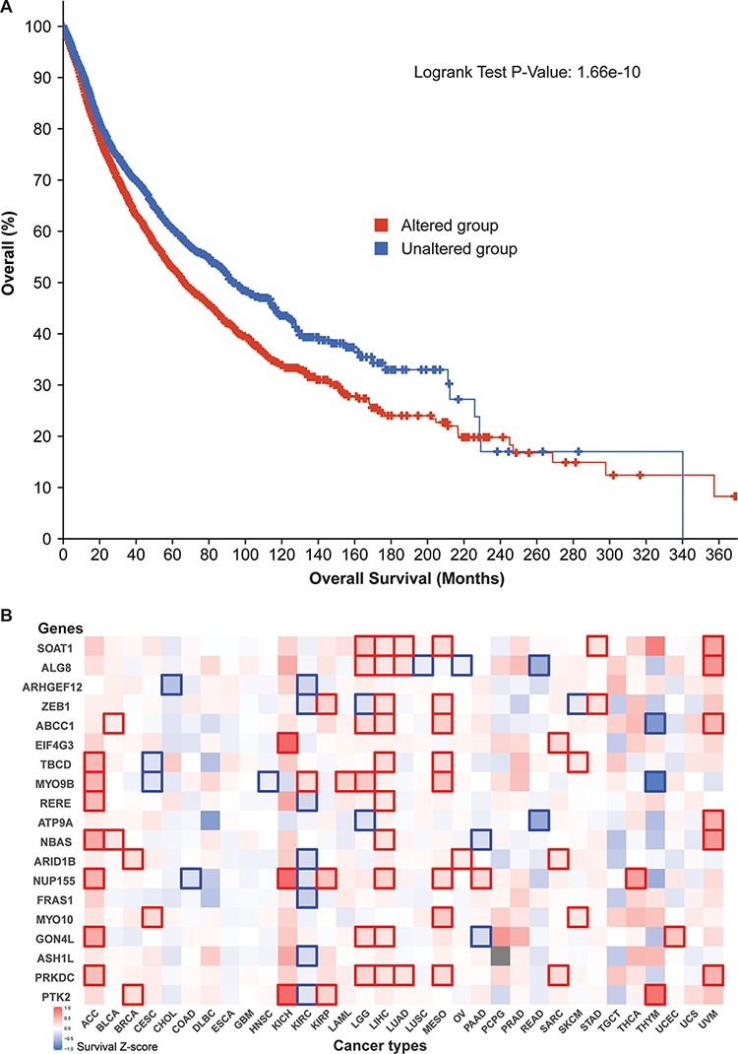
Figure 5. Cancer patient survival with regard to the 52 circRNA parental genes. (A) Overall survival analysis of 10 797 ...
Notes:
Figure 5. Cancer patient survival with regard to the 52 circRNA parental genes. (A) Overall survival analysis of 10 797 patients in our TCGA pan-cancer data set. See Figure 4 for definitions of altered and unaltered. (B) Cancer-type-specific survival analysis. Z-score polarities reflect the genes’ beneficial or detrimental effects on survival. Bolded squares highlight statistically significant survival differences.
Unless provided in the caption above, the following copyright applies to the content of this slide: © The Author(s) 2021. Published by Oxford University Press.This is an Open Access article distributed under the terms of the Creative Commons Attribution License (http://creativecommons.org/licenses/by/4.0/), which permits unrestricted reuse, distribution, and reproduction in any medium, provided the original work is properly cited.

Slide 6
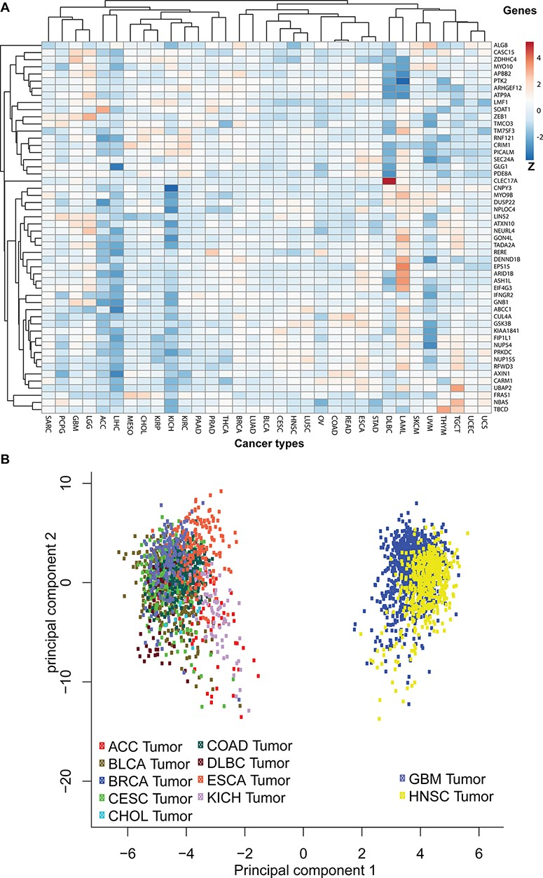
Figure 6. Pan-cancer expression pattern analyses. (A) The pan-cancer expression patterns for the 52 circRNA parental ...
Notes:
Figure 6. Pan-cancer expression pattern analyses. (A) The pan-cancer expression patterns for the 52 circRNA parental genes. Genes with similar expression patterns are clustered together. The Z-scores indicate higher or lower than average expressions in each category. (B) A principal component analysis based on pan-cancer expression profiles. The TCGA data sets are plotted in different colours: adrenocortical carcinoma (ACC), bladder urothelial carcinoma (BLCA), breast invasive carcinoma (BRCA), cervical squamous cell carcinoma and endocervical adenocarcinoma (CESC), cholangiocarcinoma (CHOL), colon adenocarcinoma (COAD), oesophageal carcinoma (ESCA), glioblastoma multiforme (GBM), head and neck squamous cell carcinoma (HNSC) and KICH.
Unless provided in the caption above, the following copyright applies to the content of this slide: © The Author(s) 2021. Published by Oxford University Press.This is an Open Access article distributed under the terms of the Creative Commons Attribution License (http://creativecommons.org/licenses/by/4.0/), which permits unrestricted reuse, distribution, and reproduction in any medium, provided the original work is properly cited.

