Slide 1
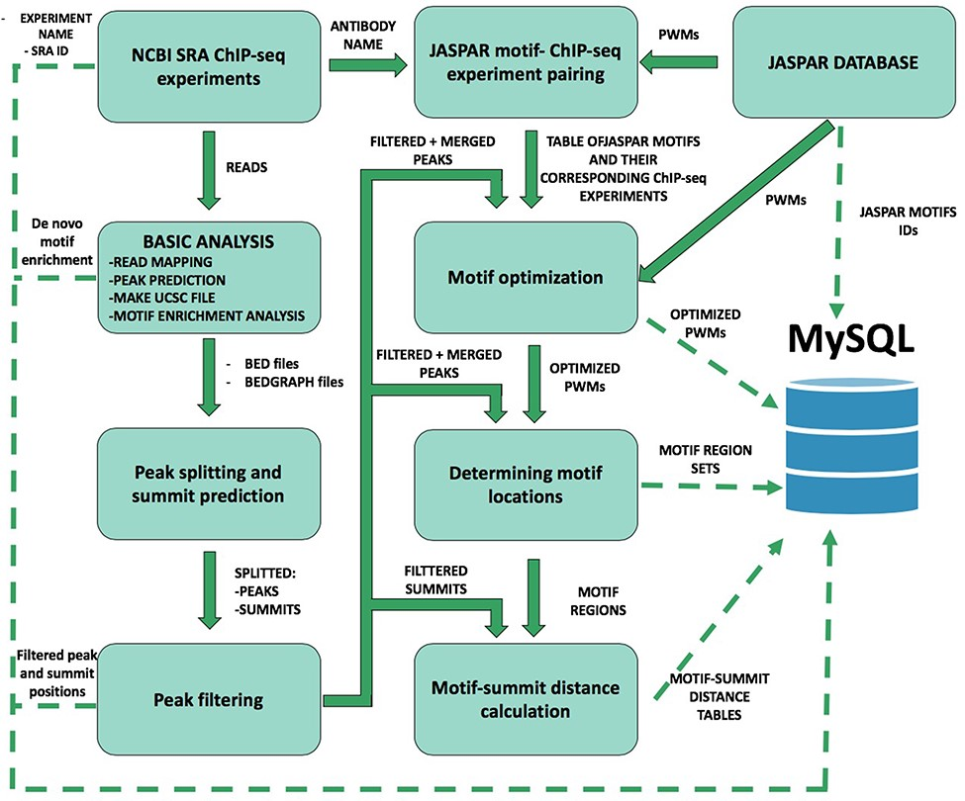
Figure 1 Schematic overview of ChIP-seq data processing and imported content from MySQL. The analysis steps and data ...
Notes:
Figure 1 Schematic overview of ChIP-seq data processing and imported content from MySQL. The analysis steps and data conversion are marked with thick arrows. The uploaded results/files are represented with dashed lines. A vast majority of processed data are available on ChIPSummitDB, including the predicted peak regions, optimized JASPAR CORE PWMs, identified TFBSs and calculated protein position information.
Unless provided in the caption above, the following copyright applies to the content of this slide: © The Author(s) 2020. Published by Oxford University Press.This is an Open Access article distributed under the terms of the Creative Commons Attribution License (http://creativecommons.org/licenses/by/4.0/), which permits unrestricted reuse, distribution, and reproduction in any medium, provided the original work is properly cited.

