Slide 1
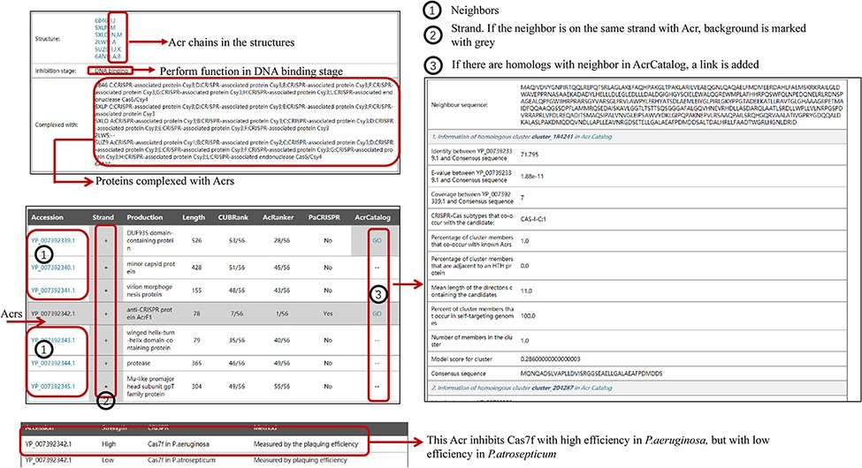
Figure 2. The organization of newly added entries. Data shown in the right panel come from AcrCatalog database ...
Notes:
Figure 2. The organization of newly added entries. Data shown in the right panel come from AcrCatalog database (http://acrcatalog.pythonanywhere.com/catalog/), which is constructed by Gussow et al. Gray background in ‘Strand’ column means Acr and its neighbors whose coding genes are in the same strand, which may form directon, a term proposed by Gussow et al. (10). Rows marked by ‘1’ represent accession numbers of Acr neighbors. In ‘AcrCatalog’ column, ‘GO’ labels with highlighted gray background means similarity sequence can be found in AcrCatalog database.
Unless provided in the caption above, the following copyright applies to the content of this slide: © The Author(s) 2022. Published by Oxford University Press.This is an Open Access article distributed under the terms of the Creative Commons Attribution License (https://creativecommons.org/licenses/by/4.0/), which permits unrestricted reuse, distribution, and reproduction in any medium, provided the original work is properly cited.

