Slide 1
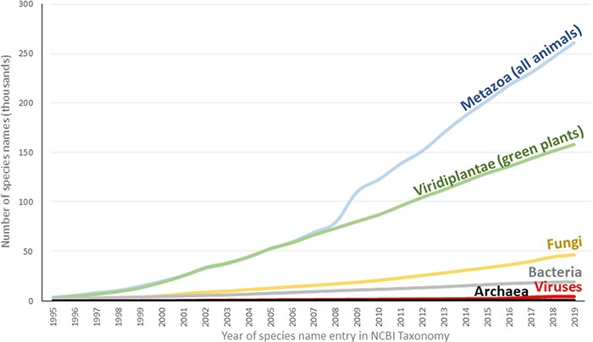
Figure 2 Species names added over time to NCBI Taxonomy. The first occurrence of each species in the NCBI Taxonomy was ...
Notes:
Figure 2 Species names added over time to NCBI Taxonomy. The first occurrence of each species in the NCBI Taxonomy was determined by the created date of its associated TaxNode. This date represents the first addition of the species into the database irrespective of subsequent name changes.
Unless provided in the caption above, the following copyright applies to the content of this slide: Published by Oxford University Press 2020.This work is written by US Government employees and is in the public domain in the US.

