Slide 1
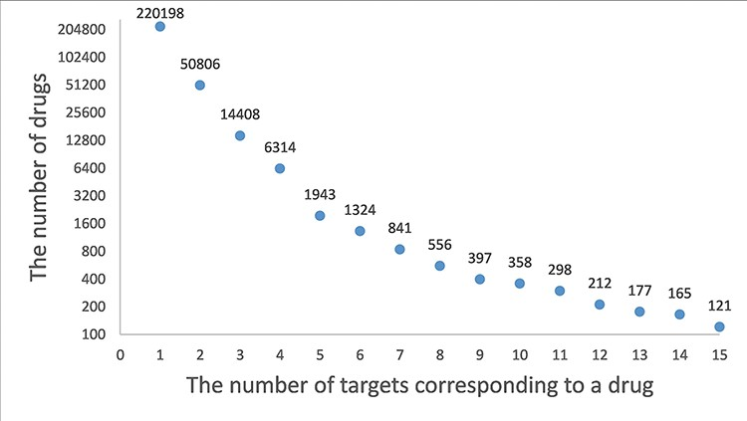
Figure 2. A frequency plot of the number of targets for a drug. The x-axis indicates the number of targets ...
Notes:
Figure 2. A frequency plot of the number of targets for a drug. The x-axis indicates the number of targets corresponding to a drug and the y-axis indicates the number of drugs. In this figure, only the drugs with less than 15 target genes are shown which account for 99.5% of the drugs.
Unless provided in the caption above, the following copyright applies to the content of this slide: © The Author(s) 2022. Published by Oxford University Press.This is an Open Access article distributed under the terms of the Creative Commons Attribution-NonCommercial License (https://creativecommons.org/licenses/by-nc/4.0/), which permits non-commercial re-use, distribution, and reproduction in any medium, provided the original work is properly cited. For commercial re-use, please contact journals.permissions@oup.com

