Slide 1
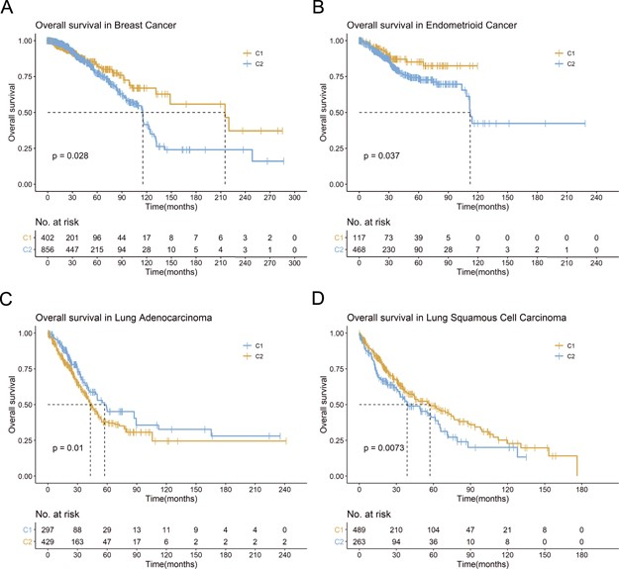
Figure 5 Example for ATdb application. Kaplan–Meier plot for (A) breast cancer (TCGA-BRCA); (B) endometrioid cancer ...
Notes:
Figure 5 Example for ATdb application. Kaplan–Meier plot for (A) breast cancer (TCGA-BRCA); (B) endometrioid cancer (TCGA-UCEC); (C) lung adenocarcinoma (TCGA-LUAD); (D) lung squamous cell carcinoma (TCGA-LUSC).
Unless provided in the caption above, the following copyright applies to the content of this slide: © The Author(s) 2020. Published by Oxford University Press.This is an Open Access article distributed under the terms of the Creative Commons Attribution License (http://creativecommons.org/licenses/by/4.0/), which permits unrestricted reuse, distribution, and reproduction in any medium, provided the original work is properly cited.

