Slide 1
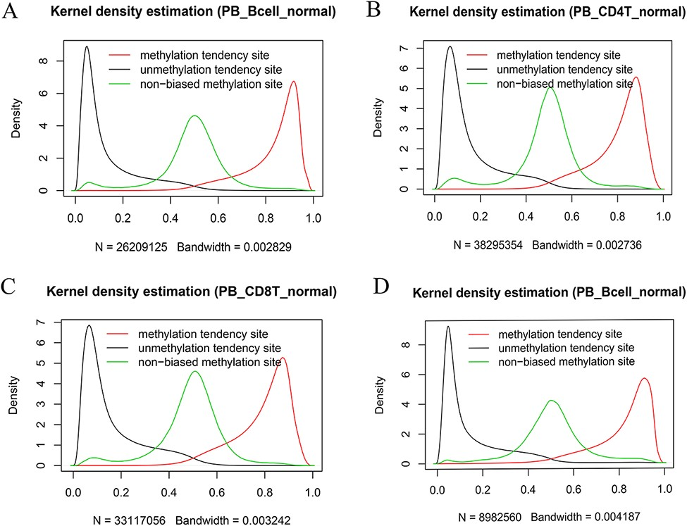
Figure 7. Kernel density estimation of beta values of the sites derived from the indicated categories. The figures show ...
Notes:
Figure 7. Kernel density estimation of beta values of the sites derived from the indicated categories. The figures show beta value distributions of the sites from MTSs, UTSs and nonbiased tendency sites in normal peripheral blood B cells (A, D), normal peripheral CD4+ T cells (B) and normal peripheral CD8+ T cells (C). Figures A, B and C are from the 450k platform, whereas D is from the 850k platform.
Unless provided in the caption above, the following copyright applies to the content of this slide: © The Author(s) 2022. Published by Oxford University Press.This is an Open Access article distributed under the terms of the Creative Commons Attribution License (https://creativecommons.org/licenses/by/4.0/), which permits unrestricted reuse, distribution, and reproduction in any medium, provided the original work is properly cited.

