Slide 1
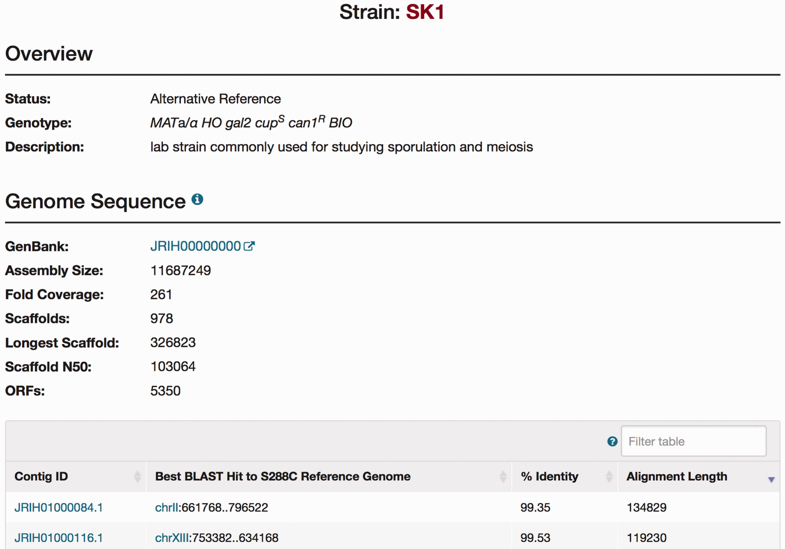
Figure 3. The SGD SK1 Strain page. Strain pages are available for each of the alternative strains. The Strain page ...
Notes:
Figure 3. The SGD SK1 Strain page. Strain pages are available for each of the alternative strains. The Strain page includes an Overview section for descriptive information of each strain, and a Genome Sequence section for brief statistics of the new sequence integrated in the database (NCBI accession number, the number of scaffolds, and the number of ORFs) and a table for information on each contig.
Unless provided in the caption above, the following copyright applies to the content of this slide: © The Author(s) 2016. Published by Oxford University Press. This is an Open Access article distributed under the terms of the Creative Commons Attribution License ( http://creativecommons.org/licenses/by/4.0/ ), which permits unrestricted reuse, distribution, and reproduction in any medium, provided the original work is properly cited.

