Slide 1
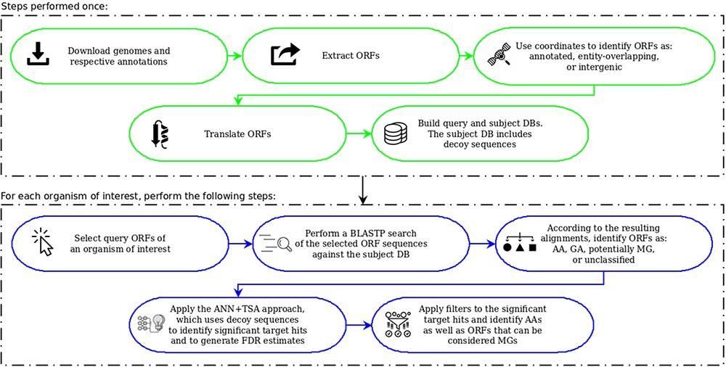
Figure 5. OCCAM pipeline. In green are the steps to be performed only once for a given version of genomes and ...
Notes:
Figure 5. OCCAM pipeline. In green are the steps to be performed only once for a given version of genomes and respective annotations. In blue are the steps to be executed for each organism of interest.
Unless provided in the caption above, the following copyright applies to the content of this slide: © The Author(s) 2020. Published by Oxford University Press.This is an Open Access article distributed under the terms of the Creative Commons Attribution License (http://creativecommons.org/licenses/by/4.0/), which permits unrestricted reuse, distribution, and reproduction in any medium, provided the original work is properly cited.

