Slide 1
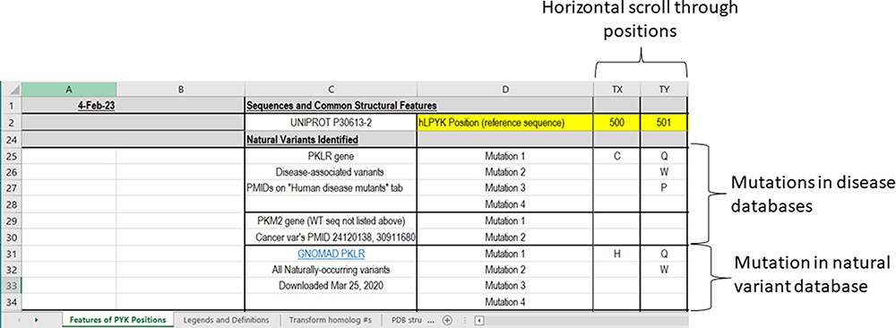
Figure 4. The third section of the ‘Features of PYK Positions’ worksheet in the PYK-SubstitutionOME workbook. Rows 1 ...
Notes:
Figure 4. The third section of the ‘Features of PYK Positions’ worksheet in the PYK-SubstitutionOME workbook. Rows 1 and 2 are anchored to provide position reference points, as are Columns A–D. This third section contains substitutions associated with PKD and other substitutions identified in the human population; the latter are not necessarily associated with disease.
Unless provided in the caption above, the following copyright applies to the content of this slide: © The Author(s) 2023. Published by Oxford University Press.This is an Open Access article distributed under the terms of the Creative Commons Attribution License (https://creativecommons.org/licenses/by/4.0/), which permits unrestricted reuse, distribution, and reproduction in any medium, provided the original work is properly cited.

