Slide 1
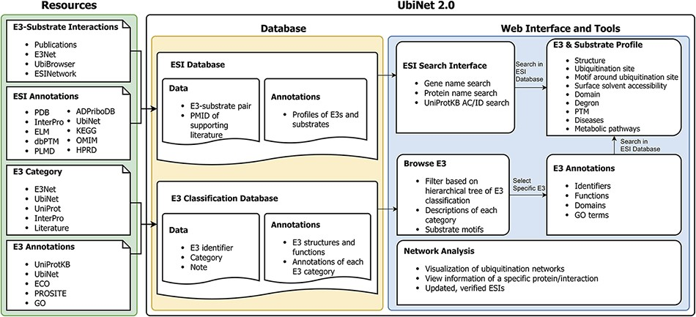
Figure 1. Schematic representation of the data integration and database construction and the development of web ...
Notes:
Figure 1. Schematic representation of the data integration and database construction and the development of web interface and analytics tools of UbiNet 2.0.
Unless provided in the caption above, the following copyright applies to the content of this slide: © The Author(s) 2021. Published by Oxford University Press.This is an Open Access article distributed under the terms of the Creative Commons Attribution License (http://creativecommons.org/licenses/by/4.0/), which permits unrestricted reuse, distribution, and reproduction in any medium, provided the original work is properly cited.

Slide 2
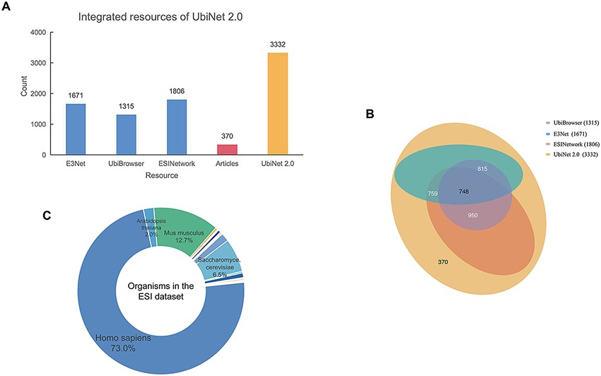
Figure 2. Integrated resources of UbiNet 2.0. (A) The numbers of ESIs collected from three other platforms, literature ...
Notes:
Figure 2. Integrated resources of UbiNet 2.0. (A) The numbers of ESIs collected from three other platforms, literature as well as UbiNet 2.0. (B) The Venn diagram on the resources. It shows the overlap of ESI records between the resources. The numbers in the brackets beside the database names are the total number of ESIs in the corresponding database. (C) Organisms involved in the ESI data set of UbiNet 2.0.
Unless provided in the caption above, the following copyright applies to the content of this slide: © The Author(s) 2021. Published by Oxford University Press.This is an Open Access article distributed under the terms of the Creative Commons Attribution License (http://creativecommons.org/licenses/by/4.0/), which permits unrestricted reuse, distribution, and reproduction in any medium, provided the original work is properly cited.

Slide 3
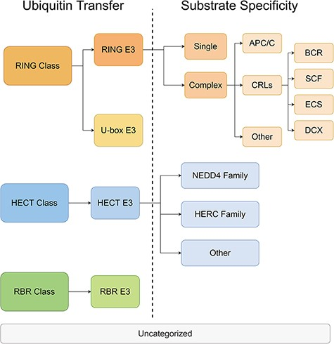
Figure 3. The hierarchical tree of E3 categories.
Notes:
Figure 3. The hierarchical tree of E3 categories.
Unless provided in the caption above, the following copyright applies to the content of this slide: © The Author(s) 2021. Published by Oxford University Press.This is an Open Access article distributed under the terms of the Creative Commons Attribution License (http://creativecommons.org/licenses/by/4.0/), which permits unrestricted reuse, distribution, and reproduction in any medium, provided the original work is properly cited.

Slide 4
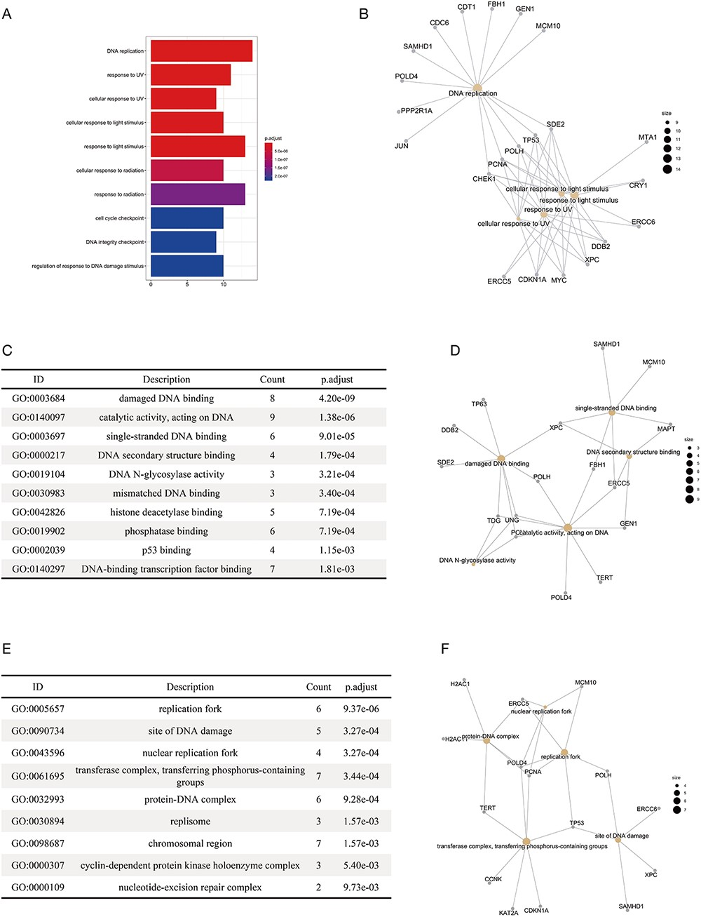
Figure 4. The results of the functional enrichment analyses on the substrates of DCX E3 ligases. (A) The bar chart ...
Notes:
Figure 4. The results of the functional enrichment analyses on the substrates of DCX E3 ligases. (A) The bar chart shows the enriched biological processes of the substrates of DCX E3s. (B) The network between the substrates of DCX E3s and the enriched biological processes. The yellow circles represent the functional terms, while the gray circles represent the substrates. The size of the yellow circles indicates the number of substrates associated with that functional term. (C) The bar chart illustrates the enriched molecular functions of the substrates of DCX E3s. (D) The network between the substrates of DCX E3s and the enriched molecular functions. (E) The enriched cellular compartments of the substrates of DCX E3s are listed. (F) The network between the substrates of DCX E3s and enriched cellular compartments.
Unless provided in the caption above, the following copyright applies to the content of this slide: © The Author(s) 2021. Published by Oxford University Press.This is an Open Access article distributed under the terms of the Creative Commons Attribution License (http://creativecommons.org/licenses/by/4.0/), which permits unrestricted reuse, distribution, and reproduction in any medium, provided the original work is properly cited.

Slide 5
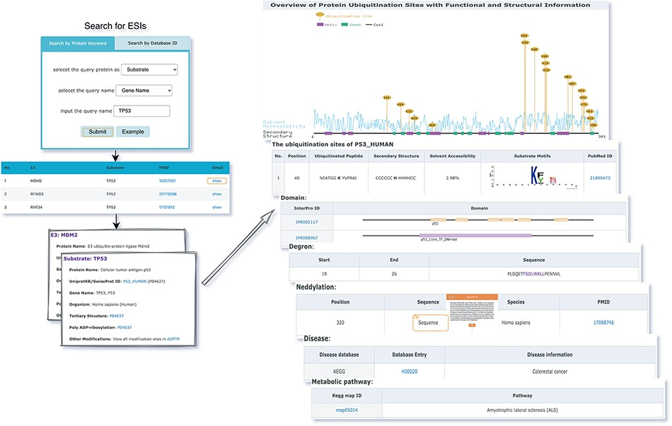
Figure 5. The first service for browsing ESIs by specifying identifiers of an E3 or a substrate in the search panel and ...
Notes:
Figure 5. The first service for browsing ESIs by specifying identifiers of an E3 or a substrate in the search panel and view the E3 and substrate profiles.
Unless provided in the caption above, the following copyright applies to the content of this slide: © The Author(s) 2021. Published by Oxford University Press.This is an Open Access article distributed under the terms of the Creative Commons Attribution License (http://creativecommons.org/licenses/by/4.0/), which permits unrestricted reuse, distribution, and reproduction in any medium, provided the original work is properly cited.

Slide 6
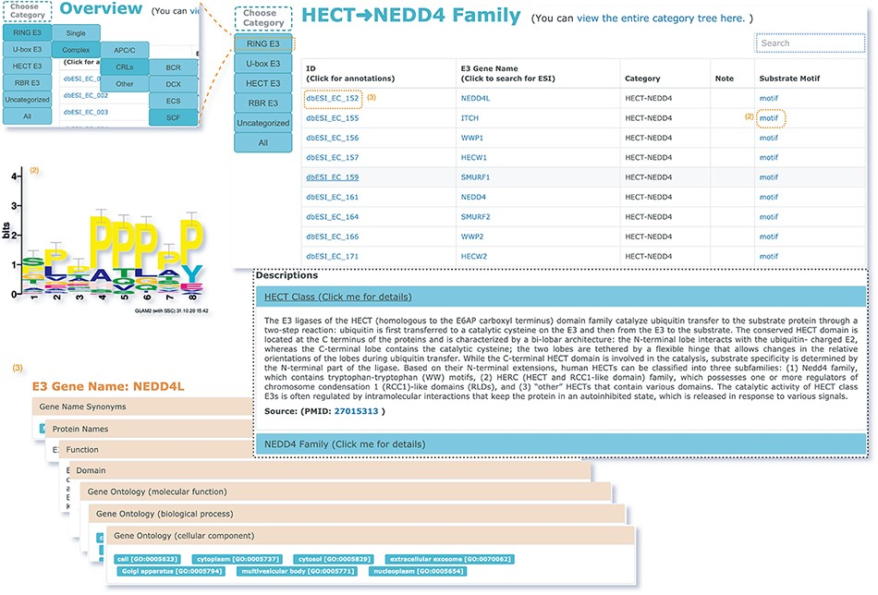
Figure 6. The second service for browsing the data of E3 classification.
Notes:
Figure 6. The second service for browsing the data of E3 classification.
Unless provided in the caption above, the following copyright applies to the content of this slide: © The Author(s) 2021. Published by Oxford University Press.This is an Open Access article distributed under the terms of the Creative Commons Attribution License (http://creativecommons.org/licenses/by/4.0/), which permits unrestricted reuse, distribution, and reproduction in any medium, provided the original work is properly cited.

Slide 7
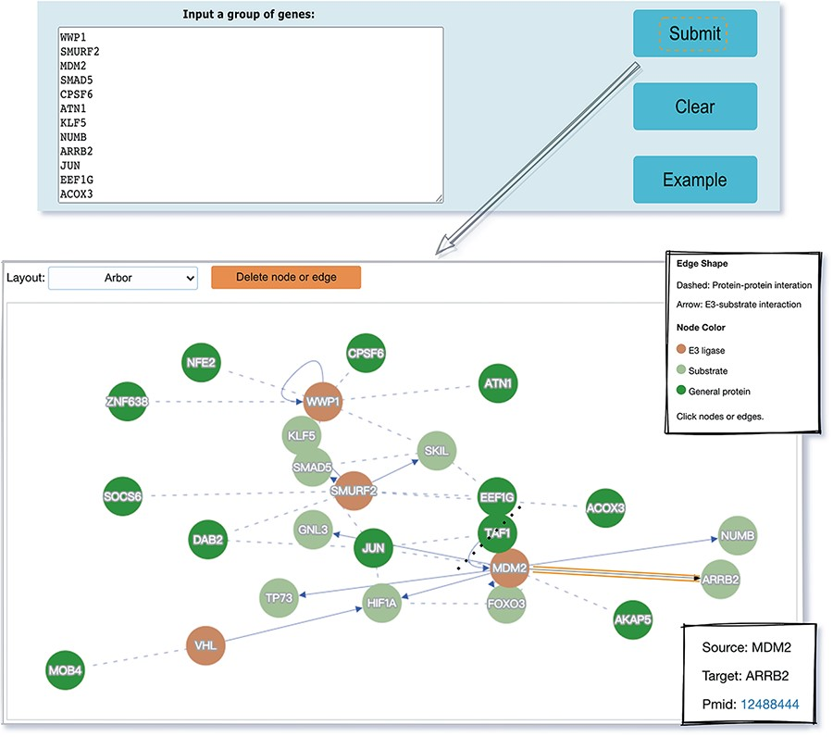
Figure 7. The visualization tool used to generate a network of a list of proteins specified by users.
Notes:
Figure 7. The visualization tool used to generate a network of a list of proteins specified by users.
Unless provided in the caption above, the following copyright applies to the content of this slide: © The Author(s) 2021. Published by Oxford University Press.This is an Open Access article distributed under the terms of the Creative Commons Attribution License (http://creativecommons.org/licenses/by/4.0/), which permits unrestricted reuse, distribution, and reproduction in any medium, provided the original work is properly cited.

