Slide 1
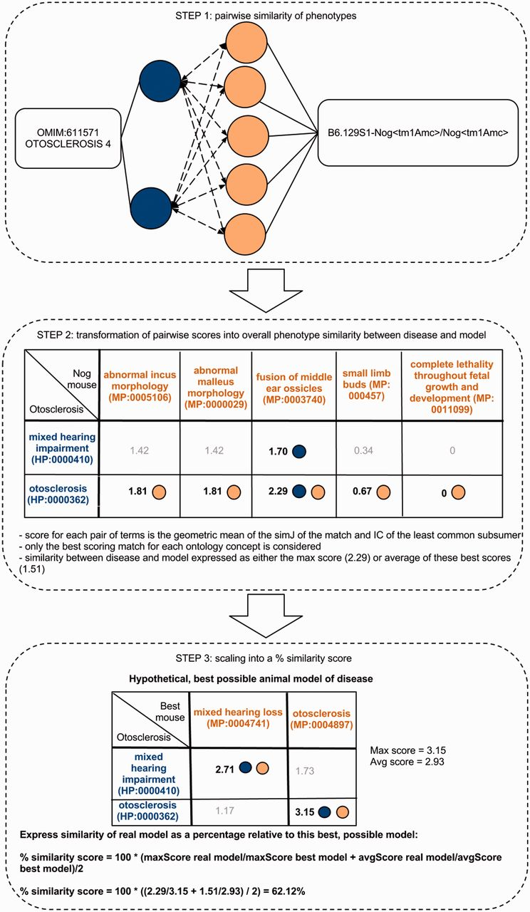
Figure 1. Determining the phenotype similarity of two entities, e.g. a mouse model and a disease, is a three-step ...
Notes:
Figure 1. Determining the phenotype similarity of two entities, e.g. a mouse model and a disease, is a three-step process in our method. The first step is the alignment of ontology concepts based on OWLSim and assigning scores to individual pairs of ontology concepts as illustrated in the top panel of this figure. In a second step, the best scoring matches for each of the annotated ontology concepts are identified and the overall phenotype similarity score described as either the maximum or mean of these scores. In a third step, we scale these two measures relative to their maximum possible values and calculate a single combined percentage score.
Unless provided in the caption above, the following copyright applies to the content of this slide: © The Author(s) 2013. Published by Oxford University Press.This is an Open Access article distributed under the terms of the Creative Commons Attribution Non-Commercial License (http://creativecommons.org/licenses/by-nc/3.0/), which permits non-commercial re-use, distribution, and reproduction in any medium, provided the original work is properly cited. For commercial re-use, please contact journals.permissions@oup.com

