Slide 1
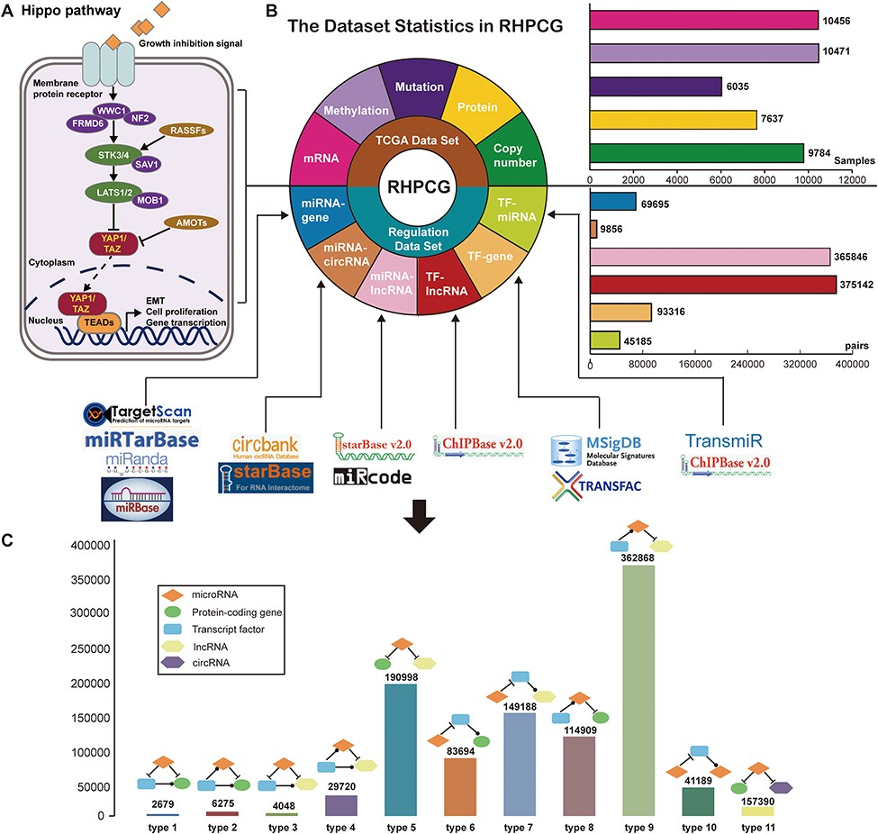
Figure 2 Flow chart of the RHPCG database. (A) Core genes in the Hippo signaling pathway. (B) Dataset statistics in ...
Notes:
Figure 2 Flow chart of the RHPCG database. (A) Core genes in the Hippo signaling pathway. (B) Dataset statistics in RHPCG. (C) Statistics of regulatory motifs in RHPCG.
Unless provided in the caption above, the following copyright applies to the content of this slide: © The Author(s) 2019. Published by Oxford University Press.This is an Open Access article distributed under the terms of the Creative Commons Attribution License (http://creativecommons.org/licenses/by/4.0/), which permits unrestricted reuse, distribution, and reproduction in any medium, provided the original work is properly cited.

