Slide 1
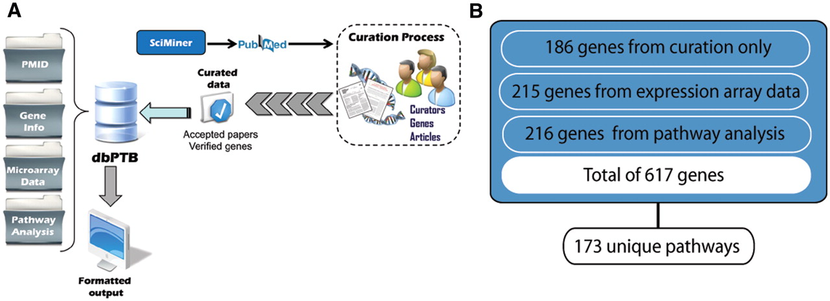
Figure 1. (A) Workflow for retrieval of articles, curation and extraction of genes from literature, microarray data and ...
Notes:
Figure 1. (A) Workflow for retrieval of articles, curation and extraction of genes from literature, microarray data and gene interpolation for pathway analysis. (B) Total number of genes, their associated original sources and number of unique pathways represented.
Unless provided in the caption above, the following copyright applies to the content of this slide: © The Author(s) 2012. Published by Oxford University Press.This is an Open Access article distributed under the terms of the Creative Commons Attribution Non-Commercial License (http://creativecommons.org/licenses/by-nc/3.0), which permits unrestricted non-commercial use, distribution, and reproduction in any medium, provided the original work is properly cited.

