Slide 1
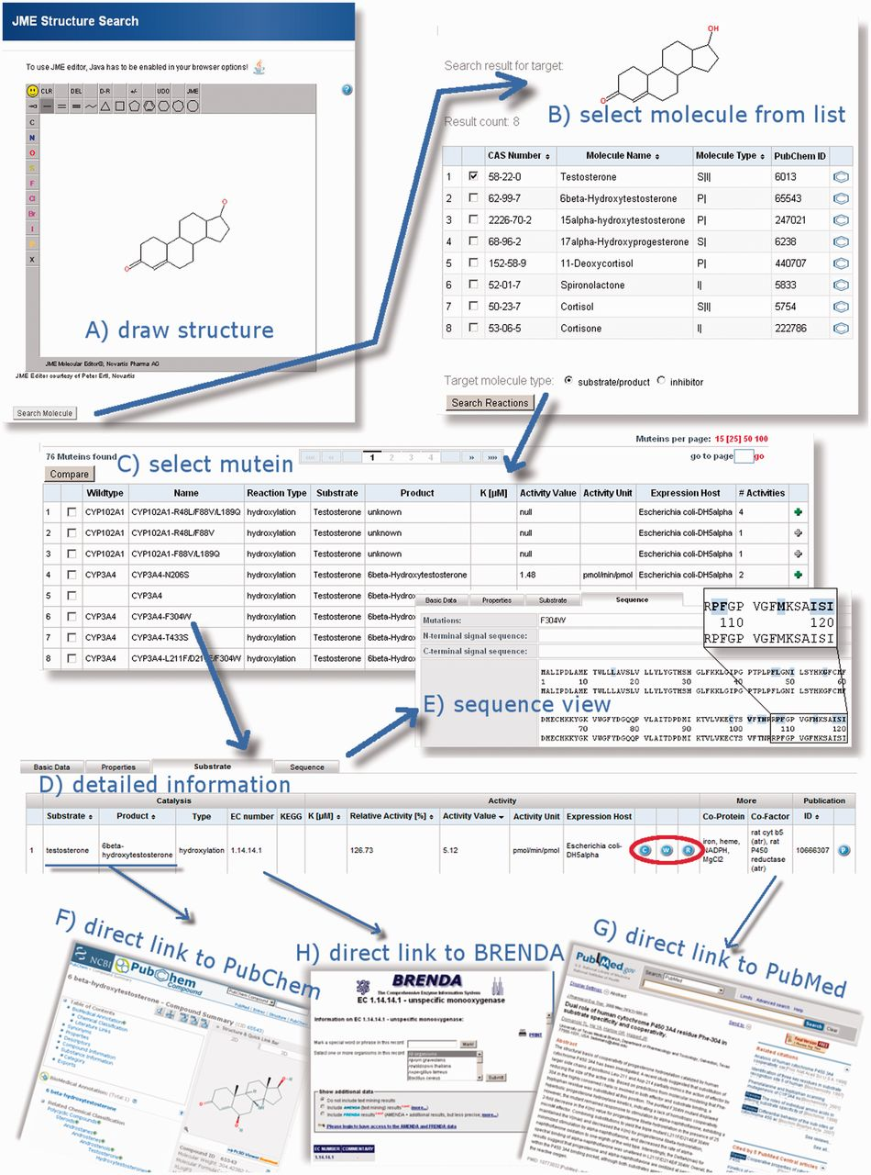
Figure 2 MuteinDB structure search, its results and the capabilities of the MuteinDB webinterface. (A) The MuteinDB ...
Notes:
Figure 2 MuteinDB structure search, its results and the capabilities of the MuteinDB webinterface. (A) The MuteinDB (sub) structure search uses the JME editor, which allows users to draw arbitrary molecular structures. (B) The user-drawn structure is used as seed for the following database search and shown on top of the structure search result table. In this table all molecules, substrates, products or inhibitors which contain the query structure are presented. A selection of these molecules can be used for a subsequent ‘Search by Reaction’. (C) All wild type enzymes and muteins which catalyze the selected molecules are shown. (D) For each row of the tabular result, further information can be obtained via the mutein or wild type name. The detailed information is organized in four main categories: (i) basic data; (ii) properties; (iii) substrate and (iv) sequence. (E) The ‘Sequence’ tab of the selected mutein allows to explore the sequence of the mutein as well as the wild type sequence. Known mutations are highlighted and linked to the corresponding entries of MuteinDB. (F) Information in the ‘Substrate’ tab is linked to third party databases. For example, (F) molecules are linked to PubChem, (H) EC-Numbers to Brenda and (G) literature to PubMed or to its DOI location. For muteins, experimental settings and wild type activity values are available from the ‘Substrate’ tab.
Unless provided in the caption above, the following copyright applies to the content of this slide: © The Author(s) 2012. Published by Oxford University Press.This is an Open Access article distributed under the terms of the Creative Commons Attribution Non-Commercial License (http://creativecommons.org/licenses/by-nc/3.0), which permits unrestricted non-commercial use, distribution, and reproduction in any medium, provided the original work is properly cited.

