Slide 1
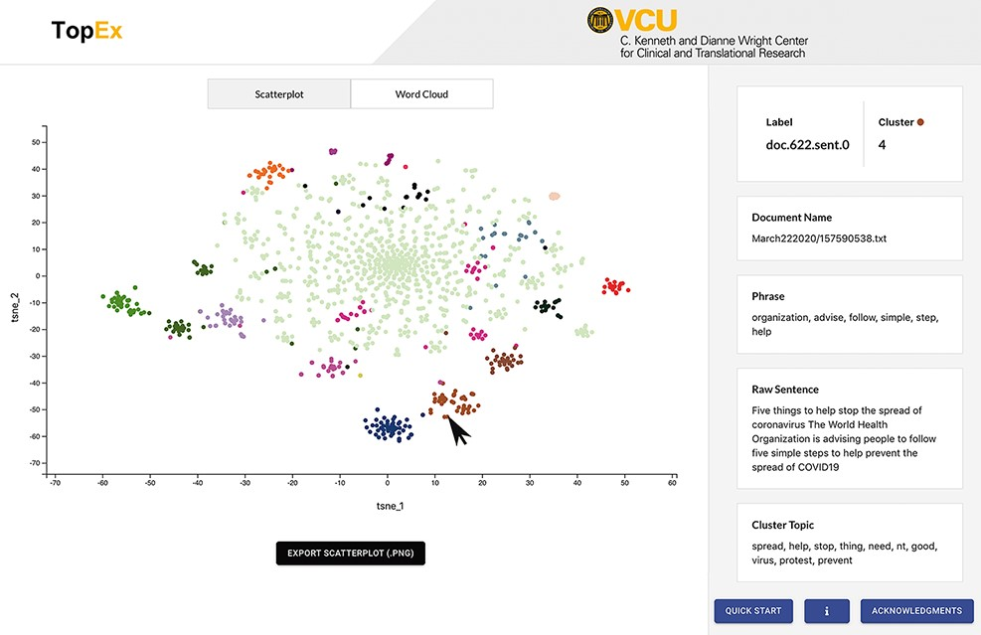
Figure 3. Screenshot of the TopEx interface showing results presented by a tSNE scatter plot and the sentence ...
Notes:
Figure 3. Screenshot of the TopEx interface showing results presented by a tSNE scatter plot and the sentence information displayed on the right when hovering over a point. Corpus used is a randomly sampled set of tweets from March 2020 in the COVID-19 Twitter Chatter data set discussed in the ‘Use Case’ section (same set of tweets that produced the UMAP visualization of Figure 4A).
Unless provided in the caption above, the following copyright applies to the content of this slide: © The Author(s) 2022. Published by Oxford University Press.This is an Open Access article distributed under the terms of the Creative Commons Attribution-NonCommercial License (https://creativecommons.org/licenses/by-nc/4.0/), which permits non-commercial re-use, distribution, and reproduction in any medium, provided the original work is properly cited. For commercial re-use, please contact journals.permissions@oup.com

