Slide 1
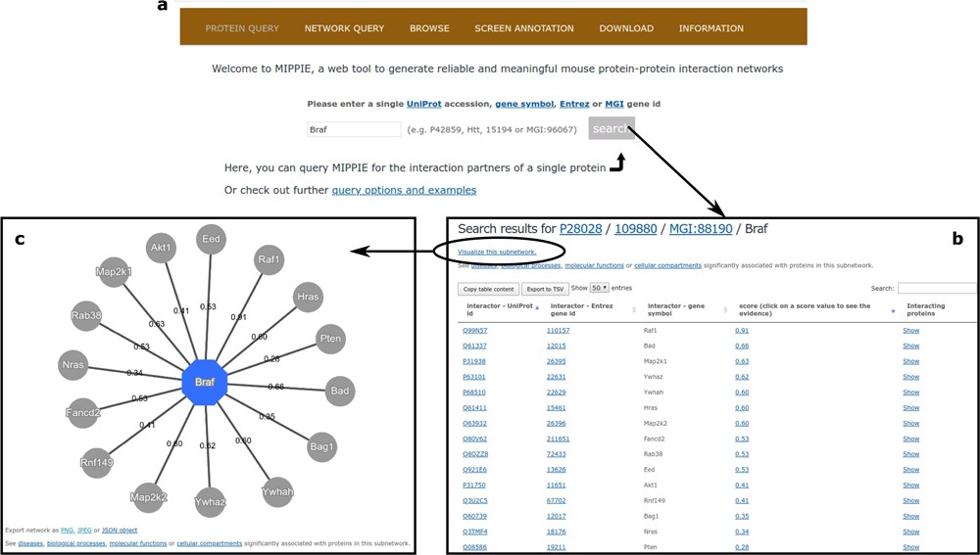
Figure 3 (a) On MIPPIE’s PROTEIN QUERY tab, users can enter a valid protein identifier to retrieve the interaction ...
Notes:
Figure 3 (a) On MIPPIE’s PROTEIN QUERY tab, users can enter a valid protein identifier to retrieve the interaction partners of that protein, if any. (b) MIPPIE generates a table with the query results and provides a link to generate a visual representation of the table (c).
Unless provided in the caption above, the following copyright applies to the content of this slide: © The Author(s) 2020. Published by Oxford University Press.This is an Open Access article distributed under the terms of the Creative Commons Attribution License (http://creativecommons.org/licenses/by/4.0/), which permits unrestricted reuse, distribution, and reproduction in any medium, provided the original work is properly cited.

