Slide 1
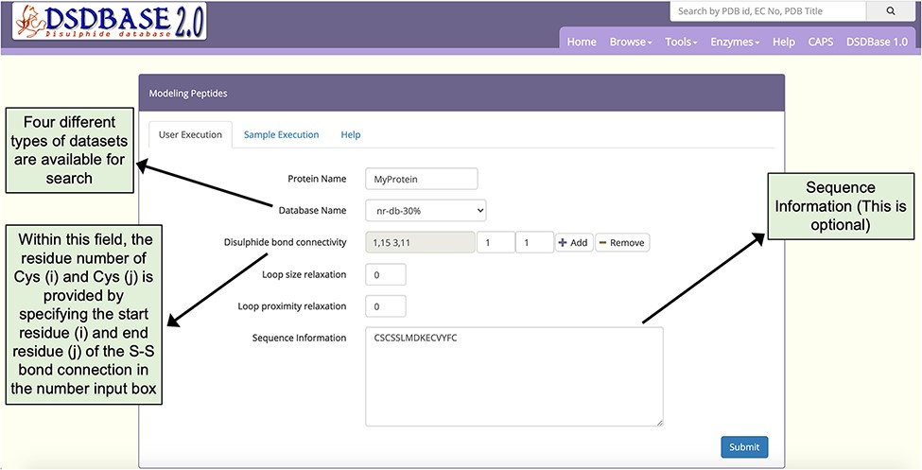
Figure 4. Snapshot of the input page for Modelling peptides. The user can probe the database for multiple ...
Notes:
Figure 4. Snapshot of the input page for Modelling peptides. The user can probe the database for multiple disulphide-bonded systems of particular connectivity and get possible conformations for that segment with the option to provide partial or no sequence information.
Unless provided in the caption above, the following copyright applies to the content of this slide: © The Author(s) 2022. Published by Oxford University Press.This is an Open Access article distributed under the terms of the Creative Commons Attribution License (https://creativecommons.org/licenses/by/4.0/), which permits unrestricted reuse, distribution, and reproduction in any medium, provided the original work is properly cited.

