Slide 1
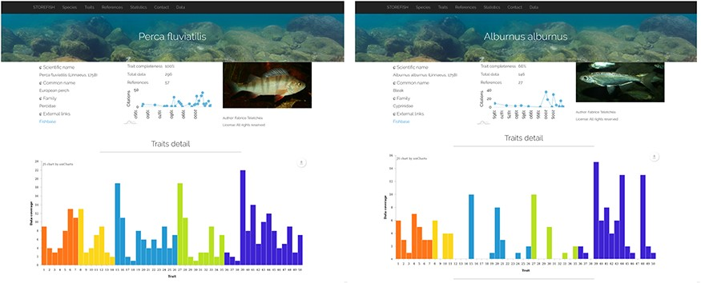
Figure 3. Comparison of trait enrichment between Perca fluviatilis (442 primary data, resulting in 237 secondary data) ...
Notes:
Figure 3. Comparison of trait enrichment between Perca fluviatilis (442 primary data, resulting in 237 secondary data) and Alburnus alburnus (146 primary data, resulting in 102 secondary data).
Unless provided in the caption above, the following copyright applies to the content of this slide: © The Author(s) 2020. Published by Oxford University Press.This is an Open Access article distributed under the terms of the Creative Commons Attribution License (http://creativecommons.org/licenses/by/4.0/), which permits unrestricted reuse, distribution, and reproduction in any medium, provided the original work is properly cited.

