Slide 1
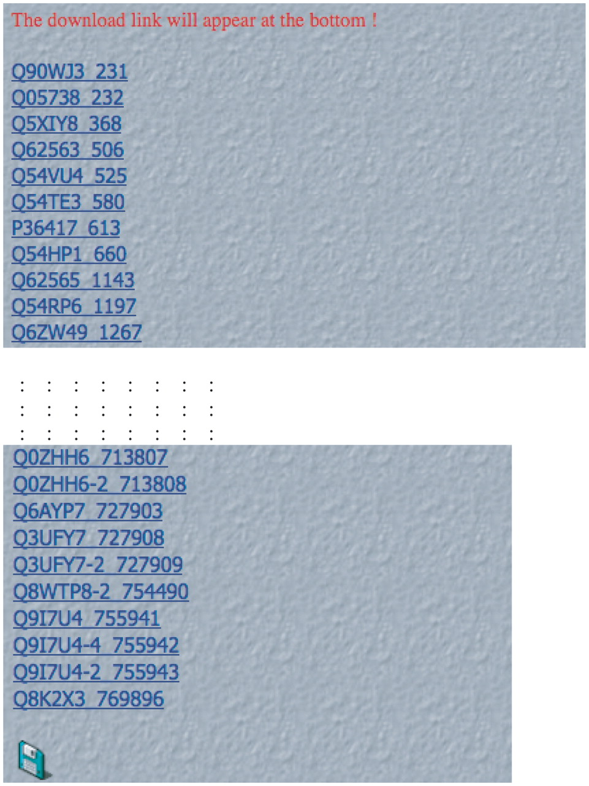
Figure 2. Screenshot of initial output after database search. An example of the initial LPS-annotate Database output ...
Notes:
Figure 2. Screenshot of initial output after database search. An example of the initial LPS-annotate Database output for the search for bias type ‘QH’. Each CB region is a live link in the depicted list. The download link for the data is at the bottom of the page.
Unless provided in the caption above, the following copyright applies to the content of this slide: © The Author(s) 2011. Published by Oxford University Press.This is Open Access article distributed under the terms of the Creative Commons Attribution Non-Commercial License (http://creativecommons.org/licenses/by-nc/2.5), which permits unrestricted non-commercial use, distribution, and reproduction in any medium, provided the original work is properly cited.

