Slide 1
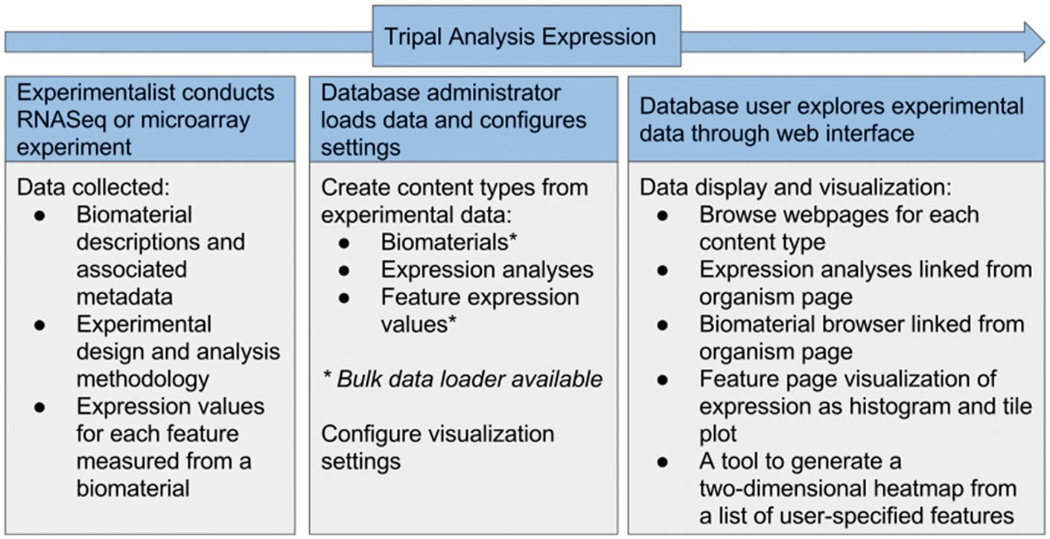
Figure 4. Flow of data in the Tripal Analysis Expression module. Either RNASeq or microarray experimental data can be ...
Notes:
Figure 4. Flow of data in the Tripal Analysis Expression module. Either RNASeq or microarray experimental data can be utilized and needs to include biomaterias, design and analysis methodology and expression values. From within a web interface, a site administrator can add and configure this content, yielding a number of visual interfaces for users to explore the data.
Unless provided in the caption above, the following copyright applies to the content of this slide: © The Author(s) 2017. Published by Oxford University Press.This is an Open Access article distributed under the terms of the Creative Commons Attribution License (http://creativecommons.org/licenses/by/4.0/), which permits unrestricted reuse, distribution, and reproduction in any medium, provided the original work is properly cited.

