Slide 1
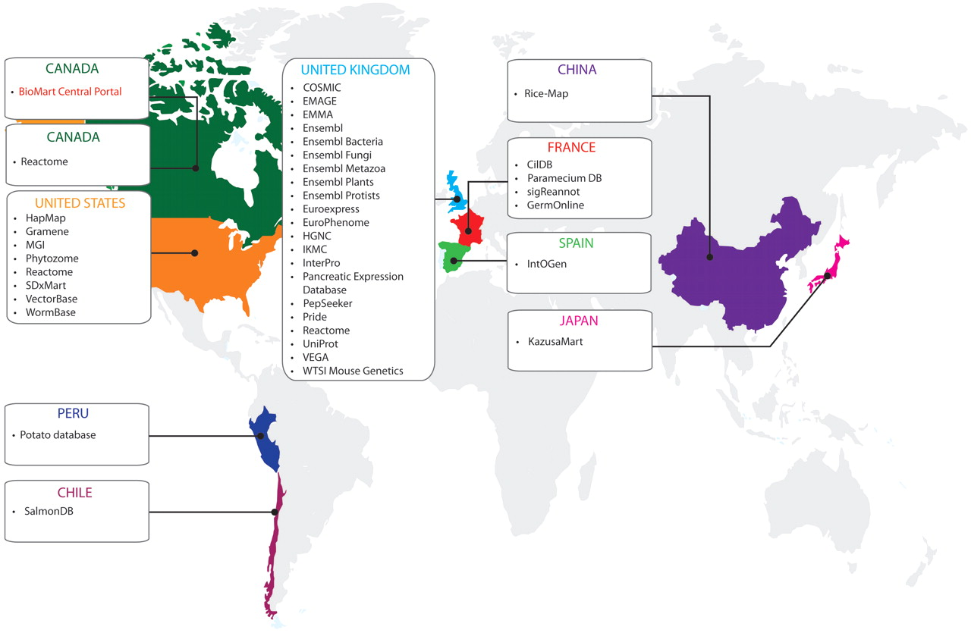
Figure 1. Databases available on the BioMart Central Portal and their host countries (April 2011).
Notes:
Figure 1. Databases available on the BioMart Central Portal and their host countries (April 2011).
Unless provided in the caption above, the following copyright applies to the content of this slide: © The Author(s) 2011. Published by Oxford University Press.This is Open Access article distributed under the terms of the Creative Commons Attribution Non-Commercial License (http://creativecommons.org/licenses/by-nc/2.5), which permits unrestricted non-commercial use, distribution, and reproduction in any medium, provided the original work is properly cited.

Slide 2
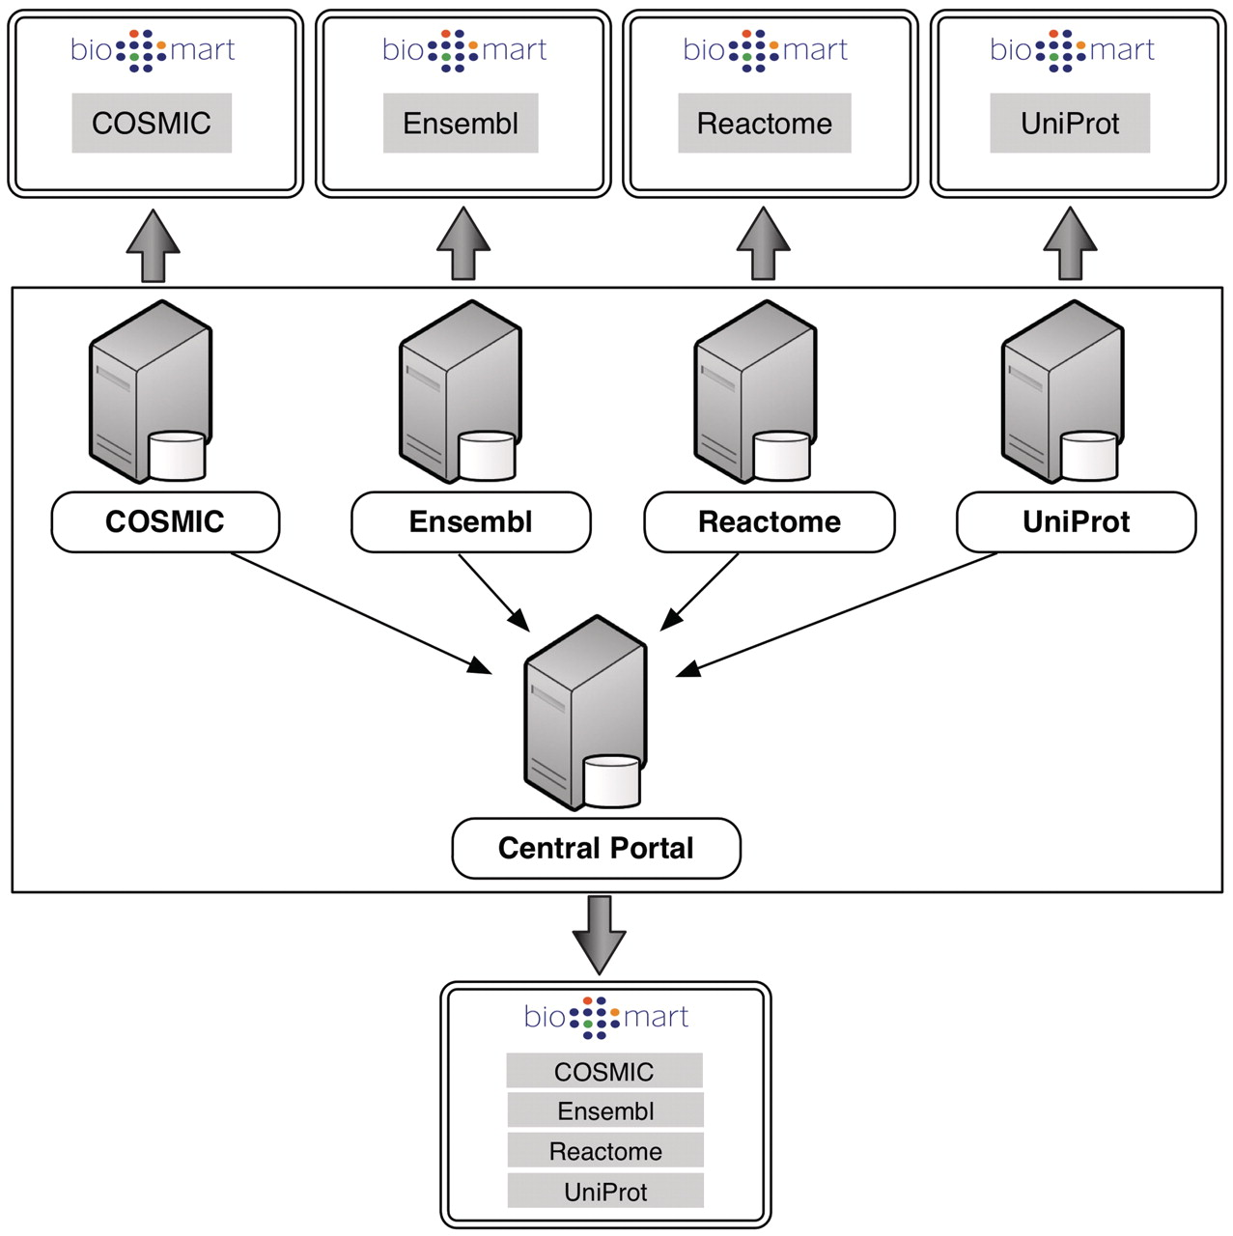
Figure 2. Each individual server hosts its own instance of BioMart retrieving data from its own local database backend. ...
Notes:
Figure 2. Each individual server hosts its own instance of BioMart retrieving data from its own local database backend. Central Portal offers a unified access point to all of these databases, distributing queries to the appropriate servers.
Unless provided in the caption above, the following copyright applies to the content of this slide: © The Author(s) 2011. Published by Oxford University Press.This is Open Access article distributed under the terms of the Creative Commons Attribution Non-Commercial License (http://creativecommons.org/licenses/by-nc/2.5), which permits unrestricted non-commercial use, distribution, and reproduction in any medium, provided the original work is properly cited.

Slide 3
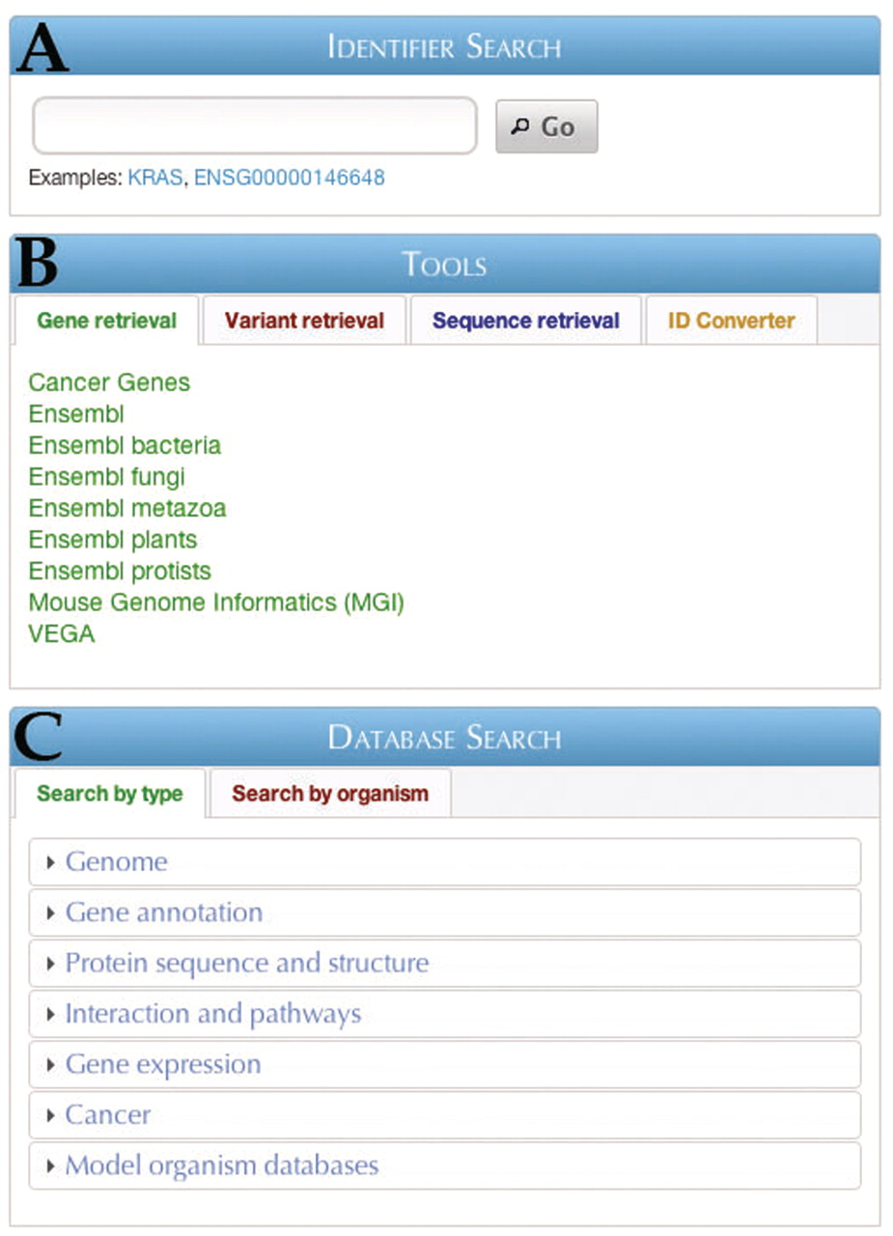
Figure 3. The BioMart Central Portal home page. Three main entry points are available: (A) Identifier search, (B) Tools ...
Notes:
Figure 3. The BioMart Central Portal home page. Three main entry points are available: (A) Identifier search, (B) Tools and (C) Database search.
Unless provided in the caption above, the following copyright applies to the content of this slide: © The Author(s) 2011. Published by Oxford University Press.This is Open Access article distributed under the terms of the Creative Commons Attribution Non-Commercial License (http://creativecommons.org/licenses/by-nc/2.5), which permits unrestricted non-commercial use, distribution, and reproduction in any medium, provided the original work is properly cited.

Slide 4
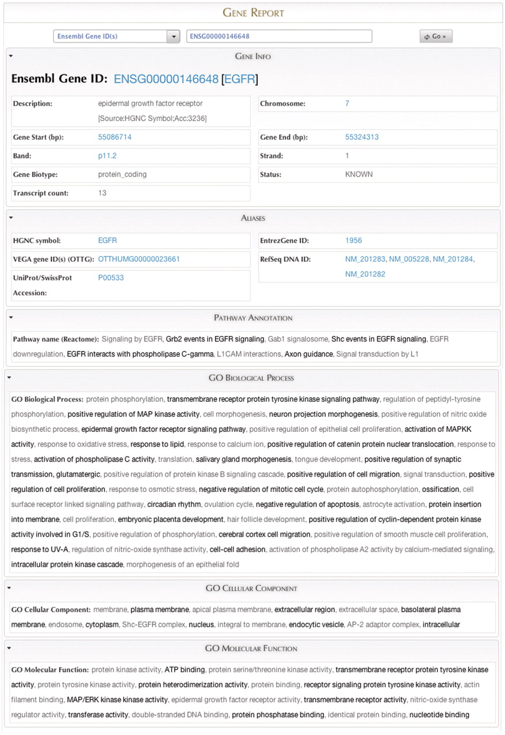
Figure 4. The Gene Report page for EGFR, displaying data federated from several sources.
Notes:
Figure 4. The Gene Report page for EGFR, displaying data federated from several sources.
Unless provided in the caption above, the following copyright applies to the content of this slide: © The Author(s) 2011. Published by Oxford University Press.This is Open Access article distributed under the terms of the Creative Commons Attribution Non-Commercial License (http://creativecommons.org/licenses/by-nc/2.5), which permits unrestricted non-commercial use, distribution, and reproduction in any medium, provided the original work is properly cited.

Slide 5
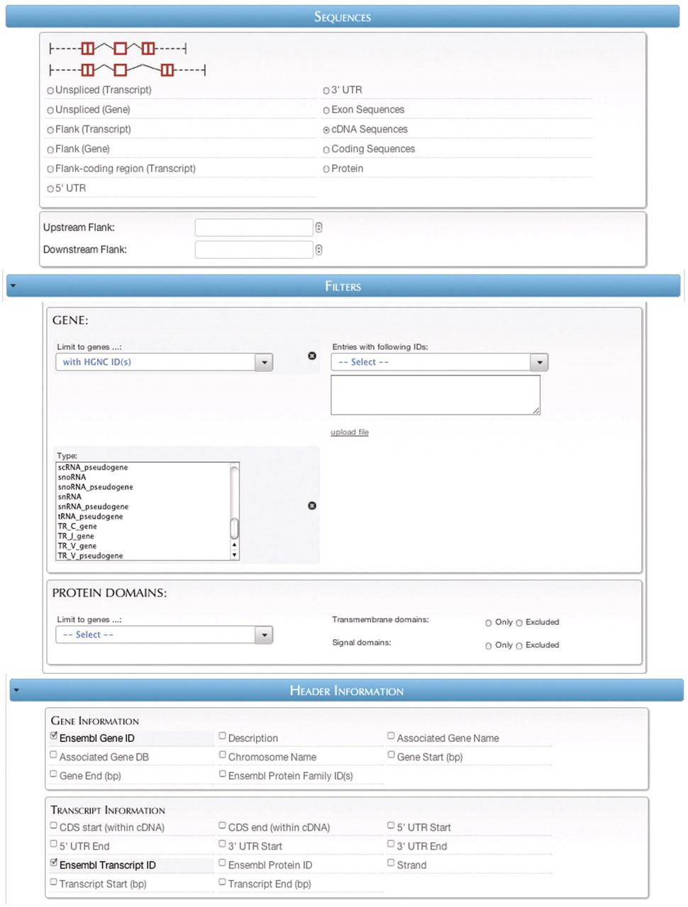
Figure 5. The sequence retrieval plug-in page.
Notes:
Figure 5. The sequence retrieval plug-in page.
Unless provided in the caption above, the following copyright applies to the content of this slide: © The Author(s) 2011. Published by Oxford University Press.This is Open Access article distributed under the terms of the Creative Commons Attribution Non-Commercial License (http://creativecommons.org/licenses/by-nc/2.5), which permits unrestricted non-commercial use, distribution, and reproduction in any medium, provided the original work is properly cited.

