Slide 1
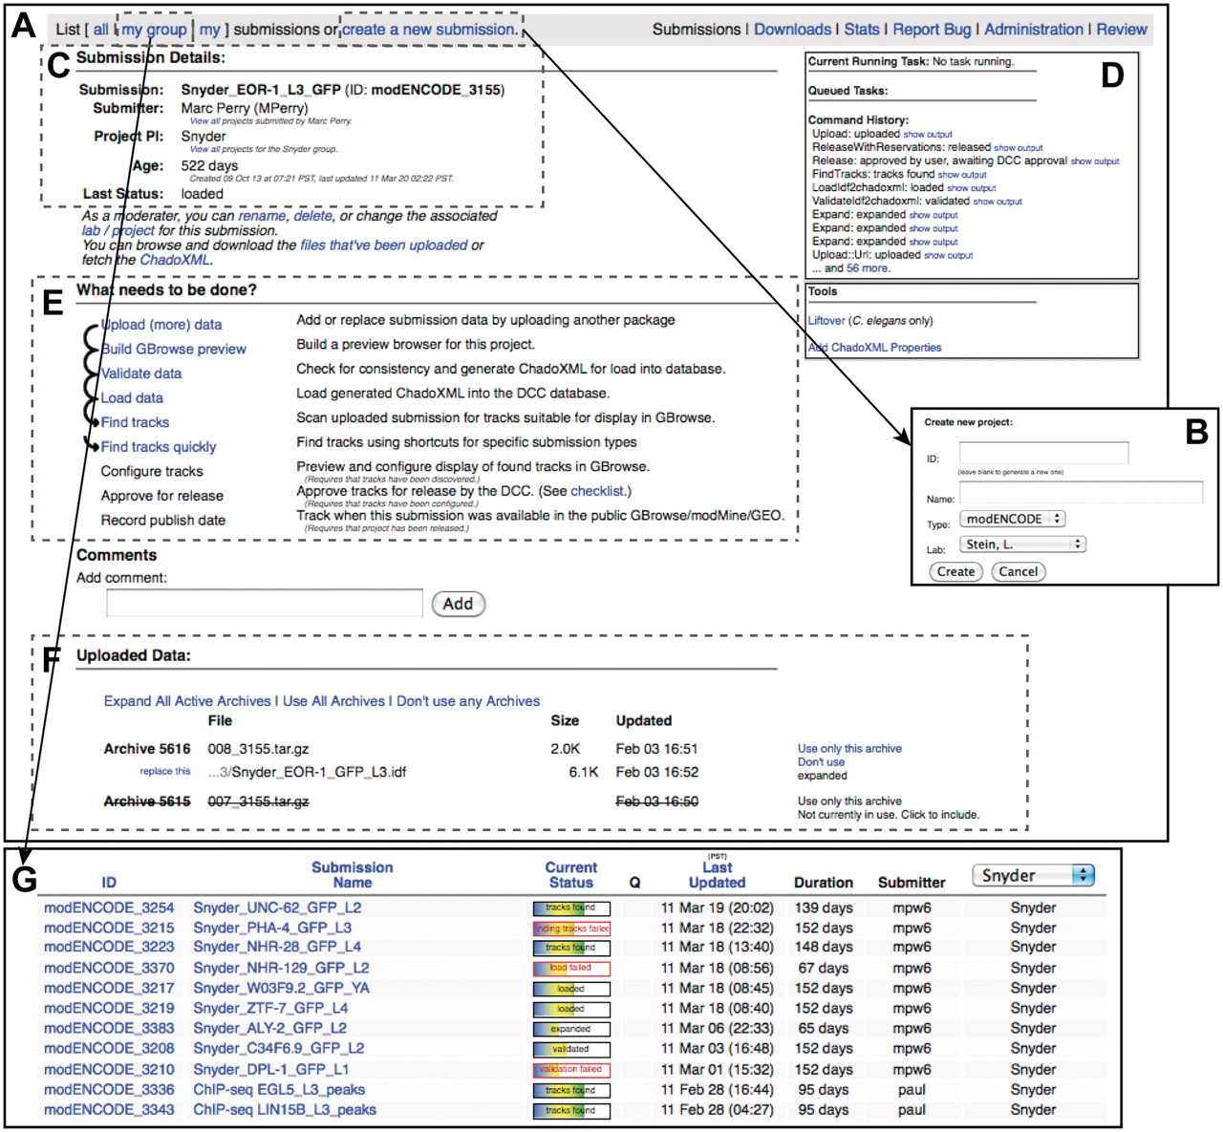
Figure 5. modENCODE submission interface. (A) The primary page for an example individual submission is shown. (B) New ...
Notes:
Figure 5. modENCODE submission interface. (A) The primary page for an example individual submission is shown. (B) New submissions are created by entering a name for the submission and selecting the appropriate laboratory and PI. (C) Once a submission is created, the current details are listed on the upper left side of the page. (D) The step-by-step series of tasks that are being executed by the pipeline can be monitored in real time, and the corresponding output from each module can be viewed. (E) Progress is indicated as the submission moves through each step of automated QC processing. In this example, all that remains to be done is configuring the tracks for the browser, final manual checklist and public release. (F) All of the primary files making up the submission package are listed on this page: the IDF, SDRF, wig and GFF3. Individual files may be replaced, if desired, by the submitting laboratory. (G) A list of active submissions can be displayed separately, providing the user with a snapshot of the vetting status of their submissions.
Unless provided in the caption above, the following copyright applies to the content of this slide: © The Author(s) 2011. Published by Oxford University Press.This is Open Access article distributed under the terms of the Creative Commons Attribution Non-Commercial License (http://creativecommons.org/licenses/by-nc/2.5), which permits unrestricted non-commercial use, distribution, and reproduction in any medium, provided the original work is properly cited.

