Slide 1
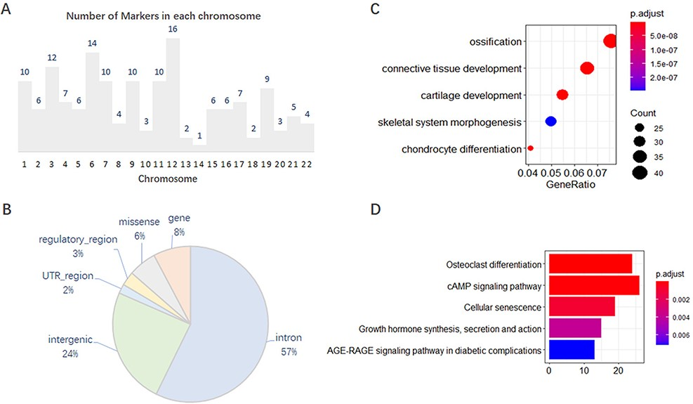
Figure 1. Features of 167 molecular markers supported by GWAS. (A) Number of markers on each chromosome. (B) SNP ...
Notes:
Figure 1. Features of 167 molecular markers supported by GWAS. (A) Number of markers on each chromosome. (B) SNP variants annotated on different genomic regions. (C) GO enrichment of the effector genes. (D) KEGG enrichment of the effector genes.
Unless provided in the caption above, the following copyright applies to the content of this slide: © The Author(s) 2022. Published by Oxford University Press.This is an Open Access article distributed under the terms of the Creative Commons Attribution-NonCommercial License (https://creativecommons.org/licenses/by-nc/4.0/), which permits non-commercial re-use, distribution, and reproduction in any medium, provided the original work is properly cited. For commercial re-use, please contact journals.permissions@oup.com

