Slide 1
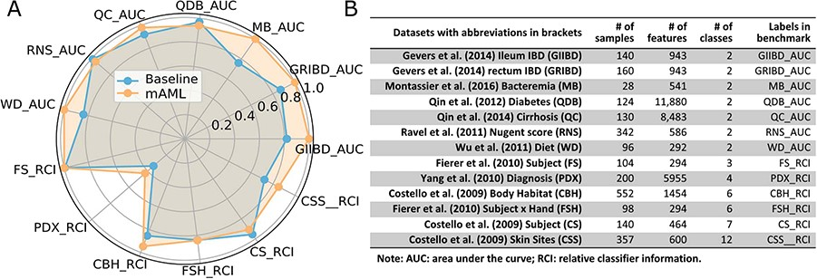
Figure 6 The performance comparison of the mAML proposed models against the baseline (A). The labels are connected ...
Notes:
Figure 6 The performance comparison of the mAML proposed models against the baseline (A). The labels are connected abbreviations with an underline between the name of the database and the metric used in the original study (B).
Unless provided in the caption above, the following copyright applies to the content of this slide: © The Author(s) 2020. Published by Oxford University Press.This is an Open Access article distributed under the terms of the Creative Commons Attribution License (http://creativecommons.org/licenses/by/4.0/), which permits unrestricted reuse, distribution, and reproduction in any medium, provided the original work is properly cited.

