Slide 1
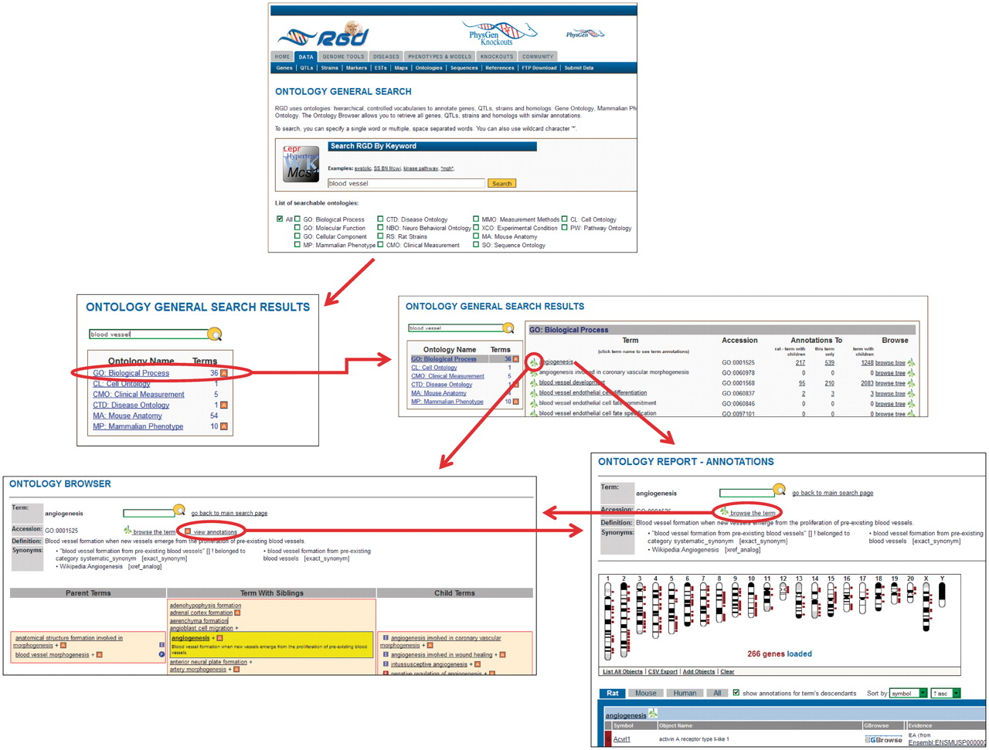
Figure 2. New ontology term search process at RGD. In this example, a search is done for ‘blood vessel’. From the ...
Notes:
Figure 2. New ontology term search process at RGD. In this example, a search is done for ‘blood vessel’. From the ontologies returned, the user selects ‘GO: Biological Process’. From the terms returned, the user selects ‘angiogenesis’. Via convenient links the user has the option of viewing the term in the ontology browser or viewing the annotations for the term on the ontology report page. The user also has the option of following a link from the browser to the annotations or the reverse.
Unless provided in the caption above, the following copyright applies to the content of this slide: © The Author(s) 2012. Published by Oxford University Press.This is an Open Access article distributed under the terms of the Creative Commons Attribution Non-Commercial License (http://creativecommons.org/licenses/by-nc/3.0), which permits unrestricted non-commercial use, distribution, and reproduction in any medium, provided the original work is properly cited.

