Slide 1
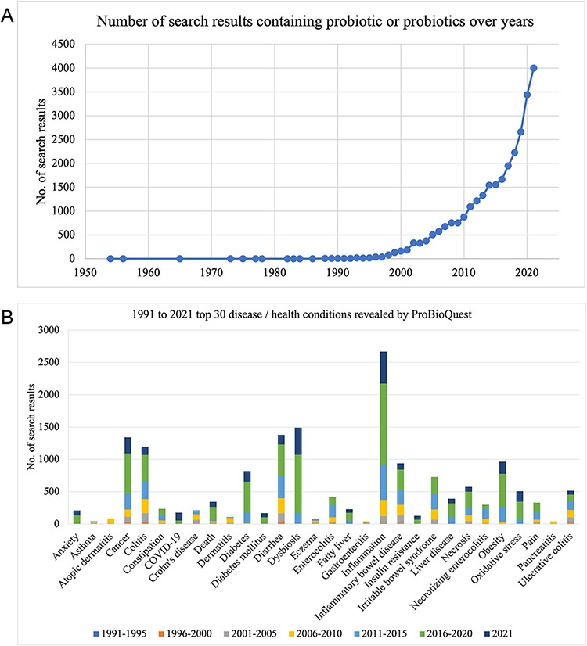
Figure 4. The number of articles containing ‘probiotic/probiotics’ from 1950 to 2021 and articles of top 30 ...
Notes:
Figure 4. The number of articles containing ‘probiotic/probiotics’ from 1950 to 2021 and articles of top 30 Disease/Health in 5-years groups. (A) The number of articles on probiotics has been growing rapidly during the past two decades. (B) Popular topics such as inflammation, diarrhea and cancer maintained a high rate of occurrence in the articles from 1991 to 2021.
Unless provided in the caption above, the following copyright applies to the content of this slide: © The Author(s) 2022. Published by Oxford University Press.This is an Open Access article distributed under the terms of the Creative Commons Attribution-NonCommercial License (https://creativecommons.org/licenses/by-nc/4.0/), which permits non-commercial re-use, distribution, and reproduction in any medium, provided the original work is properly cited. For commercial re-use, please contact journals.permissions@oup.com

