Slide 1
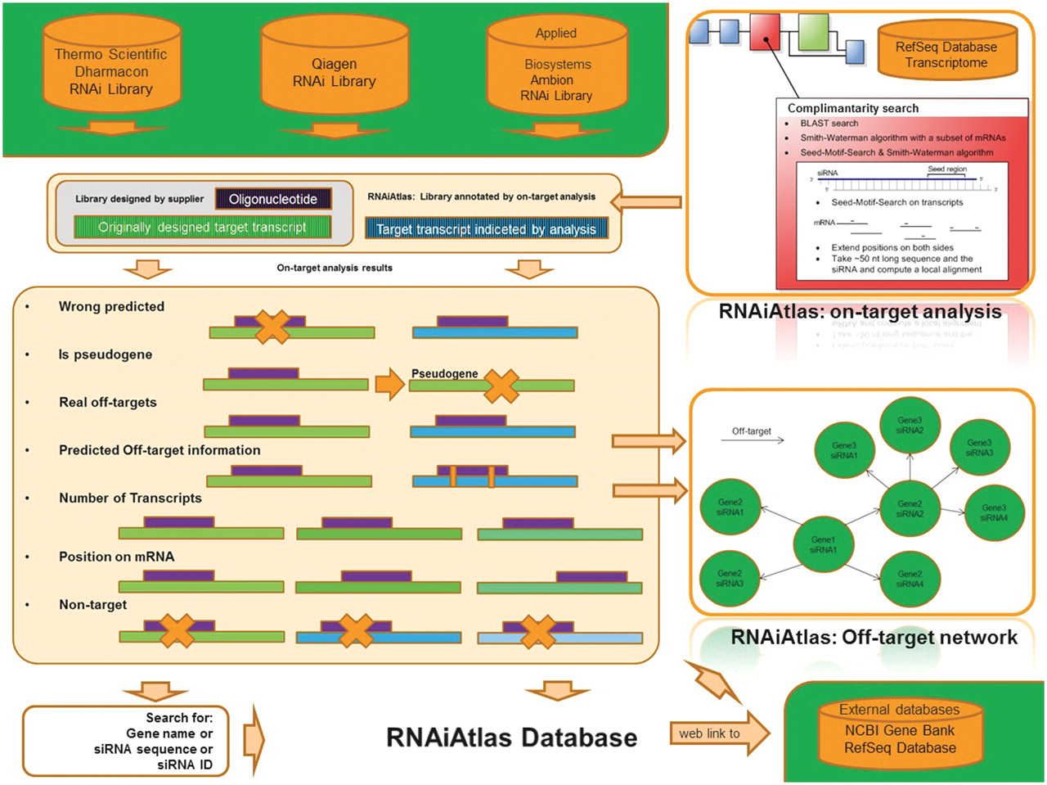
Figure 1 Overview of RNAiAtlas database content. The re-annotation of commercially available human genome-wide siRNA ...
Notes:
Figure 1 Overview of RNAiAtlas database content. The re-annotation of commercially available human genome-wide siRNA (three human, genome-wide) libraries with different NCBI reference sequences (RefSeq) were collected in a database. On-target analysis calculations were performed using a dedicated design/evaluation pipeline to quantitatively assess the specificity of the constructs. Interactive network visualization allows the inspection of the off-target network between an siRNA and its target genes.
Unless provided in the caption above, the following copyright applies to the content of this slide: © The Author(s) 2012. Published by Oxford University Press.This is an Open Access article distributed under the terms of the Creative Commons Attribution Non-Commercial License (http://creativecommons.org/licenses/by-nc/3.0), which permits unrestricted non-commercial use, distribution, and reproduction in any medium, provided the original work is properly cited.

