Slide 1
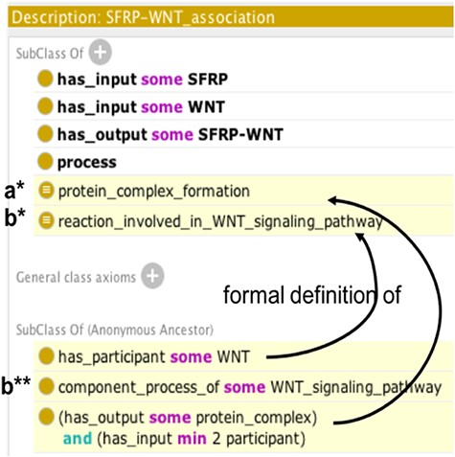
Figure 3. Example of automatic reasoning with Protégé. Asserted axioms are shown in uncolored lines and inferred axioms ...
Notes:
Figure 3. Example of automatic reasoning with Protégé. Asserted axioms are shown in uncolored lines and inferred axioms are highlighted in yellow. Following automatic reasoning, SFRP-WNT heterodimer association is classified as subclass of the ‘protein complex formation’ (a*) and ‘reaction involved in WNT signaling pathway’ classes (b*), thus it inherits the component_process_of ‘WNT_signaling pathway’ property (b**).
Unless provided in the caption above, the following copyright applies to the content of this slide: © The Author(s) 2021. Published by Oxford University Press. All rights reserved. For permissions, please e-mail: journals.permissions@oup.comThis article is published and distributed under the terms of the Oxford University Press, Standard Journals Publication Model (https://academic.oup.com/journals/pages/open_access/funder_policies/chorus/standard_publication_model)

