Slide 1
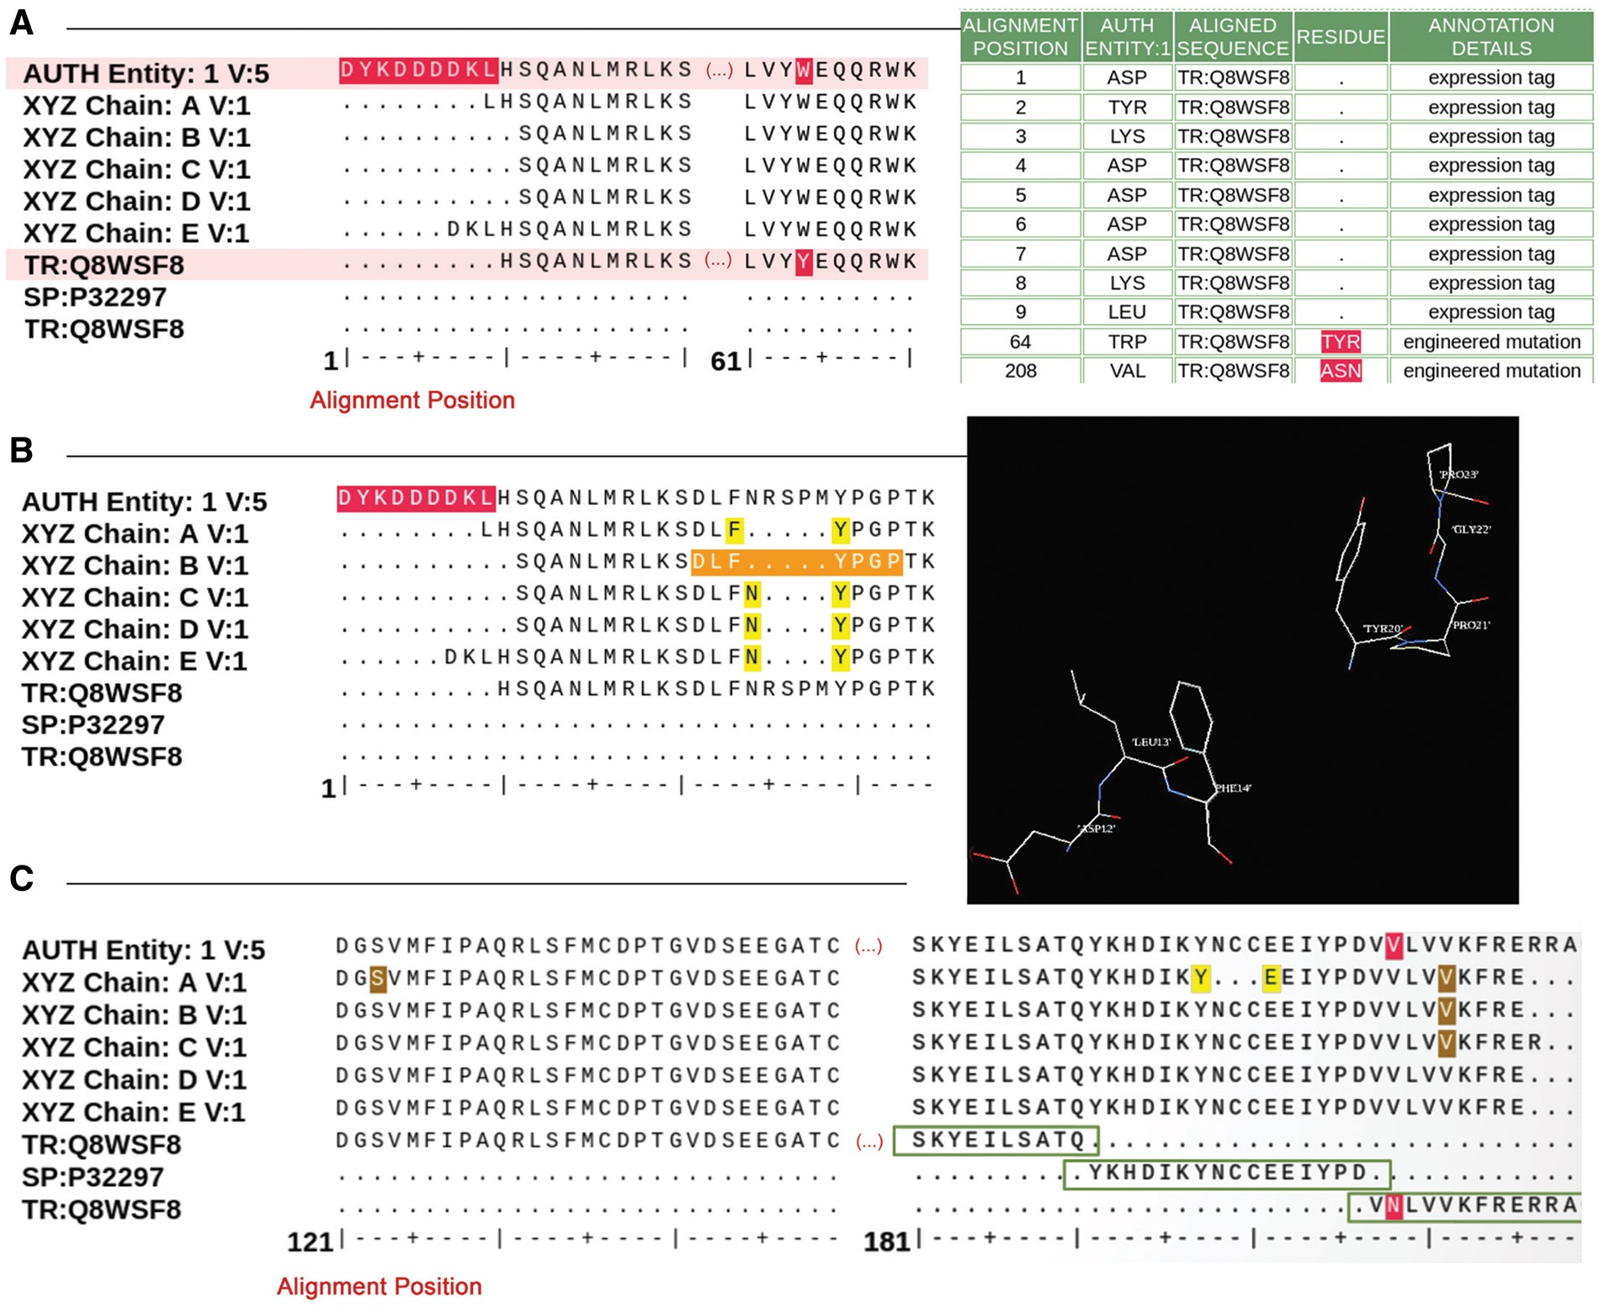
Figure 4. Examples of sequence alignments from the sequence processing module. (A) Alignment between the sample ...
Notes:
Figure 4. Examples of sequence alignments from the sequence processing module. (A) Alignment between the sample sequence (labeled ‘AUTH Entity’), the sequence extracted from the atom data for each polymer chain and the corresponding UniProt sequence. Sequence discrepancies are highlighted in red and listed in a table where the appropriate annotation can be selected. For example, residues 1–9 in the sample sequence (top sequence in the alignment) are not present in the UniProt sequence (bottom sequence in the alignment) because these are part of an expression tag. Similarly, the Tyrosine-Tryptophan (TYR-TRP) conflict at position 64 is annotated as a mutation based on information provided by the Depositor during data submission. (B) Example illustrating the sequence and 3D viewer. Residues depicted in orange in the sequence are highlighted and selected for visualization with the 3D viewer available on the alignment page. (C) Example of a sequence alignment for a chimeric protein construct. This chimeric acetylcholine-binding protein from Aplysia californica, PDB entry 5TVC, contains a loop C from the human alpha-3 nicotinic acetylcholine receptor. The alignment shows that residues 1–181 in the deposited sample sequence correspond to UniProt sequence Q8WSF8, residues 182–197 to UniProt sequence P32297 and residues 198–219 again to UniProt sequence Q8WSF8.
Unless provided in the caption above, the following copyright applies to the content of this slide: © The Author(s) 2018. Published by Oxford University Press.This is an Open Access article distributed under the terms of the Creative Commons Attribution License (http://creativecommons.org/licenses/by/4.0/), which permits unrestricted reuse, distribution, and reproduction in any medium, provided the original work is properly cited.

