Slide 1
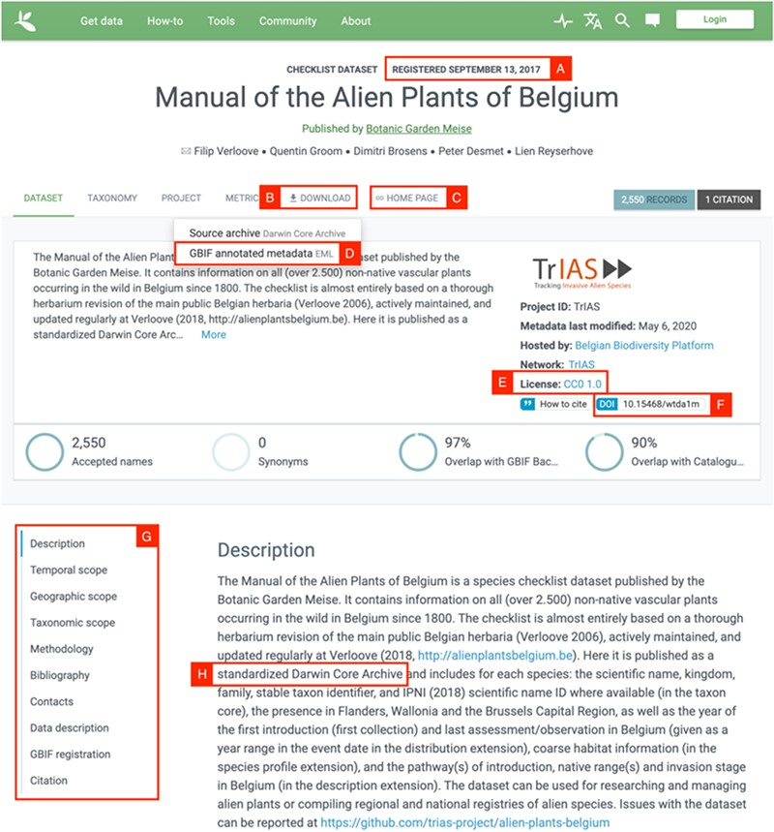
Figure 3. Screenshot of the GBIF dataset page for the Manual of Alien Plants Belgium. Letters A-H refer to the ...
Notes:
Figure 3. Screenshot of the GBIF dataset page for the Manual of Alien Plants Belgium. Letters A-H refer to the different aspects of FAIR data, see text for further details.
Unless provided in the caption above, the following copyright applies to the content of this slide: © The Author(s) 2020. Published by Oxford University Press.This is an Open Access article distributed under the terms of the Creative Commons Attribution License (http://creativecommons.org/licenses/by/4.0/), which permits unrestricted reuse, distribution, and reproduction in any medium, provided the original work is properly cited.

Slide 2
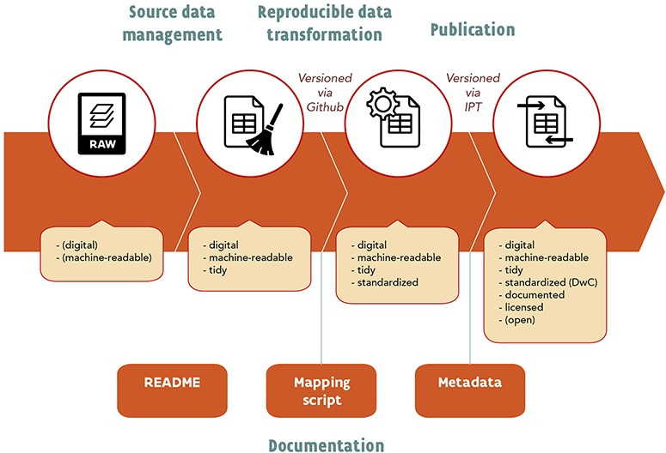
Figure 1. Schematic overview of the suggested workflow.
Notes:
Figure 1. Schematic overview of the suggested workflow.
Unless provided in the caption above, the following copyright applies to the content of this slide: © The Author(s) 2020. Published by Oxford University Press.This is an Open Access article distributed under the terms of the Creative Commons Attribution License (http://creativecommons.org/licenses/by/4.0/), which permits unrestricted reuse, distribution, and reproduction in any medium, provided the original work is properly cited.

Slide 3
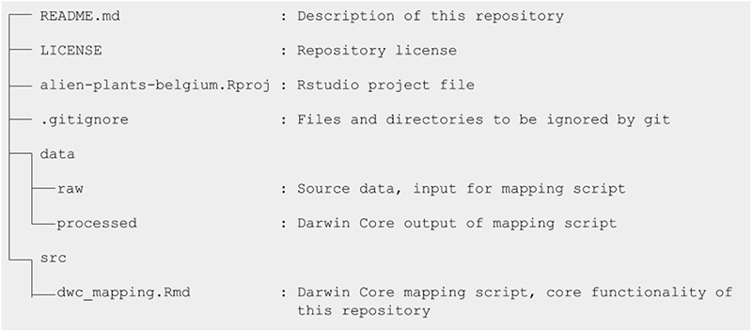
Structure of the GitHub repository of the Manual of Alien Plants Belgium.
Notes:
Structure of the GitHub repository of the Manual of Alien Plants Belgium.
Unless provided in the caption above, the following copyright applies to the content of this slide: © The Author(s) 2020. Published by Oxford University Press.This is an Open Access article distributed under the terms of the Creative Commons Attribution License (http://creativecommons.org/licenses/by/4.0/), which permits unrestricted reuse, distribution, and reproduction in any medium, provided the original work is properly cited.

