Slide 1
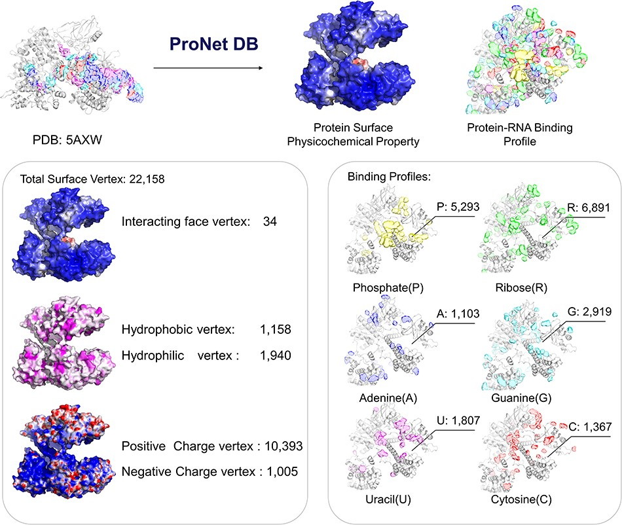
Figure 4. Case study (PDB: 5AXW): ProNet DB shows comprehensive information of the protein structure surface ...
Notes:
Figure 4. Case study (PDB: 5AXW): ProNet DB shows comprehensive information of the protein structure surface fingerprints as well as the protein–RNA binding landscape. On the left panel: Iface region is consistent with the nucleic acid-binding sites, and electron donor region is located at non-binding sites. On the right panel: The RNA-binding landscape shows the RNA-binding sites located at the inner region.
Unless provided in the caption above, the following copyright applies to the content of this slide: © The Author(s) 2024. Published by Oxford University Press.This is an Open Access article distributed under the terms of the Creative Commons Attribution License (https://creativecommons.org/licenses/by/4.0/), which permits unrestricted reuse, distribution, and reproduction in any medium, provided the original work is properly cited.

