Slide 1
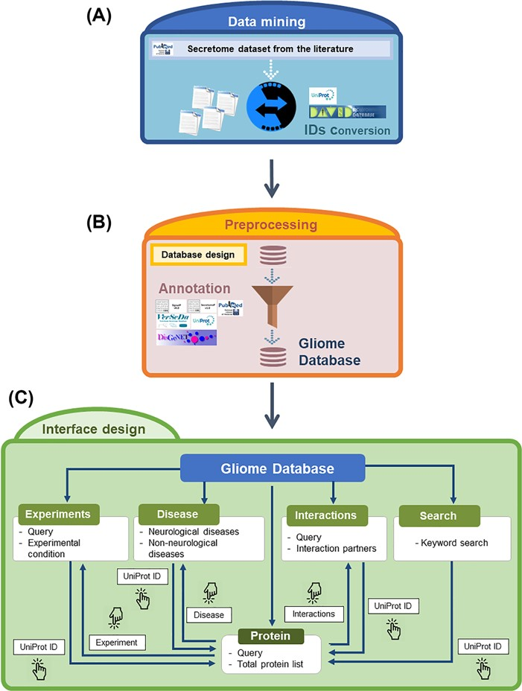
Figure 2 Overview of the Gliome database. (A) Data mining step to obtain the glia secretome information. The obtained ...
Notes:
Figure 2 Overview of the Gliome database. (A) Data mining step to obtain the glia secretome information. The obtained protein names are converted into UniProt ID. (B) Information is entered according to the database format so that users can browse various types of information. At this step, various external databases were used alongside ours. (C) A diagram of navigation at the Gliome database. The protein identifiers of any types were converted into official gene name/UniProt ID.
Unless provided in the caption above, the following copyright applies to the content of this slide: © The Author(s) 2020. Published by Oxford University Press.This is an Open Access article distributed under the terms of the Creative Commons Attribution License (http://creativecommons.org/licenses/by/4.0/), which permits unrestricted reuse, distribution, and reproduction in any medium, provided the original work is properly cited.

