Slide 1
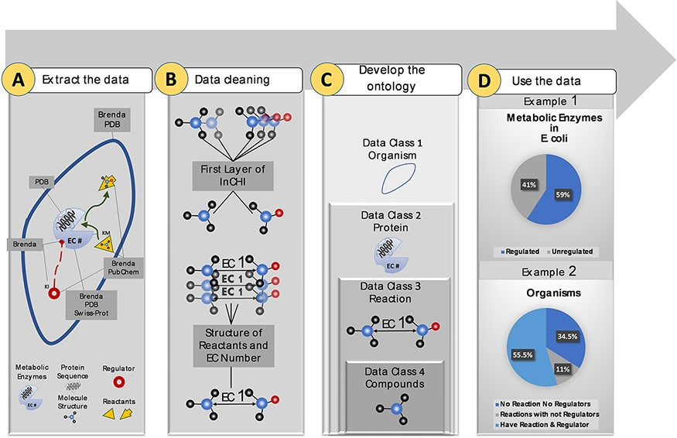
Figure 1. Visual abstract of the current study. Panel (A): Kinetic data scraped from BRENDA, PDB, PubChem and ...
Notes:
Figure 1. Visual abstract of the current study. Panel (A): Kinetic data scraped from BRENDA, PDB, PubChem and Swiss-Prot, each focused on separate sections of metabolism. Panel (B): Redundancy in compounds and reactions is filtered. Panel (C): Standard representation of multi-source data in hierarchical ontologies. Panel (D): The KinMod database enables extracting statistics of within- and cross-species relationships. (Example 1) 59% of enzymes in Escherichia coli have at least one known regulator, an example of the within-species relationship. (Example) 55.5% of organisms have at least one established reaction and regulator, an instance of the cross-species relationship.
Unless provided in the caption above, the following copyright applies to the content of this slide: © The Author(s) 2022. Published by Oxford University Press.This is an Open Access article distributed under the terms of the Creative Commons Attribution-NonCommercial License (https://creativecommons.org/licenses/by-nc/4.0/), which permits non-commercial re-use, distribution, and reproduction in any medium, provided the original work is properly cited. For commercial re-use, please contact journals.permissions@oup.com

Slide 2
Figure 2. Data overview of the KinMod database.
Notes:
Figure 2. Data overview of the KinMod database.
Unless provided in the caption above, the following copyright applies to the content of this slide: © The Author(s) 2022. Published by Oxford University Press.This is an Open Access article distributed under the terms of the Creative Commons Attribution-NonCommercial License (https://creativecommons.org/licenses/by-nc/4.0/), which permits non-commercial re-use, distribution, and reproduction in any medium, provided the original work is properly cited. For commercial re-use, please contact journals.permissions@oup.com

Slide 3
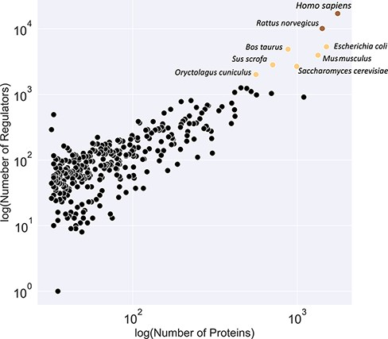
Figure 3. Classification of organisms based on their number of proteins (x-axis) and regulators (y-axis) into three ...
Notes:
Figure 3. Classification of organisms based on their number of proteins (x-axis) and regulators (y-axis) into three classes (brown, yellow and black). The brown class represents intensively studied organisms with more than 10K regulators and 1K proteins, whereas the black category denotes moderately researched models with less than 2K effectors and 500 proteins.
Unless provided in the caption above, the following copyright applies to the content of this slide: © The Author(s) 2022. Published by Oxford University Press.This is an Open Access article distributed under the terms of the Creative Commons Attribution-NonCommercial License (https://creativecommons.org/licenses/by-nc/4.0/), which permits non-commercial re-use, distribution, and reproduction in any medium, provided the original work is properly cited. For commercial re-use, please contact journals.permissions@oup.com

Slide 4
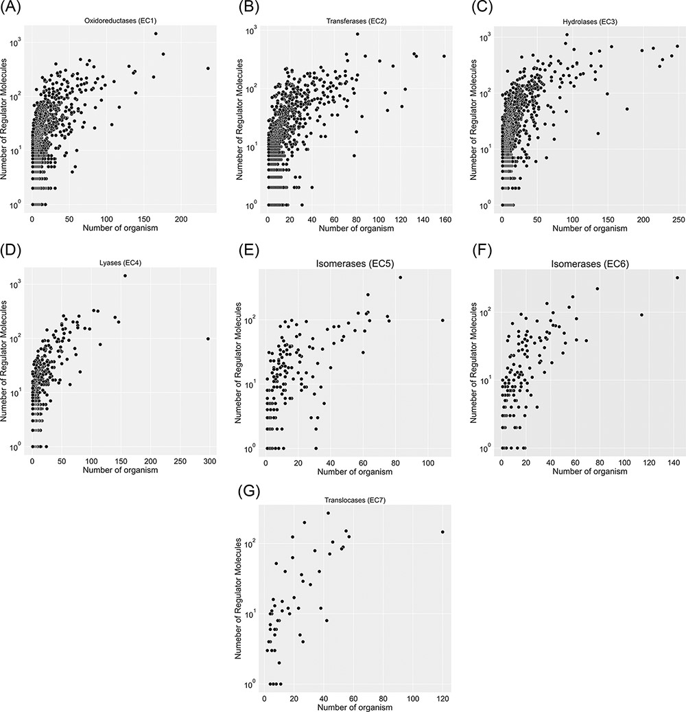
Figure 4. Visualization of seven EC classes based on the number of regulators interacting with each EC number and the ...
Notes:
Figure 4. Visualization of seven EC classes based on the number of regulators interacting with each EC number and the number of specific organisms that inherit them in metabolism. EC(1) represents the highest number of regulated enzymes among the seven categories.
Unless provided in the caption above, the following copyright applies to the content of this slide: © The Author(s) 2022. Published by Oxford University Press.This is an Open Access article distributed under the terms of the Creative Commons Attribution-NonCommercial License (https://creativecommons.org/licenses/by-nc/4.0/), which permits non-commercial re-use, distribution, and reproduction in any medium, provided the original work is properly cited. For commercial re-use, please contact journals.permissions@oup.com

Slide 5
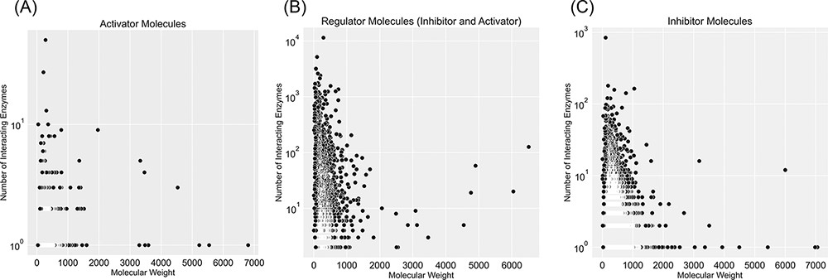
Figure 5. Visualization of compound categories, inhibitors, activators and molecules that are both inhibitors and ...
Notes:
Figure 5. Visualization of compound categories, inhibitors, activators and molecules that are both inhibitors and activators, based on the number of interacting enzymes and their molecular weight.
Unless provided in the caption above, the following copyright applies to the content of this slide: © The Author(s) 2022. Published by Oxford University Press.This is an Open Access article distributed under the terms of the Creative Commons Attribution-NonCommercial License (https://creativecommons.org/licenses/by-nc/4.0/), which permits non-commercial re-use, distribution, and reproduction in any medium, provided the original work is properly cited. For commercial re-use, please contact journals.permissions@oup.com

Slide 6
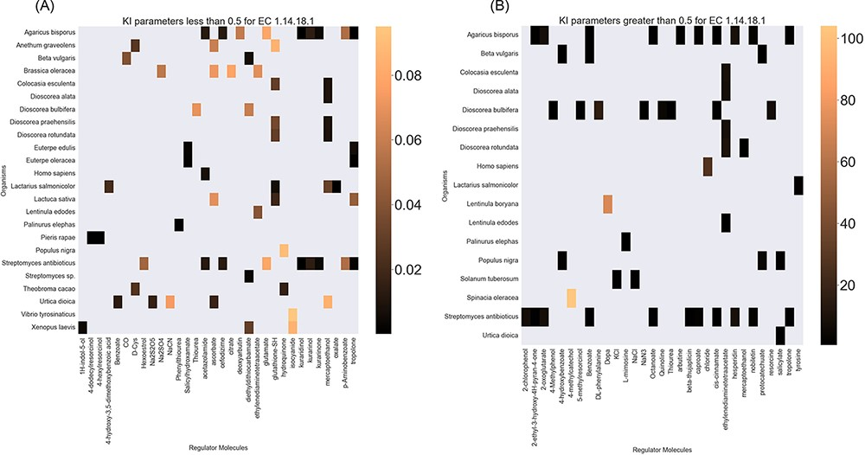
Figure 6. A heatmap of EC 1.14.18.1 ${{\rm{K}}_{\rm{I}}}$ values of regulator molecules (x-axis) seen in particular ...
Notes:
Figure 6. A heatmap of EC 1.14.18.1 ${{\rm{K}}_{\rm{I}}}$ values of regulator molecules (x-axis) seen in particular organisms (y-axis). As the distribution of ${{\rm{K}}_{\rm{I}}}$ is highly skewed, data is visualized in two heatmaps (the first heatmap presents a heatmap of values less than 0.5 and the second figure represents a heatmap of parameters greater than 0.5). Lower values of ${{\rm{K}}_{\rm{I}}}$ parameters are associated with higher inhibition effects.
Unless provided in the caption above, the following copyright applies to the content of this slide: © The Author(s) 2022. Published by Oxford University Press.This is an Open Access article distributed under the terms of the Creative Commons Attribution-NonCommercial License (https://creativecommons.org/licenses/by-nc/4.0/), which permits non-commercial re-use, distribution, and reproduction in any medium, provided the original work is properly cited. For commercial re-use, please contact journals.permissions@oup.com

Slide 7
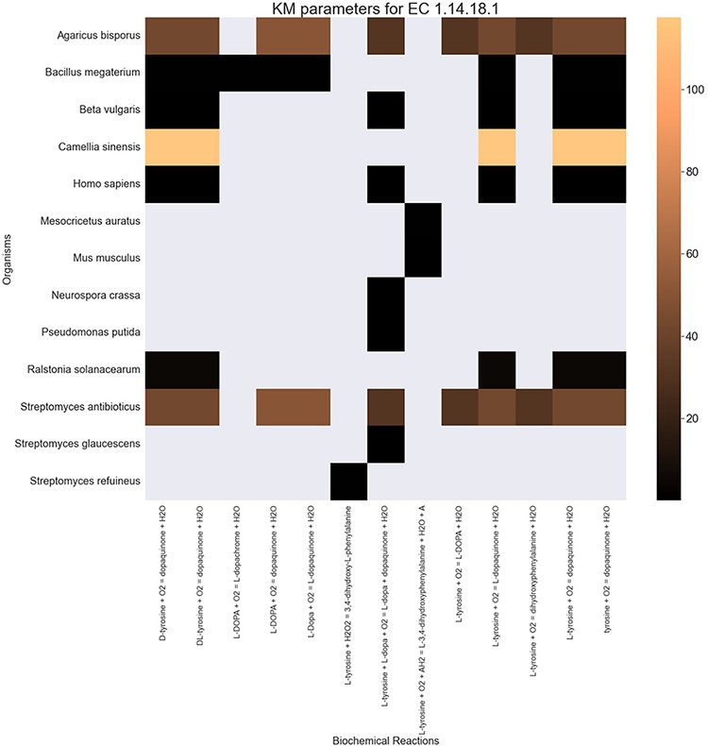
Figure 7. A heatmap of ${{\rm{K}}_{\rm{M}}}$ values for all the reactions catalysed by 1.14.18.1 (x-axis) seen in ...
Notes:
Figure 7. A heatmap of ${{\rm{K}}_{\rm{M}}}$ values for all the reactions catalysed by 1.14.18.1 (x-axis) seen in particular organisms (y-axis).
Unless provided in the caption above, the following copyright applies to the content of this slide: © The Author(s) 2022. Published by Oxford University Press.This is an Open Access article distributed under the terms of the Creative Commons Attribution-NonCommercial License (https://creativecommons.org/licenses/by-nc/4.0/), which permits non-commercial re-use, distribution, and reproduction in any medium, provided the original work is properly cited. For commercial re-use, please contact journals.permissions@oup.com

Slide 8
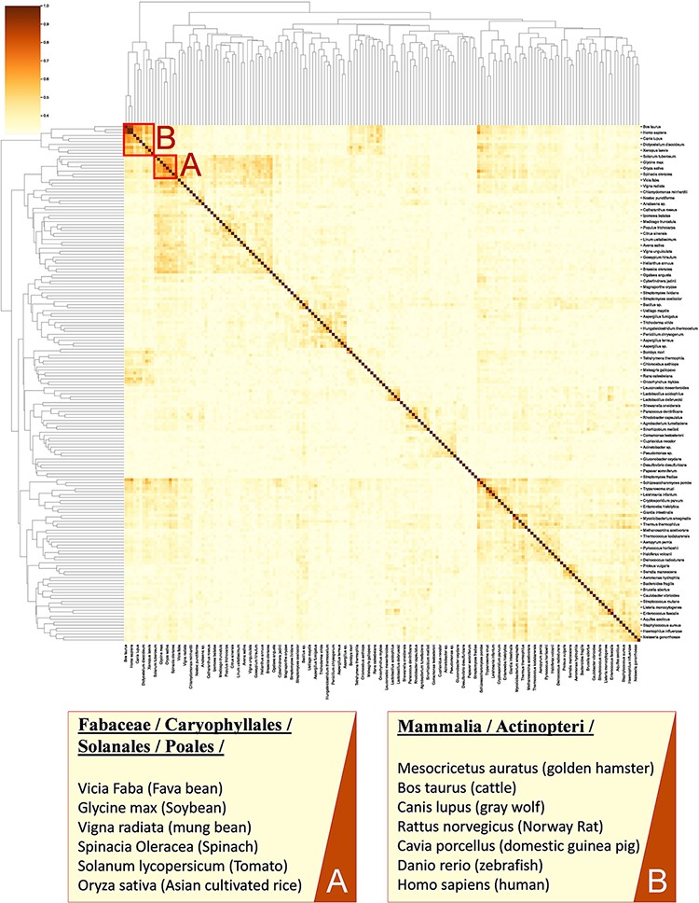
Figure 8. A cluster map of a random sample of 174 models based on their similarity in functional metabolism. Red box A ...
Notes:
Figure 8. A cluster map of a random sample of 174 models based on their similarity in functional metabolism. Red box A contains species belonging to Magnoliopsida (flowering plants) class. Box B include species of class Mammalia and Actinopteri.
Unless provided in the caption above, the following copyright applies to the content of this slide: © The Author(s) 2022. Published by Oxford University Press.This is an Open Access article distributed under the terms of the Creative Commons Attribution-NonCommercial License (https://creativecommons.org/licenses/by-nc/4.0/), which permits non-commercial re-use, distribution, and reproduction in any medium, provided the original work is properly cited. For commercial re-use, please contact journals.permissions@oup.com

