Slide 1
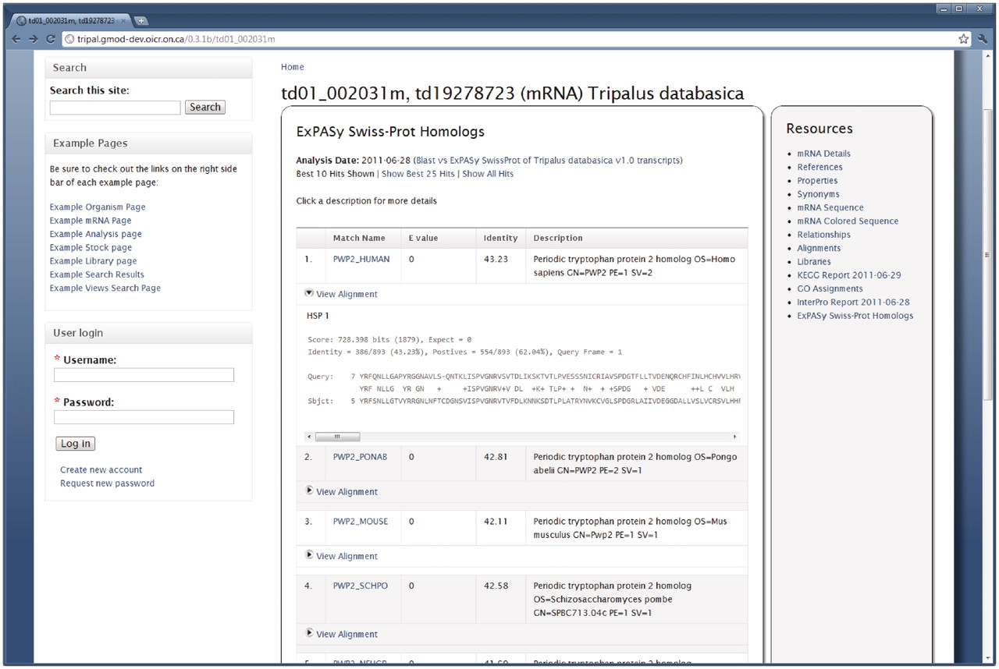
Figure 5. BLAST results for a feature. The Tripal Analysis BLAST module provides a summary of BLAST homology results on ...
Notes:
Figure 5. BLAST results for a feature. The Tripal Analysis BLAST module provides a summary of BLAST homology results on the Feature page. This example is for a feature that was compared to the ExPASy Swiss-Prot protein database. At first glance visitors view the match, e-value, percent identity and a description of the matching sequence. The actual alignment can be seen by clicking the ‘View Alignment’ link under each match. By default only the top 10 results are shown, however, visitors can choose to see the top 25 or all of the matches by clicking the appropriate links at the top of the report. The name given to the BLAST analysis is also visible at the top of the report. Visitors can find more information about this blast job by visiting the BLAST Analysis page by clicking the analysis name.
Unless provided in the caption above, the following copyright applies to the content of this slide: © The Author(s) 2011. Published by Oxford University Press.This is an Open Access article distributed under the terms of the Creative Commons Attribution Non-Commercial License (http://creativecommons.org/licenses/by-nc/3.0), which permits unrestricted non-commercial use, distribution, and reproduction in any medium, provided the original work is properly cited.

