Slide 1
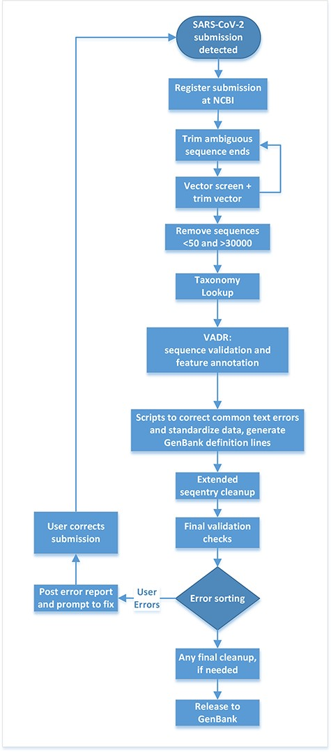
Figure 2. Post-submission processing steps performed at NLM/NCBI to evaluate, annotate and prepare SARS-CoV-2 sequence ...
Notes:
Figure 2. Post-submission processing steps performed at NLM/NCBI to evaluate, annotate and prepare SARS-CoV-2 sequence data for public release to the GenBank database.
Unless provided in the caption above, the following copyright applies to the content of this slide: Published by Oxford University Press 2022. This work is written by (a) US Government employee(s) and is in the public domain in the US.This work is written by (a) US Government employee(s) and is in the public domain in the US.

