Slide 1
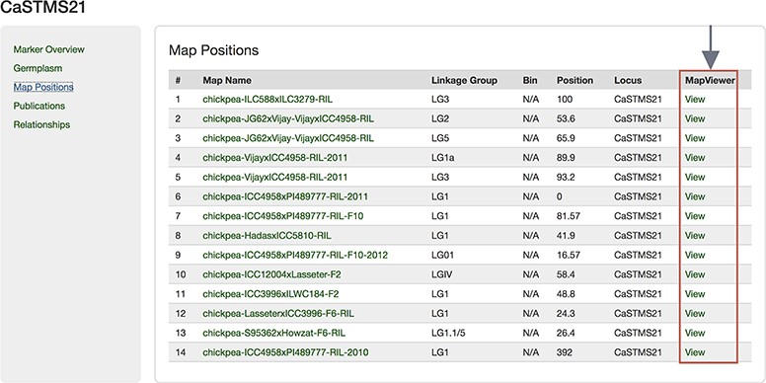
Figure 6 Map Positions table of a Marker page showing the link to MapViewer.
Notes:
Figure 6 Map Positions table of a Marker page showing the link to MapViewer.
Unless provided in the caption above, the following copyright applies to the content of this slide: © The Author(s) 2019. Published by Oxford University Press.This work is written by US Government employees and is in the public domain in the US.

